Slide 1
CRIME SCENE PRELIMINARIES

Slide 2
What is a Crime Scene?
“Crime Scene or scene or a crime is referring to a place or places where the crime has been committed or any evidence related to such crime is found.”
“Scene of Crime (occurrence) is the place where the crime has been committed or the sites which are connected with the crime or where evidence is found.
Crime Scene is a place where individuals are involved in the crime meet. Traces are exchanged with the individuals present there on the site, leave odds and ends and marks of tools, wearing apparels, tires, hand, feet, and other body parts.”

Slide 3
What happens during crime scene investigation?
At a scene, the case investigator and crime scene personnel work together to: define and secure areas that may contain evidence; examine and document the scene; collect physical evidence; and preserve, package and submit the evidence to the laboratory for analysis. With these key pieces of evidence, the investigator can attempt to reconstruct the elements of the crime.
The more thorough the crime scene team is at conducting its job, the more likely it is to accurately determine the facts of the case.

Slide 4
Importance of crime scene:-
The importance of Crime Scene Investigation is to help establish whatever happened and to identify the accountable person. This is done carefully by documenting the conditions at a Crime Scene. And by recognizing all the pertinent physical evidence.

Slide 5
Types of Crime Scene
Based on evidence found on the crime scene:
1. Primary Crime Scene
The crime scene where the actual crime occurred or where more usable pieces of evidence were found is known as the primary crime scene. For example, A murder scene, theft, assault, etc.
2. Secondary Crime Scene
The crime scene which is some or another way related to the crime but is not a place where the actual crime is committed is known as a secondary crime scene. It is very important because it may provide a strong link between the suspect and the victim.

Slide 6
For example, In a murder case where murder is done at one place and the body is dumped in a different place. In this case, the secondary crime scene (where the body is dumped) can provide more information in terms of evidence like cloth, fibre, hair, weapon, etc. of the suspect. This will help to trace the primary crime scene.
3. Tertiary crime scene
The tertiary crime scene is related to the primary and secondary crime scene. Once the offence is done on the primary crime scene(first scene) the evidence can be found on secondary crime scene (second scene) , the object used for committing crime can be found on some other place (third place) and examination carried out after that is known as tertiary crime scene
EX- For instance an offender enter a residence,( primary crime scene) take the girl in another room to rape her ( secondary crime scene) transport the victim (car would be the tertiary crime scene).

Slide 7
Based on the geographical location of the crime scene:
Outdoor crime scene
A crime that is committed in an open and wide area like a field, park, road, playground, etc. is known as an outdoor crime scene. An outdoor crime scene is more vulnerable to loss or contamination of evidence by sunlight, air, or extreme weather.
Thus, outdoor crime demands professional handling of evidence and documentation by the first responding office or a forensic expert.

Slide 8
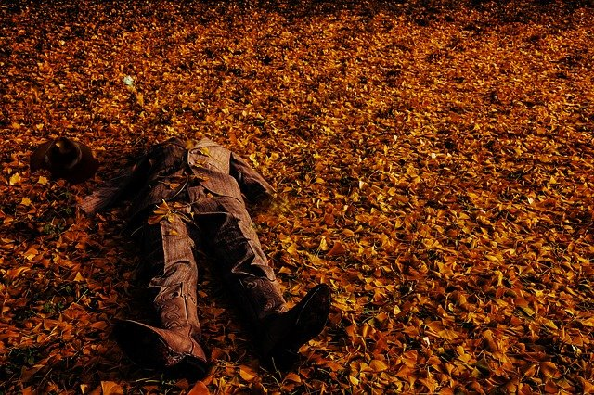

Slide 9
Characteristics of outdoor crime scene
1. Evidence found at an outdoor crime scene is more susceptible.
2. It requires larger investigating teams depending upon the size of the crime scene.
3. It is more prone to a damage of evidence by climatic conditions.
4. More eye witnesses can be found in outdoor crime scenes which can help to solve the case more quickly.
5. Grid or strip search method provides a better result to find evidence at an outdoor crime scene.

Slide 10
2. Indoor Crime Scene
A crime that is committed in an enclosed and small area like a room, hall, corridor, kitchen, etc. is known as an indoor crime scene. An indoor crime scene is less vulnerable to loss or contamination of evidence by whether condition as it occurred in an enclosed area.
Thus, timely cordoning of the entry/exit gates of the place like doors and windows help to collect evidence easily and fast resolution of the case can be done.

Slide 11
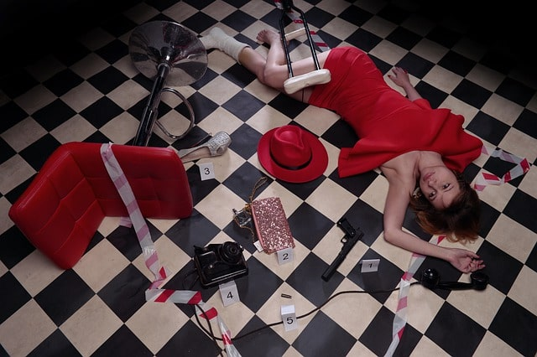

Slide 12
Characteristics of Indoor Crime Scene
1. Evidence found in an indoor crime scene is less susceptible.
2. It requires a small team of IOs/ Forensic experts as the area of an indoor crime scene is generally small.
3. It is less prone to damages of evidence through climatic conditions.
4. Less or no eye witness can be found in an indoor crime scene as their areas are generally closed and protected.
5. Spiral, circular, and zone search methods provide better results to find evidence at an indoor crime scene.

Slide 13
3. Mobile/ Conveyance Crime Scene
Conveyance is a means of transportation. Types of crimes committed in conveyances include the following: Vehicle, Train/Bus, Lift, Flight. Physical evidence recovered from these scenes may extend well beyond the conveyance.
Suspects leaving in a hurry may carelessly leave additional evidence. A conveyance, such as a vehicle, may be transported to the laboratory after proper documentation has been completed.

