Slide 1
BASIS OF FINGERPRINTING
CHAPTER 3

Slide 2
FINGERPRINT PATTERNS
Fingerprint patterns refer to the overall shape and arrangement of the ridges on a person's fingertips.
There are three main types of fingerprint patterns: arches, loops, and whorls.
Arches: Arches are the simplest type of fingerprint pattern, characterized by ridges that enter from one side of the print and exit from the other side, forming a wave-like pattern in the center. Arches can be further divided into two subtypes: plain arches, which have a simple curve, and tented arches, which have a spike in the center.
Loops: Loops are the most common type of fingerprint pattern, characterized by ridges that enter from one side of the print, form a curve or loop in the center, and exit from the same side. Loops can be further divided into radial loops, which open toward the thumb, and ulnar loops, which open toward the pinky.

Slide 3
Whorls: Whorls are characterized by ridges that form circular or spiral patterns in the center of the print.
Whorls can be further divided into four subtypes: plain whorls, which have a single, circular pattern; central pocket whorls, which have a circular pattern with a dot or short ridge in the center; double loop whorls, which have two separate loop patterns; and accidental whorls, which have no clear pattern and exhibit features of both loops and whorls.
In addition to these three main types, fingerprints can also exhibit other patterns, such as composite patterns, which are a combination of two or more of the main types, and variant patterns, which exhibit unusual or rare characteristics.
Overall, the patterns of fingerprints provide a useful way of classifying and identifying individual prints, which can be used in forensic investigations, biometric identification, and other applications.

Slide 4
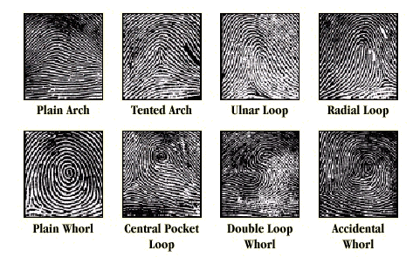

Slide 5
FINGERPRINT CHARACTERISTICS
Fingerprint characteristics, also known as minutiae, are unique features of a fingerprint that are used to identify and distinguish it from other fingerprints. These characteristics include ridge endings, bifurcations, dots, islands, spurs, and enclosures.
Ridge endings: Ridge endings are the points where ridges terminate. They are often used to determine the location and orientation of a fingerprint.
Bifurcations: Bifurcations occur when a single ridge splits into two branches. They are often used to determine the orientation and shape of a fingerprint.
Dots: Dots are small, isolated ridges that do not belong to a larger pattern. They are often used to confirm the presence of a fingerprint.

Slide 6
Islands: Islands are small ridges that are surrounded by other ridges. They are often used to determine the location and orientation of a fingerprint.
Spurs: Spurs occur when a ridge bifurcates and one branch is shorter than the other. They are often used to determine the direction of a fingerprint.
Enclosures: Enclosures occur when ridges form a complete loop, with no openings. They are often used to determine the size and shape of a fingerprint.
By examining the number, location, and orientation of these characteristics, forensic experts can compare and match fingerprints to determine if they belong to the same individual. Fingerprint characteristics are also used in automated fingerprint identification systems, which use computer algorithms to search large databases of fingerprints for matches.

Slide 7
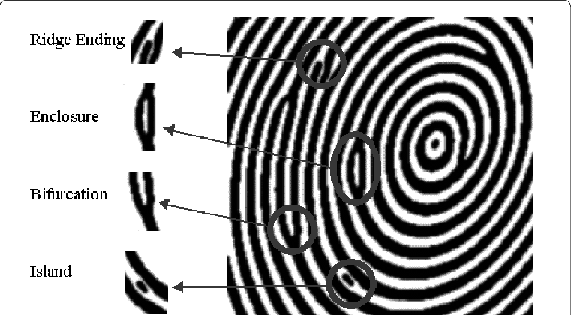

Slide 8
