Slide 1
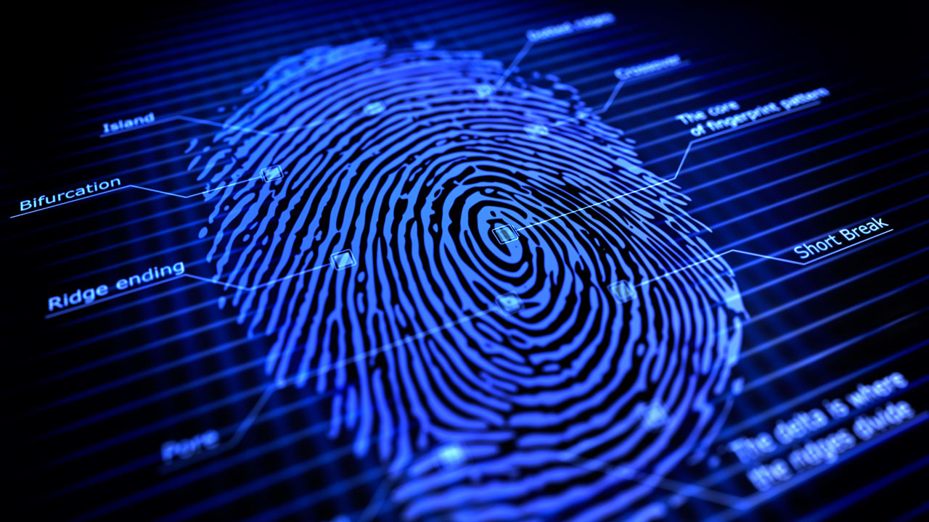
BASICS OF FINGERPRINTING
CHAPTER 1

Slide 2
FINGERPRINT
A fingerprint is a unique pattern of ridges and valleys on the tips of the fingers, thumbs, and toes of humans and other primates. Fingerprint patterns are formed in the womb and remain largely unchanged throughout a person's life, except for minor variations due to injury or aging.
The study of fingerprints is known as dactyloscopy, and it is used in forensic science to identify individuals who have left their fingerprints at a crime scene. Fingerprint analysis can also be used for security purposes, such as in biometric authentication systems that use fingerprints as a means of verifying identity.
Fingerprint patterns can be classified into three major types: arches, loops, and whorls. Arches are the simplest pattern and make up about 5% of all fingerprints. Loops make up about 60-65% of fingerprints, and whorls make up about 30-35%.
Fingerprint identification is based on the uniqueness of each person's fingerprint pattern, which is determined by the intricate arrangement of ridges and valleys on the skin. No two fingerprints are exactly alike, and even identical twins have different fingerprints. This makes fingerprints a valuable tool for identification in a wide range of applications, from law enforcement to access control.

Slide 3
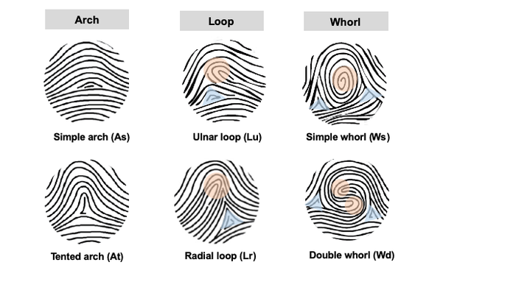

Slide 4
MEANING:-
The term "fingerprint" generally refers to the unique pattern of ridges and valleys on the skin of the fingers, thumbs, and toes of humans and other primates. However, the term can also have broader meanings depending on the context.
In a forensic context, a fingerprint refers specifically to the pattern of ridges and valleys left on a surface by the friction ridges on a finger or thumb. This can include latent prints (invisible prints left on a surface by sweat or other substances on the skin) as well as visible prints left by ink or other substances applied to the fingers.
In a broader sense, the term "fingerprint" can also refer to any unique identifier or pattern that distinguishes one entity from another. For example, in computer science, a digital fingerprint or hash is a unique identifier generated from a block of data, which can be used for file integrity checks, identification, or other purposes.

Slide 5
Concept of fingerprint
The concept of fingerprint refers to the unique and permanent pattern of ridges and valleys on the skin of a person's fingers, thumbs, and toes. This pattern is formed during fetal development and remains unchanged throughout a person's lifetime, except for minor variations due to injury or aging.
The concept of fingerprint is important in several fields, including forensic science, law enforcement, and biometrics. In forensic science and law enforcement, fingerprints are used to identify suspects and link them to crime scenes. Fingerprint analysis can also help to exclude innocent individuals from suspicion.
In biometrics, fingerprints are used as a means of identifying and verifying the identity of individuals. Fingerprint scanners are commonly used for access control in secure environments, such as government buildings, financial institutions, and research facilities.
The concept of fingerprint also highlights the uniqueness and individuality of each person. No two fingerprints are alike, and even identical twins have different fingerprints. This makes fingerprints a valuable tool for identification and verification purposes in a variety of applications.

Slide 6
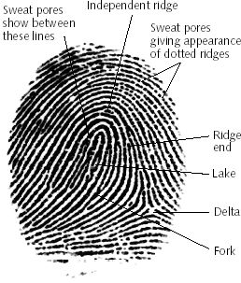

Slide 7
HISTORY BACKGROUND WITH SPECIAL REFERENCES IN INDIA
The use of fingerprints for identification purposes in India can be traced back to ancient times when fingerprints were used for both religious and administrative purposes. In fact, the ancient Indian text, the "Arthashastra," mentions the use of handprints for identifying individuals in official documents.
However, the modern use of fingerprints in India can be attributed to Sir William Herschel, a British officer who served in India during the 19th century. Herschel began using fingerprints to sign documents and as a means of identifying prisoners. In 1858, he recorded the fingerprints of local Indians to prevent fraud in contracts.
In 1897, the British Indian government passed the Fingerprinting of Criminals Act, which made the use of fingerprints mandatory for identifying criminals. The act was first implemented in Bengal and later expanded to other parts of the country. Under this act, fingerprints were taken of all arrested persons and recorded in the Criminal Register.

Slide 8
In 1947, after India gained independence from British rule, the Fingerprint Bureau was established as part of the Central Bureau of Investigation (CBI). The bureau was responsible for collecting, storing, and analyzing fingerprint data for criminal investigations.
Today, the use of fingerprints in India has expanded beyond law enforcement to include civil identification and security clearance. The government of India has established a national database of fingerprints called the National Automated Fingerprint Identification System (NAFIS), which is used by law enforcement agencies across the country. The Aadhaar program, India's national identification system, also includes biometric data, including fingerprints, for identification purposes.

