Slide 1
OTHER IMPRESSION EVIDENCES
CHAPTER 10

Slide 2
FOOTPRINT
Footprint impressions are a common form of physical evidence found at crime scenes and can be a valuable tool in forensic investigations. Footprint impressions are made when a person steps on a surface, leaving an impression of the bottom of their foot or shoe on that surface. This impression can provide valuable information about the person who made it, such as their shoe size, gait pattern, and the amount of weight they put on their foot.
Forensic investigators use various techniques to analyze footprint impressions, such as photography, casting, and comparison to known shoe prints or footprints of suspects. The analysis of footprint impressions can provide important evidence to help identify suspects, establish a timeline of events, and reconstruct a crime scene.
There are different types of footprint impressions, such as visible footprints that can be seen with the naked eye, latent footprints that are not visible to the naked eye but can be revealed using techniques such as dusting or chemical enhancement, and plastic impressions made by the soles of shoes. In addition, plastic footprint impressions can be found on different surfaces, such as soil, sand, snow, or dust, and their preservation can vary depending on the type of surface and environmental conditions.
Overall, footprint impressions can be a valuable form of physical evidence in forensic investigations, and their analysis can provide important information to help solve crimes and bring justice to victims.

Slide 3
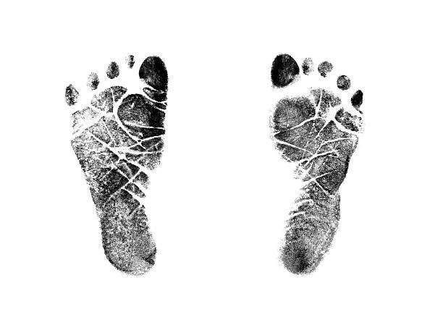

Slide 4
MEANING:-
Footprint impressions are marks left on a surface by a person's foot or shoe. They can provide valuable information to forensic investigators in criminal investigations, such as the size and pattern of the shoe or foot that made the impression. The meaning of a footprint impression depends on the context in which it is found. For example, if a footprint impression is found at a crime scene, it could indicate the presence of a suspect or a victim. The analysis of footprint impressions can help investigators determine the direction of travel, the number of individuals present, and the time frame of events.
Footprint impressions can also be used to identify individuals in some cases. Each person has a unique gait pattern, which is the way they walk, and this can be reflected in their footprints. Forensic investigators can analyze the gait pattern in footprints to determine whether they match the pattern of a suspect's known gait.

Slide 5
In addition, footprint impressions can be used to track the movements of individuals. For example, in a search and rescue operation, footprint impressions can be used to track the movements of a missing person, and in a military operation, footprint impressions can be used to track the movements of enemy soldiers.
Overall, the meaning of a footprint impression depends on the context in which it is found and the information that can be extracted from its analysis.

Slide 6
IMPORTANCE OF FOOTPRINT IMPRESSIONS
Footprint impression evidence is important in forensic investigations for several reasons:
Identification of suspects: Footprint impressions can be used to identify potential suspects in criminal investigations. By comparing the size, shape, and pattern of the footprint impression found at the crime scene to those of a suspect's shoes or feet, investigators can establish whether the suspect was present at the scene.
Reconstruction of the crime scene: Footprint impressions can help investigators reconstruct the crime scene and determine the sequence of events that occurred. For example, the direction of travel of the suspect or victim can be determined by analyzing the orientation of the footprints.
Corroboration of witness testimony: Footprint impressions can provide corroborative evidence for witness testimony. For example, if a witness reports seeing a suspect wearing a particular type of shoe, the presence of a footprint impression with a matching pattern and size can support the witness's testimony.

Slide 7
Linking suspects to multiple crime scenes: Footprint impressions can help link suspects to multiple crime scenes if the same footwear or gait pattern is found at each scene.
Exclusion of suspects: Footprint impressions can also be used to exclude suspects from an investigation if their footwear or gait pattern does not match the impression found at the crime scene.
Overall, footprint impression evidence can be a powerful tool in forensic investigations, providing valuable information to investigators and helping to establish the facts of a case.

