Slide 1
BASIS OF FINGERPRINTING
CHAPTER 5

Slide 2
CLASSIFICATION OF FINGERPRINT RECORD
Fingerprint records can be classified based on the level of detail and the purpose of the record. Here are some common types of fingerprint records:
Basic fingerprint record: This type of record includes the basic fingerprint pattern types (loops, whorls, and arches) for each finger, but does not include detailed ridge characteristics.
Detailed fingerprint record: This type of record includes detailed ridge characteristics, such as ridge endings, bifurcations, and dots, in addition to the basic pattern types. This level of detail is often required for forensic investigations or legal purposes.
Rolled fingerprint record: This type of record includes rolled prints of all ten fingers, taken one at a time, and is commonly used for identification purposes.

Slide 3
Live scan fingerprint record: This type of record is created using a digital scanner that captures high-quality images of the fingerprints. It is commonly used for biometric identification purposes, such as in background checks or security systems.
Criminal history record: This type of record includes fingerprint records and other criminal history information, such as arrests and convictions, and is used for criminal justice purposes, such as employment background checks or security clearances.
Overall, the type of fingerprint record used depends on the purpose of the record and the level of detail required. Basic records may be sufficient for some purposes, while detailed records are required for others, such as forensic investigations. Live scan records and criminal history records are commonly used for biometric identification and criminal justice purposes, respectively.

Slide 4
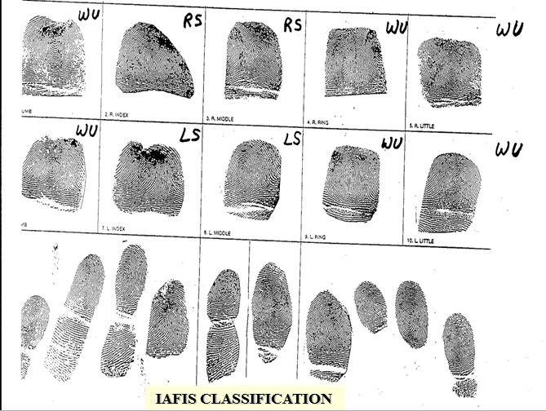

Slide 5
HOW CLASSIFICATION OF FINGERPRINTS ARE DONE?
The classification of fingerprints is based on the pattern types and ridge characteristics present in the ridges of the fingerprint. The classification system is widely used in forensic investigations and criminal justice systems for identifying individuals based on their fingerprints.
Here are the steps involved in classifying fingerprints:
Obtain a clear image of the fingerprint: The first step in fingerprint classification is to obtain a clear image of the fingerprint. This can be done by taking a rolled or plain print of the fingers using ink or a digital scanner.
Identify the pattern type: Once a clear image of the fingerprint is obtained, the pattern type is identified. The pattern type is determined by examining the ridges and determining whether they form a loop, whorl, or arch pattern.

Slide 6
Determine the sub-category of the pattern: Each pattern type can be further classified into sub-categories based on the ridge characteristics present in the fingerprint. For example, loops can be classified as radial loops or ulnar loops based on the direction the ridges take as they loop back toward the origin.
Locate the delta: The delta is a triangular area on the fingerprint where the ridges diverge. It is used to orient the fingerprint and determine the position of the pattern type and sub-category.

Slide 7
Assign a code: A code is assigned to each fingerprint based on the pattern type, sub-category, and position of the delta. The most commonly used classification system is the Henry Classification System, which assigns a code consisting of a letter representing the pattern type (L for loops, W for whorls, A for arches), a number representing the sub-category, and an additional letter representing the position of the delta.
Overall, the classification of fingerprints is a systematic process that involves identifying the pattern type, determining the sub-category, locating the delta, and assigning a code. The classification system is widely used in forensic investigations and criminal justice systems for identifying individuals based on their fingerprints.

