Slide 1
History of Typography

Slide 8
https://www.youtube.com/watch?v=yeikqw0kyqI
https://www.youtube.com/watch?v=ewEje3B1BoA

Slide 9
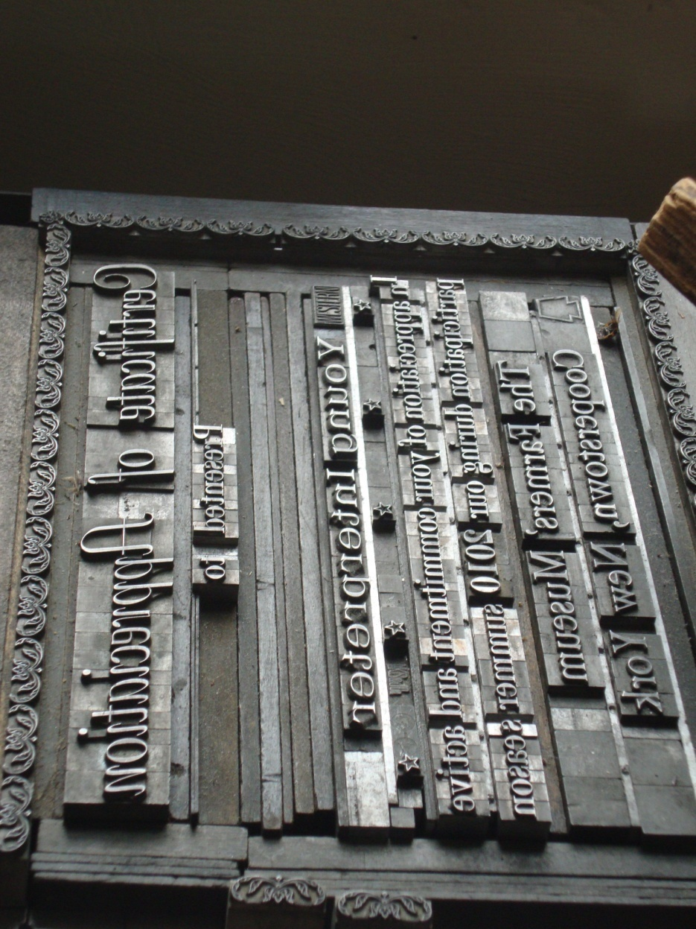
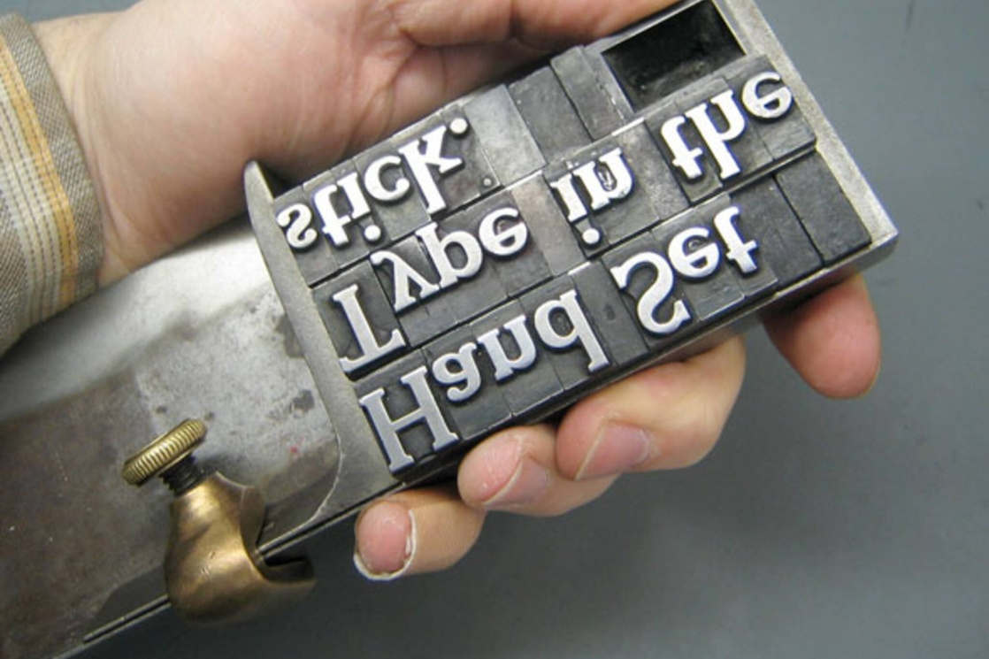

Slide 10
