Slide 1
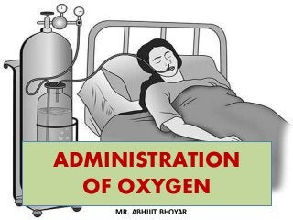
Prepared By –
Mrs.Serah Rashmi
Sncn - 18

Slide 18
