Slide 1

Unit 2
Cells and Tissues
Prepared by
Mrs P.Snehalatha Reddy
Associate Professor
Dpt-Medical Surgical Nursing
Smt Nagarathnamma college of nursing
13/12/2021

Slide 2

Classification of Tissues
a)Epithelial tissue(epithelium) b)Connective tissue
c)Muscle tissue
d)Nervous tissue

Slide 3
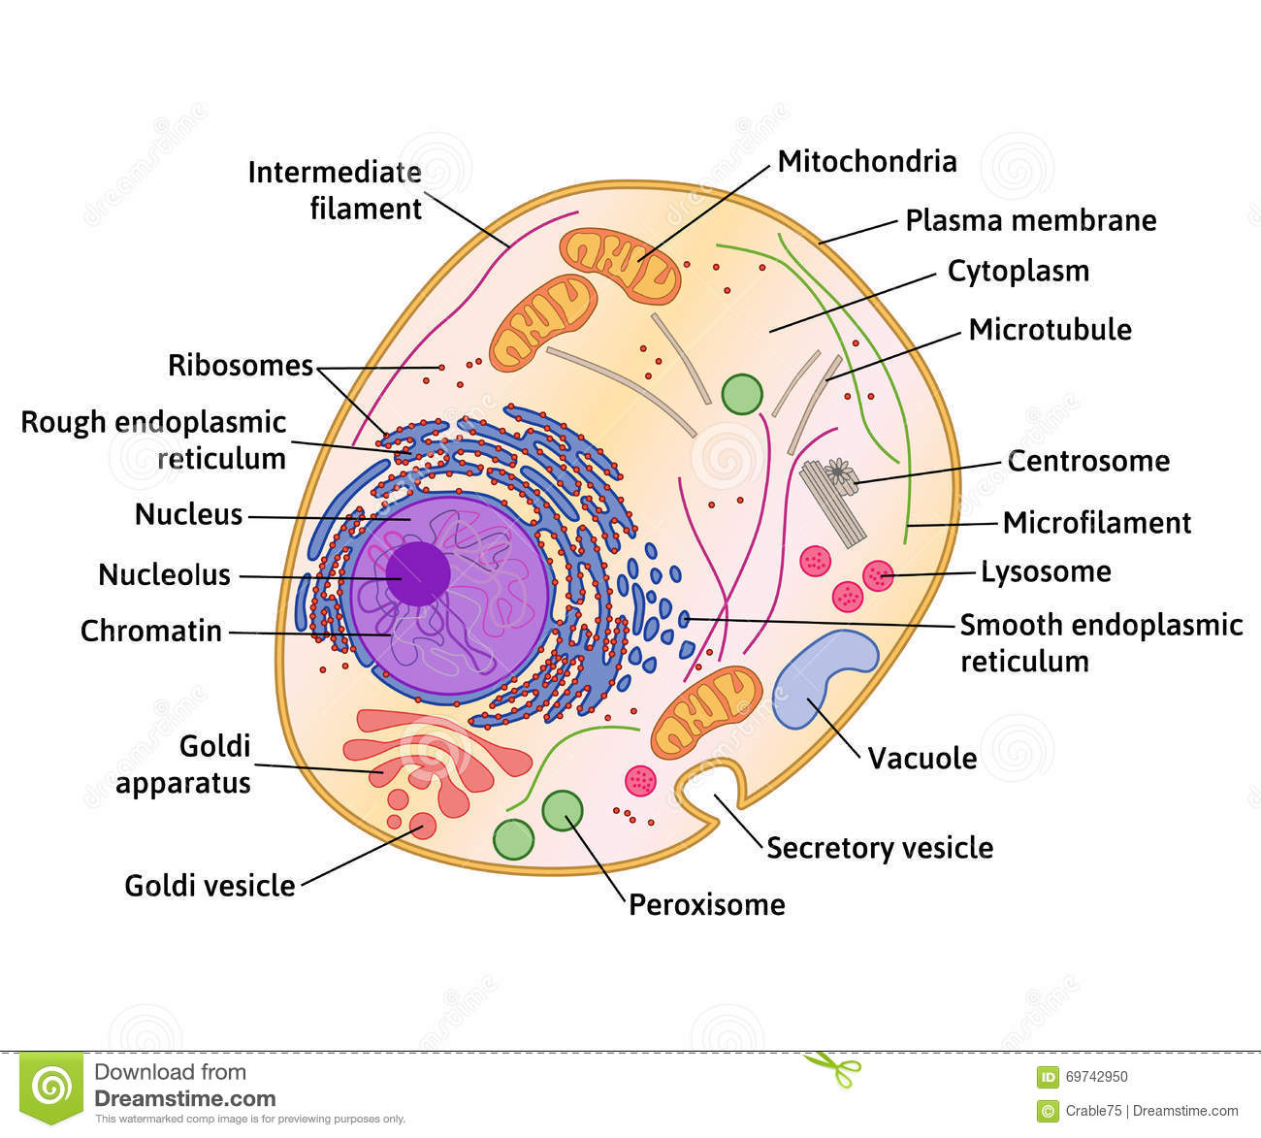
Human cell

Slide 4
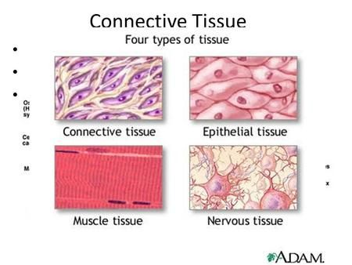

Slide 5
Epithelial tissue is of two types: a)Simple epithelium b)Stratified epithelium
a)Simple epithelium
Squamous
Cuboid
Columnar
Ciliated

Slide 6
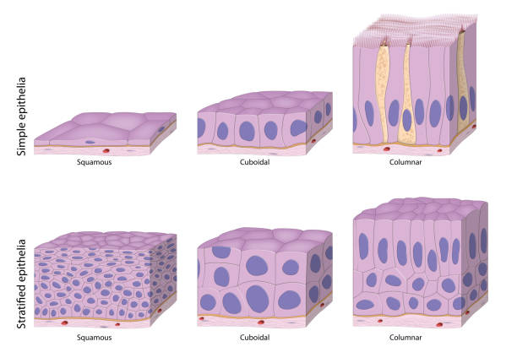

Slide 7
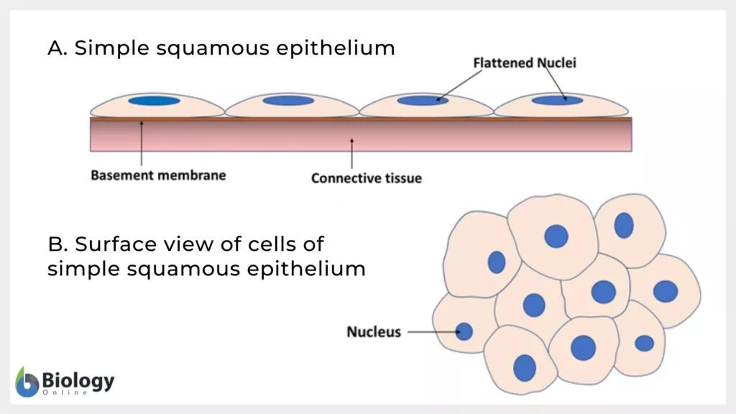

Slide 8
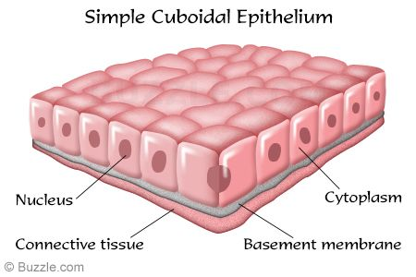

Slide 9
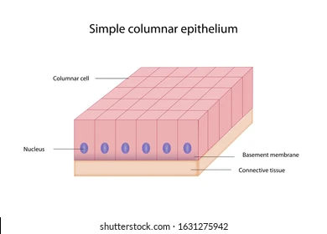

Slide 10
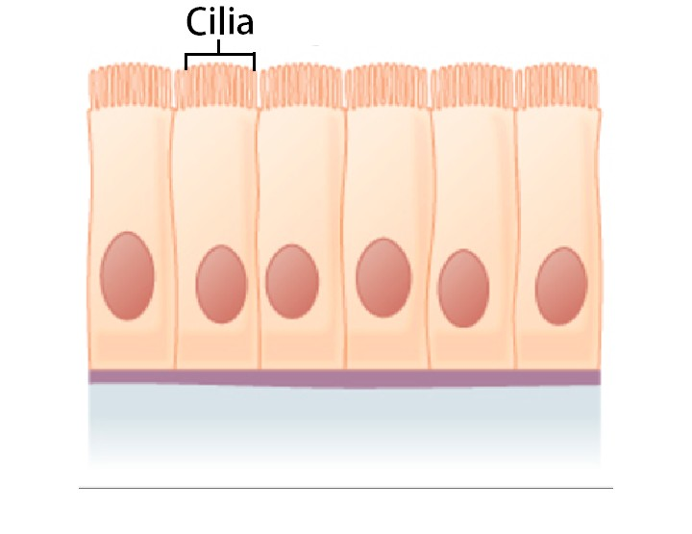

Slide 11
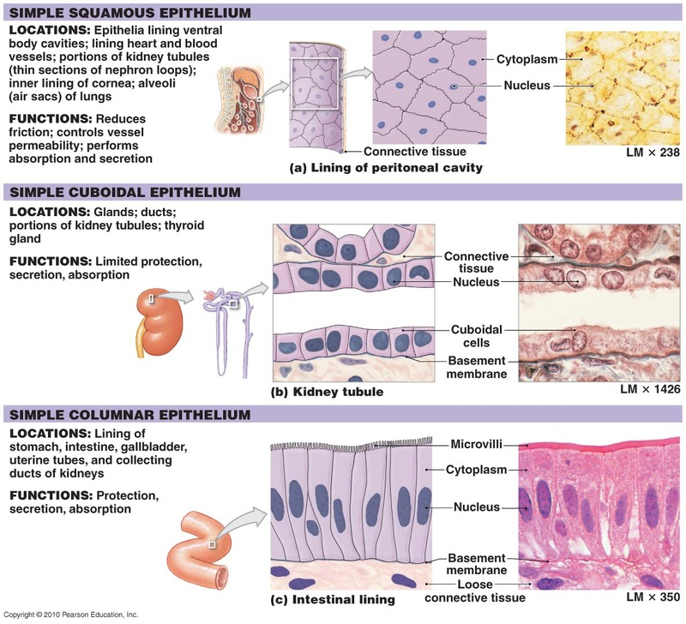

Slide 12
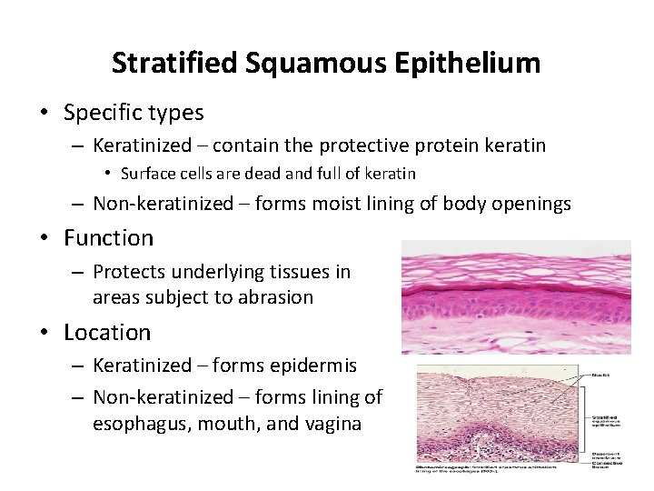

Slide 13
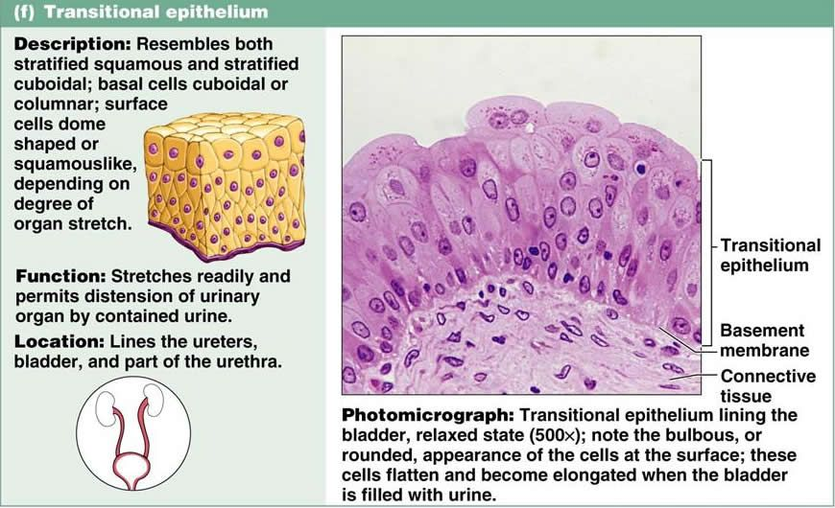

Slide 14
CONNECTIVE TISSUE
Functions
i)Binding and structural support
ii)Transport
iii)Protection
iv)Insulation

Slide 15
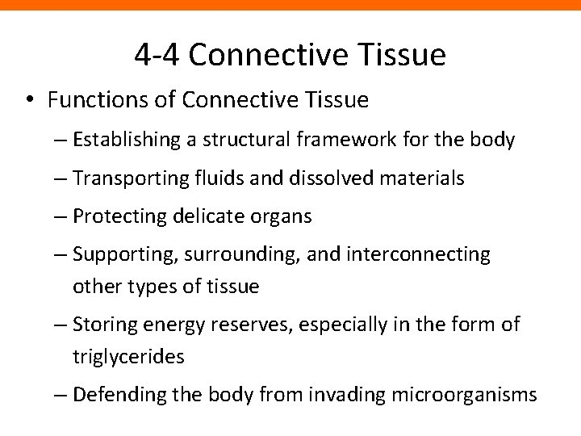

Slide 16
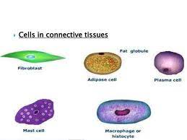

Slide 17
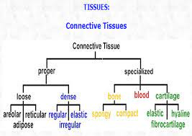

Slide 18
Tissue that supports, protects, and gives structure to other tissues and organs in the body. Connective tissue also stores fat, helps move nutrients and other substances between tissues and organs, and helps repair damaged tissue. ... Types of connective tissue include bone, cartilage, fat, blood, and lymphatic tissue.

Slide 19
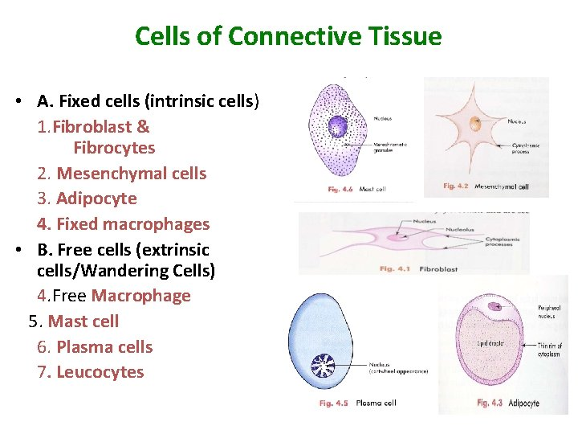

Slide 20
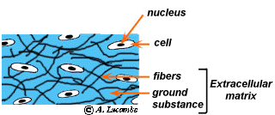

Slide 21
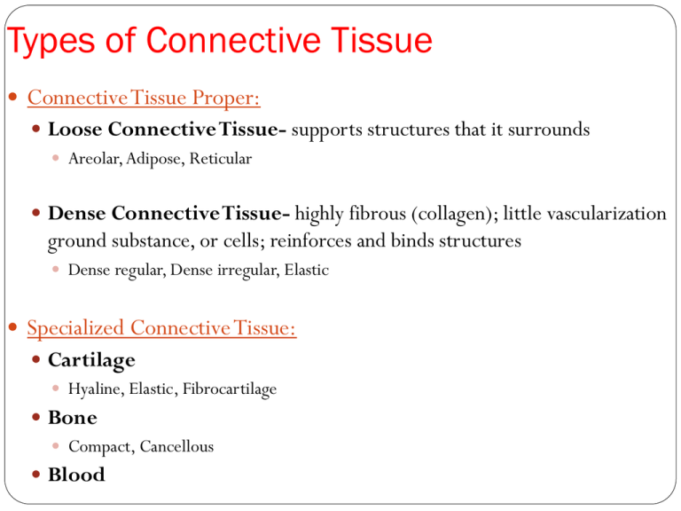

Slide 22
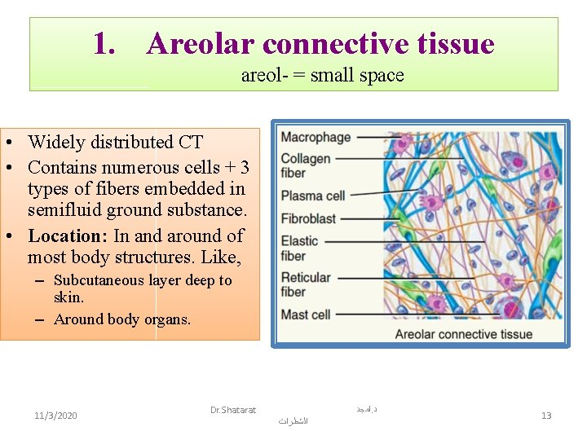

Slide 23
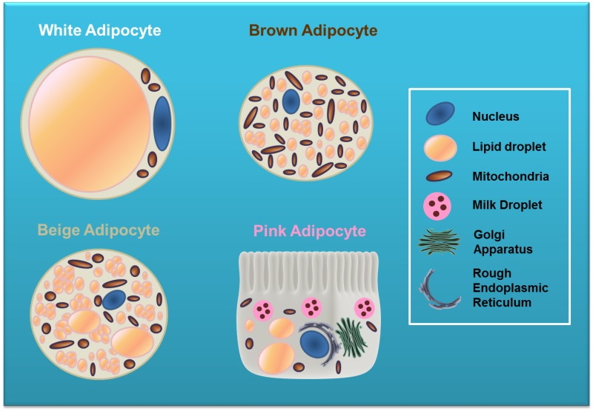

Slide 24
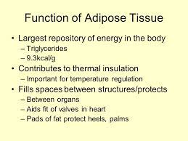

Slide 25
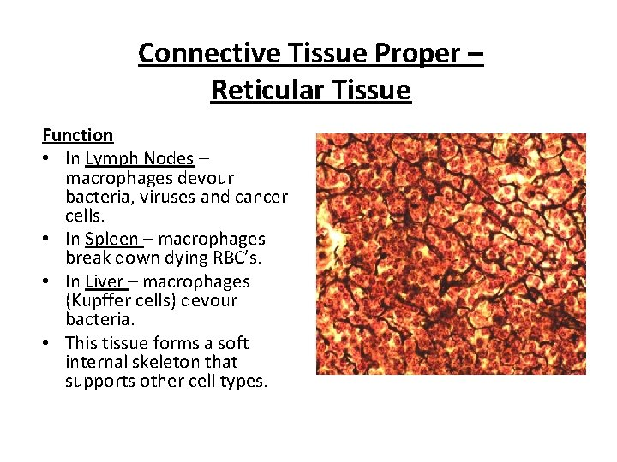

Slide 26
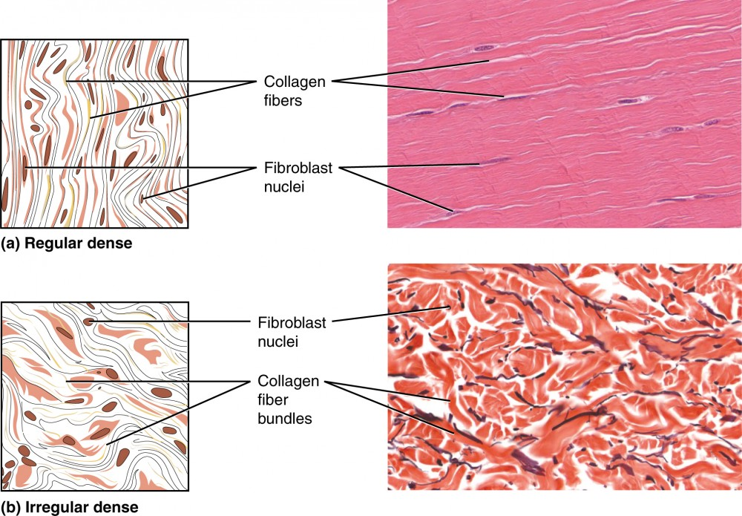

Slide 27
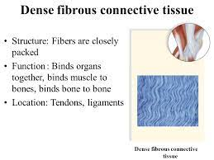

Slide 28
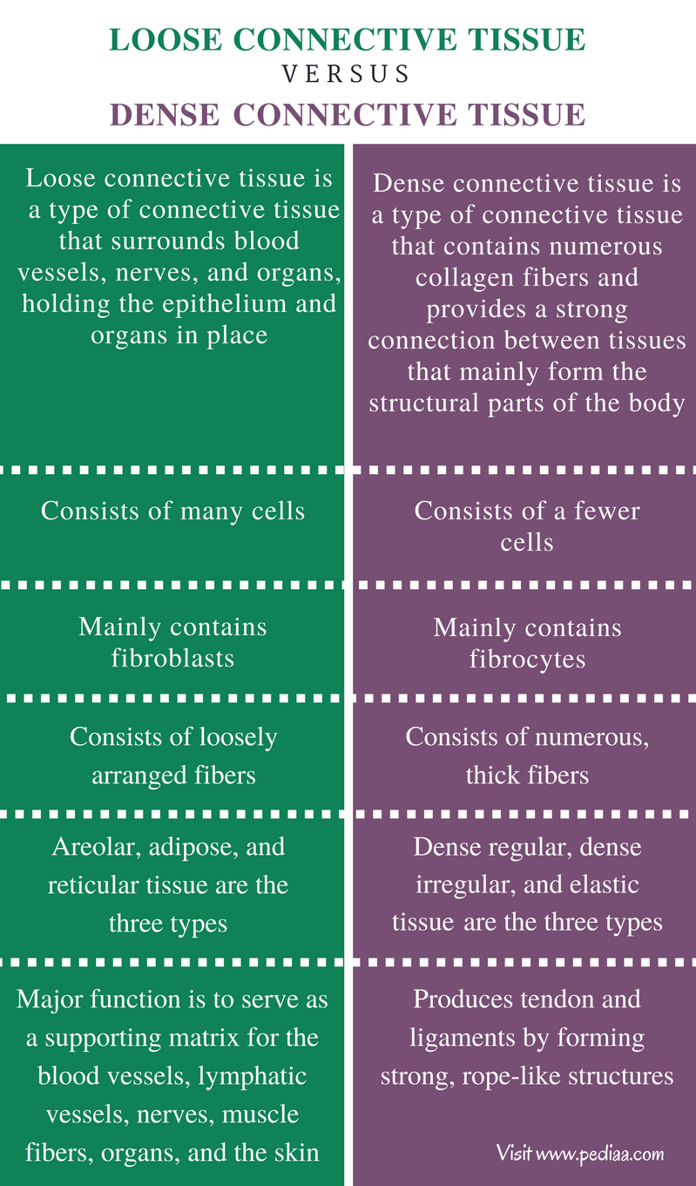

Slide 29
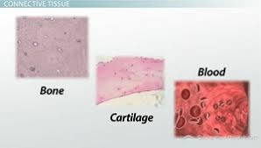

Slide 30
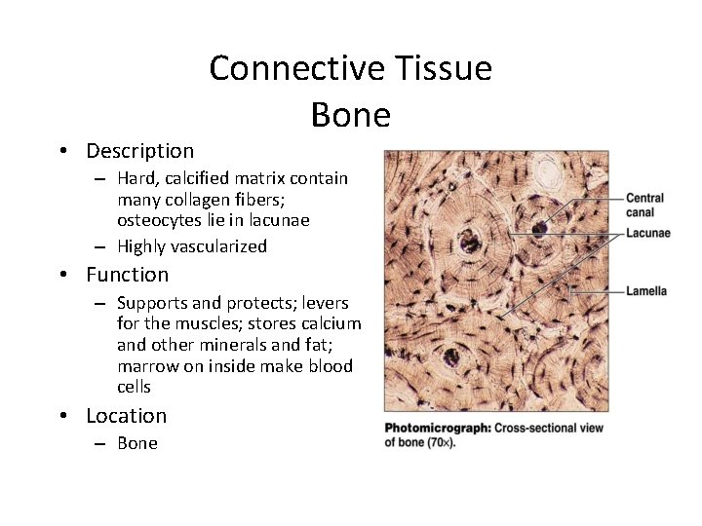

Slide 31
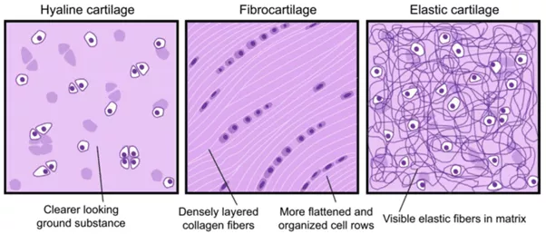

Slide 32
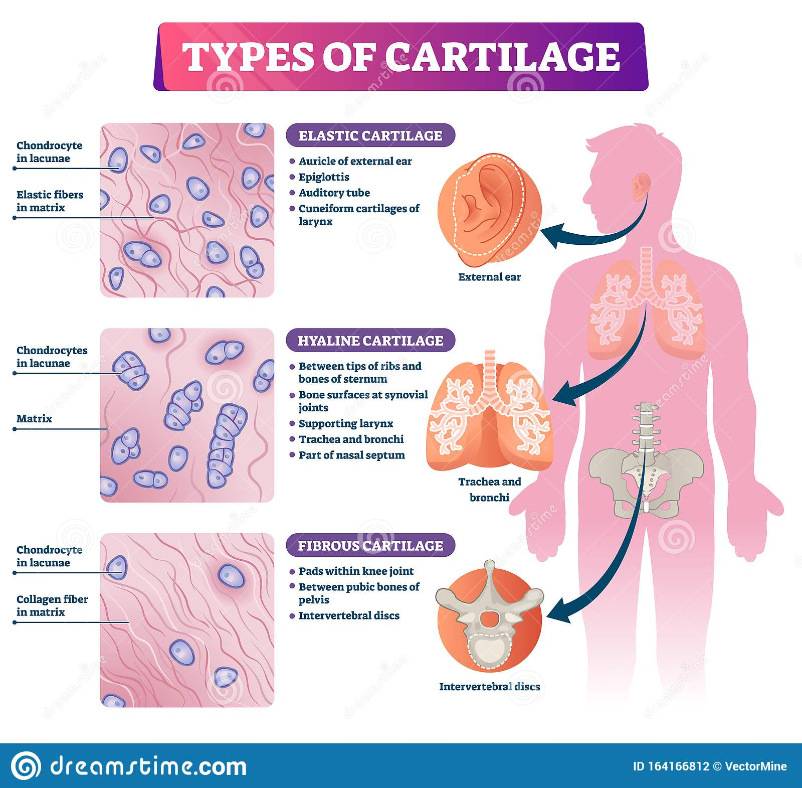

Slide 33
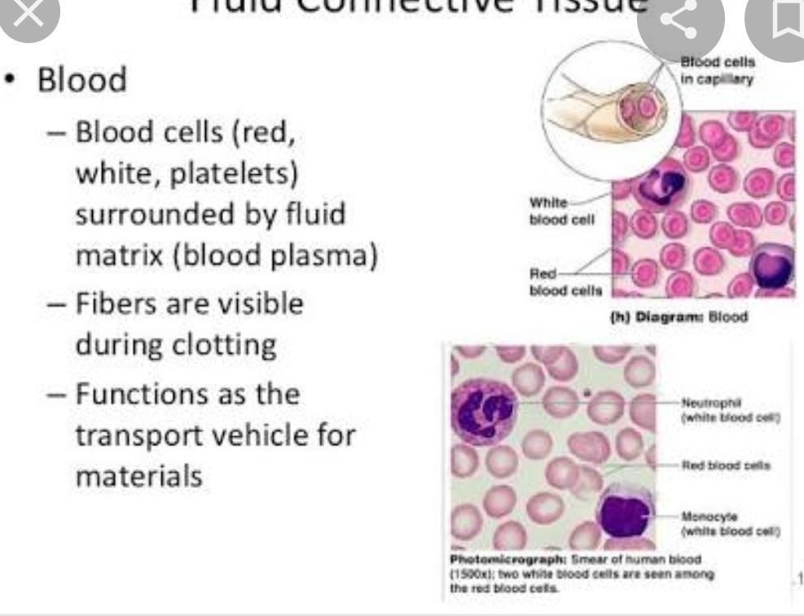

Slide 34
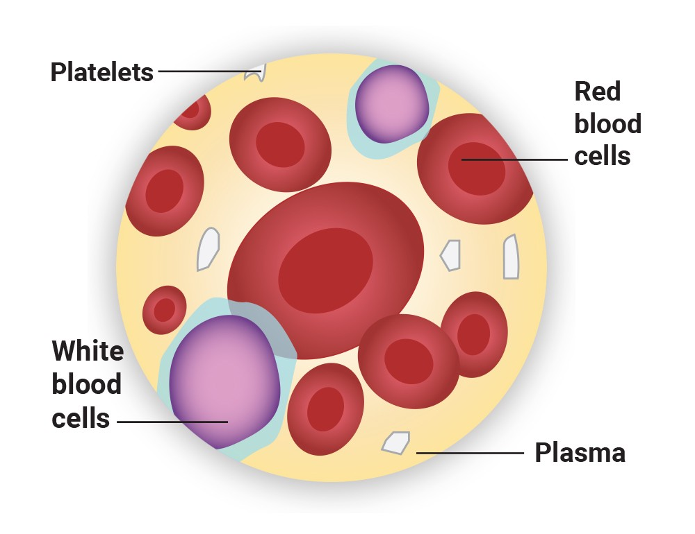

Slide 35
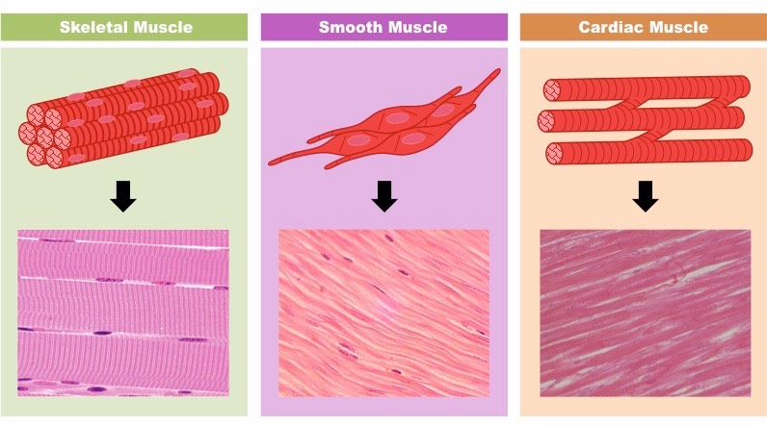

Slide 36
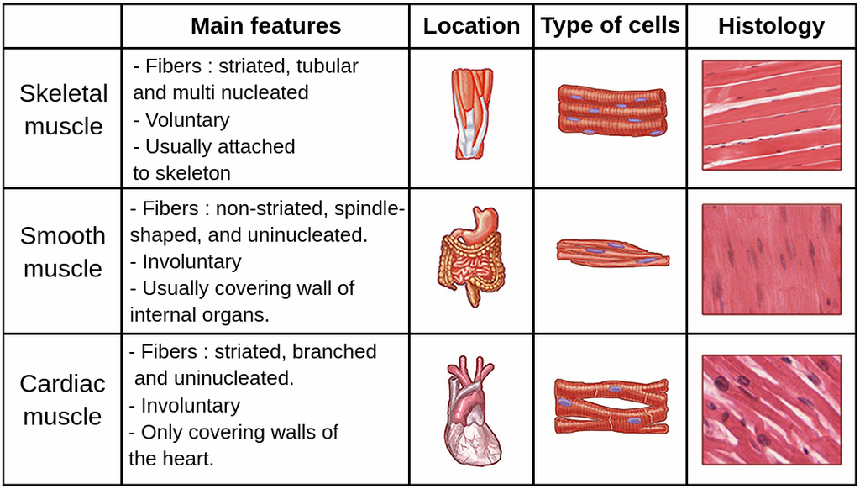

Slide 37
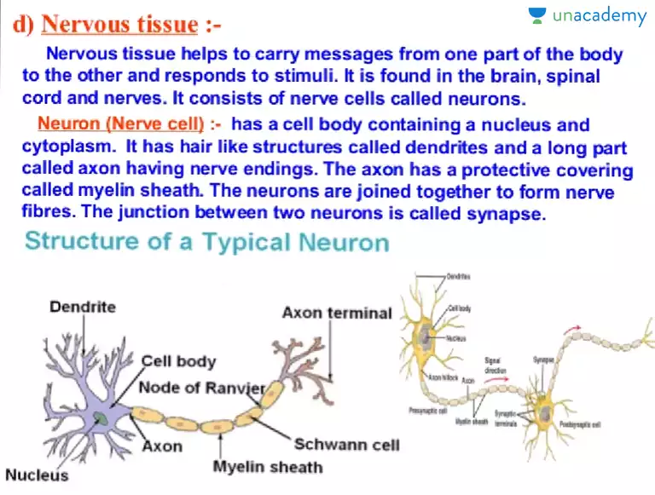

Slide 38
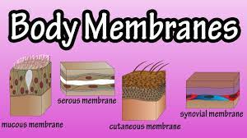

Slide 39
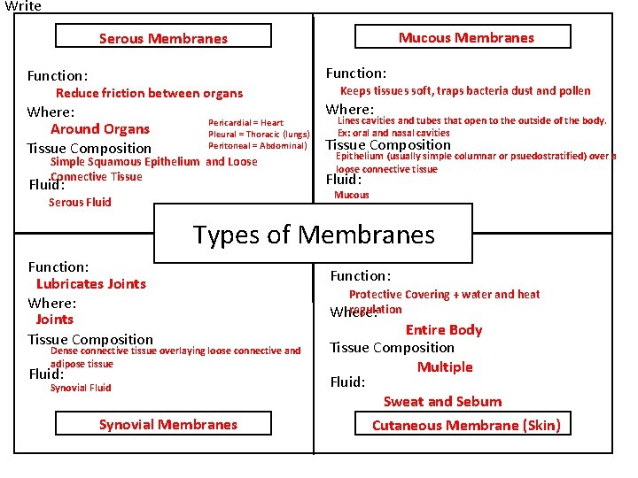

Slide 40
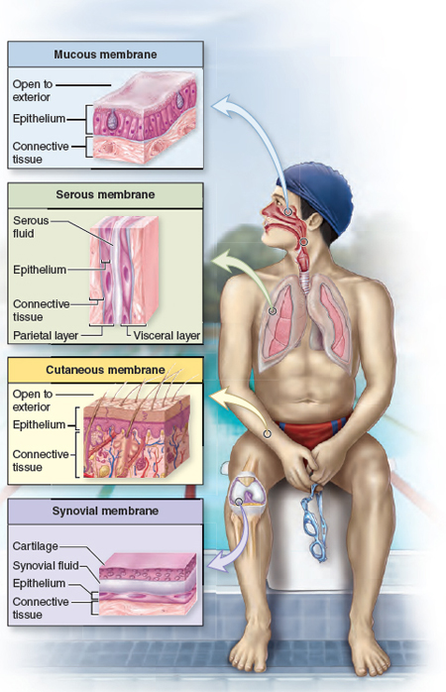

Slide 41
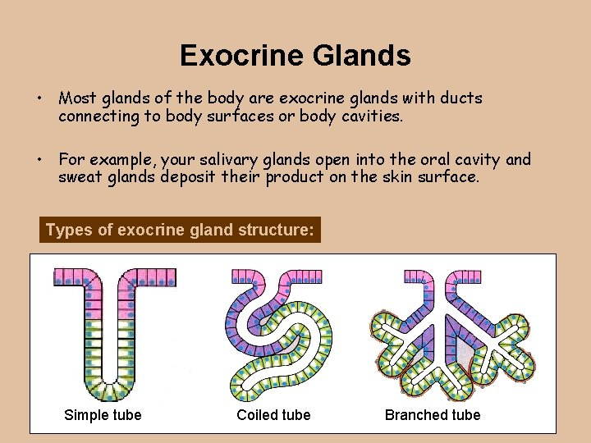

Slide 42
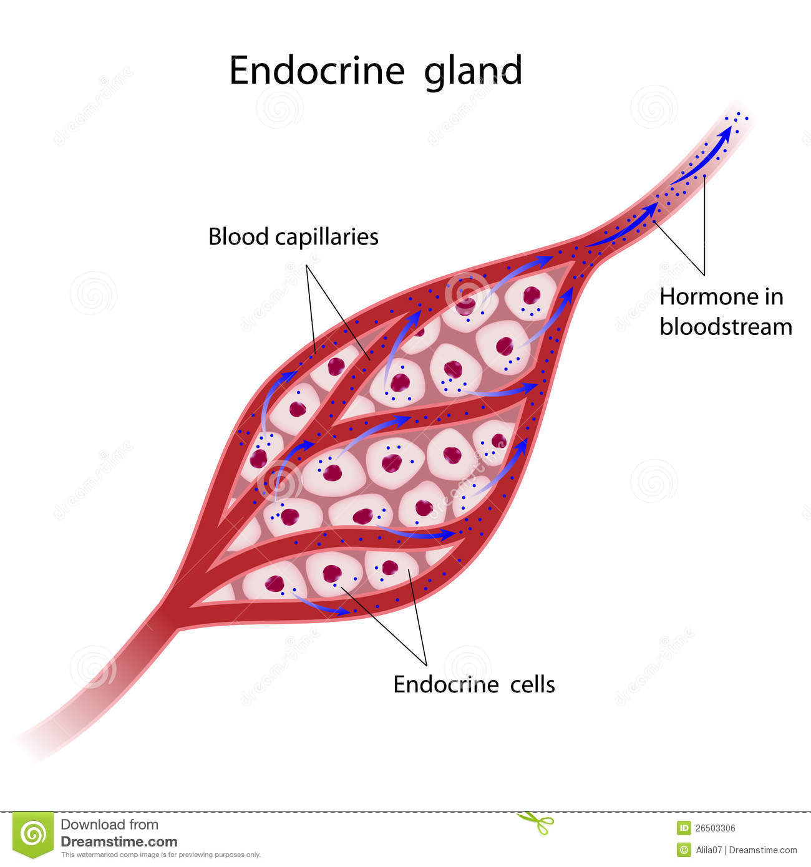

Slide 43
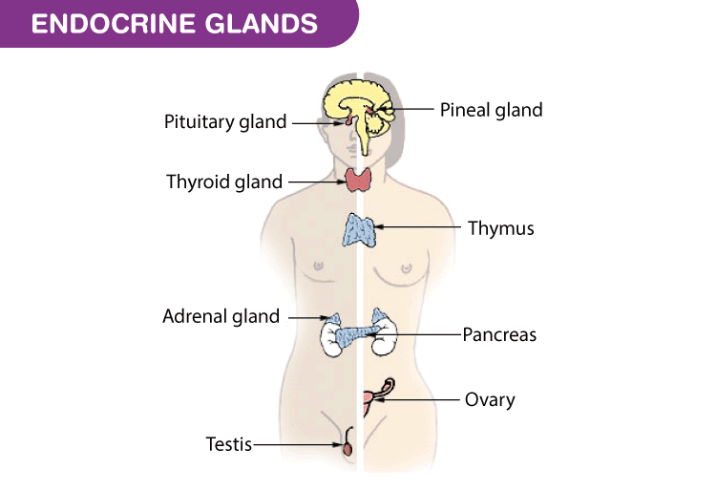

Slide 44
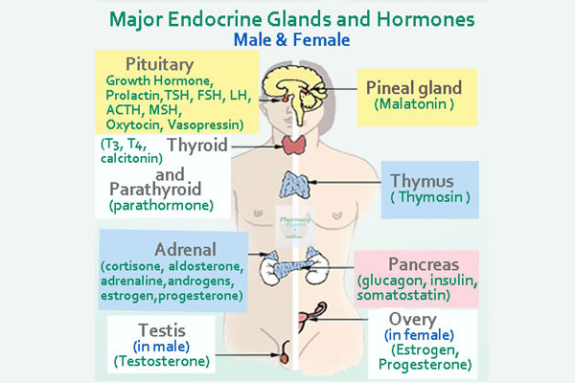

Slide 45
