Slide 2
Quality of life in Last Phase of Life
Presenter
Devi Nanjappan
Prof & Principal
Smt.Nagarathnamma school and college of Nursing,Acharya Institutes
April 22nd, 2022

Slide 3
This session Mull overs
Life
Quality of Life
Quality of Life in last phase of life
Aging and last phase

Slide 4
Aim of this session is
to explore ourselves to journey of aging and learn to glorify the quality of life

Slide 5
Objectives of this session
Able to Educate the life process to fellow collogues , care givers and around them
Advocating the Quality of Life in last phase of Life as a family member ,as a nurse and as a future geriatric people
Seeks out platform to know more information on quality of life and be a liaison in contributing /supporting the health system

Slide 6
What is life

Slide 7
It is a process

Slide 8
It is transition

Slide 9
Understand the Stages of life
Stage One: Mimicry
Stage Two: Self-Discovery
Stage Three: Commitment
Stage Four: Legacy

Slide 10
In Stage One
Person is wholly dependent on other people’s actions and approval to be happy.
This is a horrible strategy because other people are unpredictable and unreliable.
In Stage Two
one becomes reliant on oneself, but they’re still reliant on external success to be happy—making money, accolades, victory, conquests, etc.
These are more controllable than other people, but they are still mostly unpredictable in the long run.
Stage Three
Relies on a handful of relationships and endeavors that proved themselves resilient and worthwhile through Stage Two. These are more reliable.
Stage Four
we only hold on to what we’ve already accomplished for as long as possible.
At each subsequent stage
happiness becomes based more on internal, controllable values and less on the externalities of the ever-changing outside world.

Slide 11
Transition

Slide 12
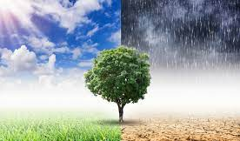
Life transition
Some of the most common ones are: reaching a significant age, e.g. 30, 40, 50, 60; getting married; becoming a parent; leaving university; changing job/losing your job; becoming ill or disabled; being bereaved; and retiring(Role transition)

Slide 13
Take home message
Learn to unlearn and move on

Slide 14
Answer is Life…..
It is a process, transition and learn to navigate

Slide 15
You experience meaning in life or your life has purpose
While doing so ….you will sustain ……

Slide 16
Your Quality of life(QoL)

Slide 17
Quality of Life (QoL):What it is?
It is the sustainable human development and well-being

Slide 18
The World Health Organization (WHO)
Quality of life (QOL) as “an individual's perception of life in the context of culture and value system in which he or she lives and in relation to his or her goals, expectations, standards, and concerns.”

Slide 19
Understand human development
It is a process of enlarging the people choices. the most critical choices are to lead a long and healthy life ,to be educated and to enjoy decent standard of living .
Additional choices include political freedom, guaranteed human rights and self respect .

Slide 20
Hence ,QOL is measured by
Human development Index (HDI)

Slide 21
Assessment of Quality of Life
(HDI)
Key dimension of assessment
Health and Life Expectancy
Education attainment
Standard of Living

Slide 22
Factors influencing QOL

Slide 23
Quality of Life (QoL)

Slide 24
Supranational organization guides for QOL Assessment
WHO
UN
OECD
ILO
EU
EC

Slide 25
Aging
It is an inevitable natural process often linked with declining health conditions
Rajasthan and Himachal Pradesh are top-scoring regions in Aged . The Aged States refer to States with an elderly population of more than 5 million

Slide 26
As per the WHO report
There are more than 600 million elderlies at a global level. The elderly population will be doubled by 2025 and rise to two billion by 2050
India is going through a phase of demographic transition progressing to population aging.
The increase in life expectancy among the elderly is because of demographic transition in developing countries
Poor health-related QOL among the elderly is often associated with physical deterioration, psychological trauma, and mental weakness.
Elderly population was estimated to be 11.6% by 2026.
The burden of multimorbidity often increases with a rise in age

Slide 27
Aging incidence
India witnessed a dramatic increase in life expectancy from 42.27 years in 1960 to 69.16 years in 2017 due to healthcare technology and quality advancements
Currently, inequality in life expectancy across gender makes women outlive men
Adult women transit towards menopause around 45 years; this is accompanied by a series of natural physiological changes
Around midlife, women may develop several conditions such as osteoporosis, depression, and urinary incontinence due to menopausal transition

Slide 28
Multimorbidity
In India, chronic non-communicable diseases (NCDs) typically start a decade earlier (around 45 years and older) than in high income countries
Multimorbidity, in general, is associated with increased healthcare utilization and expenditure, poorer quality of life, and psychological distress needing greater attention in resource constraint setting
NCDs among middle aged women in India. hypertension (Prevalence = 27.1 per 100 women), gastrointestinal disorder (Prevalence = 17.9 per 100 women), musculoskeletal disorder (Prevalence = 16.9 per 100 women), diabetes (Prevalence = 10.7 per 100 women), and obesity (Prevalence = 10.9 per 100 women) were most commonly occurring NCDs.

Slide 29
Social theories of Aging
Disengagement theory
Activity/Role theory
Continuity theory

Slide 30
Social System theories of Aging
Social Exchange theory
Modernization theory
Age Stratification theory

Slide 31
Aging- last stage
Aging is generally defined as a process of deterioration in the functional capacity of an individual that results from structural changes, with advancement of age.
The last stage in the life span is frequently sub divided into early old age which extends from age sixty to age seventy and advanced old age which begins at seventy and extends to the end of life.

Slide 32
Last phase of Aging
As the elderly population increases, heath demands, along with other social requirements, are also set to increase. It is evident from the studies that physical deterioration, psychological trauma, and mental weakness are associated with aging In India, the social security system for the elderly is not as well equipped acrossed countries
Globally, an urban population often faces mounting pressure on various socioeconomic fronts such as health-care expenditures and fiscal disciplines, which can impact the life of the elderly population

Slide 33
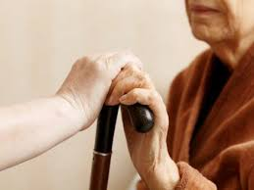
Old age population conditioned. few eg,
NCDs
Dementia
Auditory and visual impairment
Stroke
Fall and accident
Malnutrition
Communication defeats

Slide 34
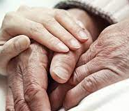
Therefore ,Geriatric Rehab shall encompass the QOL

Slide 35
Quality of Life
When it comes to quality of life, each patient has their own vision.
"Each suffering is unique. Each individual is unique, and each family and the dynamics are unique," Chan says.

Slide 36
Why QOL in later life ?
Increasing no. of older people with higher expectation of a good life within society
Higher demand of health and social care

Slide 37
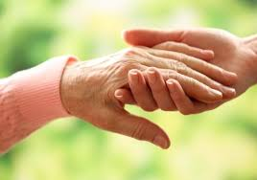
Elements of Quality end-of-life care
Overall quality of life
Physical well-being and functioning
Psychosocial well-being and functioning
Spiritual well-being
Patient perception of care
Family well-being and perceptions.

Slide 38
Positive Approaches to Aging
Emphasis on achievement of Positive, healthy, well, active or successful aging

Slide 39
Successful aging
Engaging with life
Reaching ones potential physical, psychological and social well being
To adapt ones’ values to meet the challenges in later life
Maintaining realistic sense of self
Compensatory and accommodative strategies
Cognitive efficiency
Psychological resources to built-up over a lifetime
Self mastery and Control

Slide 40
Dealing with life transitions at home
Experiencing a life transition can bring out all sorts of feelings in people.
evaluate their lives and ask themselves questions about their success, what they are doing and why, where they are going in life and what is important to them.
writing down a list of things that are important to you, what you have achieved in life and what you would like to achieve is a good starting point.
Try not to dwell on negatives, but use them to motivate you in the future
ask the opinion of someone you trust.

Slide 41
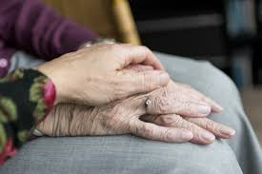
Principles for older aging care
Maximizing activity in older adults
Variation in older adults,
Concept that optimal health is directly related to optimal functional ability.

Slide 42
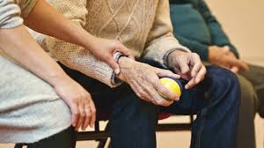
Principles to remember
Totality of Patient
Individualization
Intensity
Specific sequencing
Compliance
Timing
Avoiding aggravation

Slide 43
Rehab Model for old age are
International Classification of Impairments, Disabilities and Handicaps (ICIDH-2) of the World Health Organization (WHO)
International Classification of Function, Disability and Health ICF

Slide 46
Global perspective of quality in later life
Reinforce
reinforce the recasting of quality end-of-life care as a global public health and health systems problem;
Strengthen
strengthen capacity to deliver quality end-of-life care
Develop
develop improved strategies to acquire information about the quality of end-of-life care.

Slide 47
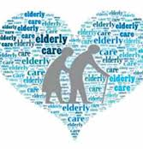
Coping With a Life-Threatening Illness
I'm sorry, but there's nothing more we can do."
No patient wants to hear that. No doctor wants to say it. And with good reason: It isn't true.
"You can be the most intelligent, organized person in the world, but hearing distressing news about your condition makes it hard to keep things straight.
Once you've learned about your diagnosis , you will have to share the news with others. For many people, this is the hardest part -- and the most necessary. "I encourage people not to go it alone,"

Slide 48
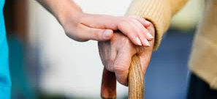
Gerontological Rehab
Focus on special needs of elderly to maintain quality of life

Slide 49
Variety of rehab Environment Acute subacute Inpatient outpatient Hospital based long term Home health Care agencies Nursing Facilities

Slide 50
Common abbreviation used
DALY
disability adjusted life year
HRQOL
health related quality of life
QALY
quality adjusted life year
QOL
quality of life
QuiLL
quality in later life

Slide 51
palliative care
It is set as “an approach that improves the quality of life of patients and their families facing the problems associated with life-threatening illness, through the prevention and relief of suffering by means of early identification and impeccable assessment and treatment of pain and other problems, physical, psychosocial and spiritual”

Slide 52
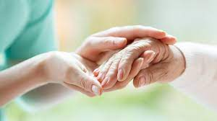
Palliative care
Palliative care is specialized medical care for people with serious illnesses. It is appropriate at any age and at any stage in a serious illness and can be provided along with curative treatment.
Palliative care focuses on providing patients with relief from the symptoms and stress of a serious illness.
The goal is to improve quality of life for both the patient and the family.
Palliative care is provided in the home, nursing homes, hospitals and outpatient

Slide 53
Palliative Care

Slide 54
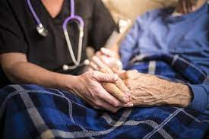
Hospice care for comforting terminally ill
Hospice care might be an option if you or a loved one has a terminal illness.
Hospice care is for people who are nearing the end of life
Hospice care is for a terminally ill person who's expected to have six months or less to live.
The goal is to keep patients comfortable and improve quality of life.

Slide 55
Contd.
Enrolling in hospice care early helps you live better and live longer.
Hospice care decreases the burden on family, decreases the family's likelihood of having a complicated grief and prepares family members for their loved one's death.
Hospice also allows a patient to be cared for at a facility for a period, not because the patient needs it, but because the family caregiver needs a break. This is known as respite care.
hospice stresses care over cure. The goal is to provide comfort during the final months and days of life.

Slide 56
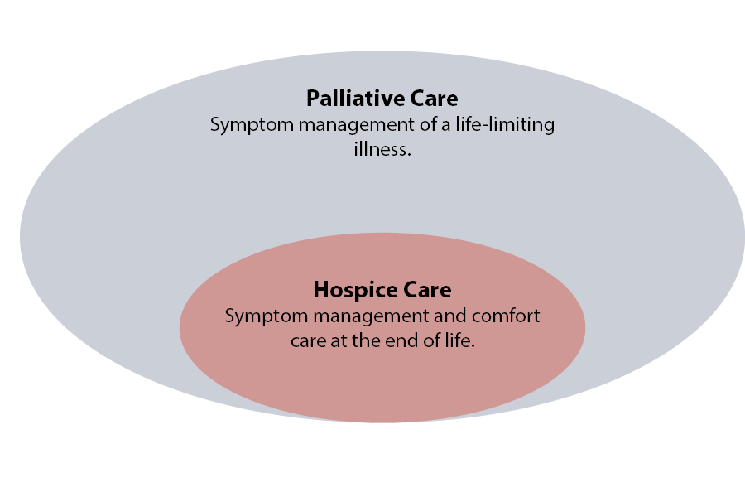
Understand care more about the quality of each day…..

Slide 57
Research Evidences

Slide 58
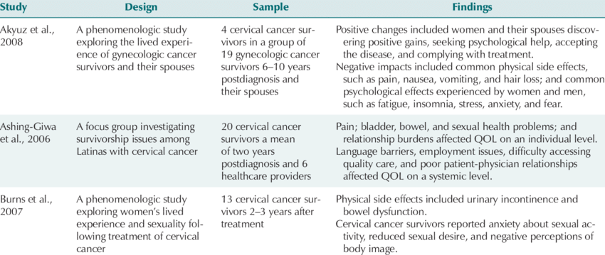
Quality-of-Life (QOL) Studies With Cervical Cancer Survivors

Slide 59
Assessing QoL in CVS

Slide 60
Quality of life among elderly in a rural area Vijaiyalakshimi Praveen, Anitha Rani M
Background: Quality of life (QOL) among elderly is an important area of concern which reflects the health status and well-being of this vulnerable population.. For India, the population of above 60 years was around 7% in 2001, which is expected to rise to 11.6% by 2026.
Methods:A community based cross-sectional study was conducted among 50 elderly subjects exiting the primary health centre at Nemam, Thiruvallur district, Tamilnadu. Data on QOL was assessed by WHO questionnaire (WHO QOL-BREF).
Conclusions:QOL score among elderly was found to be average. The scores of social relationship were low for both male and female elderly subjects. This implies an urgent need for health educating the elderly with regard to their social and physical group recreational activities that will build their self-confidence and thereby improving their QOL.

Slide 61
The WHO-QOL BREF
was used to assess the quality of life. The study showed that the elders living in the urban community reported significant lower level of quality of life in the domains of physical 51.2±3.6 and psychological 51.3±2.5 than the rural elderly populations. The rural elderly population reported significant lower level of quality of life in the domain of social relation 55.9±2.7 and environmental 57.1±3.2 than urban population.
The difference between the quality of life in rural and urban elderly population is due to the difference in the socio-demographic factors, social resource, lifestyle behaviors and income adequacy

Slide 62
Future views of QOL for Aging

Slide 63
Future views QOL in old age home
Develop community - based humanitarian minded research support group
Give prime importance to family - based rehabilitation
Systematic professional planning of their daily life
Improving the relationship between the inmates
Addressing loneliness of the inmates
Allow the inmates live with their partners
Give special name to each dormitory and make a leader for each dormitory

Slide 64
Future views QoL in old age home
Develop a Governing team from the inmates
Improving the infrastructure facilities
Improving community participation
Improvement of health care facilities
Improve the spirituality among the inmates
Make the old age home as set sufficient
Social work intervention of old age home
A Trained social worker can perform their roles in

Slide 65
How can we improve the quality of end-of-life care in the world?
Recognizing end-of-life as a global public health and health system problem
Capacity strengthening
Information strategies

Slide 66
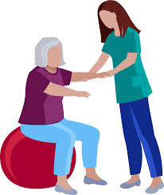
Conclusion
Aging people seek time, attention, care and support.
Therefore, social support is essential to enhance well being and quality of life of aging people

Slide 68
THANK YOU!!

