Slide 1
ANNUAL REPORT 2018-2019
Students’ Admission
Result Analysis
Placement
Research Publication and Funding
Mou & Collaborations
Extension Activity and Faculty ,Student Achievement
Departmental Activities
CnE
Roadmap 2019-2020
Glimpses of College Activities
Smt. Nagarathnamma School and College of Nursing

Slide 2
Program details
Sl.No | Yr of Estd. | Programme | Duration | Sanction Intake by Apex Body | Student Admitted 2018-2019 | Tot. Sts. on Roll
1 | 2003 | B.Sc Nursing [Basic] | 4 year | 60 | 60 | 265
2 | 2010 | B.Sc Nursing [Post Basic] | 2 year | 25 | 00
3 | 2008 | M.Sc in Nursing Medical surgical Nursing Obst & Gyne Nursing Pediatric Nursing Psychiatric Nursing Community Health Nursing | 2 year | 25 [each 5] | 01
4 | 2003 | DGNM | 3 Year | 60 | 56

Slide 3
Pass Percentage
S.N | Components | Program | Academic Year 2017-2018
 |  |  | 1 Yr | Pass% | 2Yr | Pass % | 3rd Yr | Pass % | 4th Yr | Pass %
1 | Tot. No of students appeared | M.Sc N | 02 | 100 | 02 | 100 | -- | - | - | -
2 | Tot. No of students appeared | DGNM | 17 | 100 | 13 | 100 | 13 | 100 | - | -
3 | Tot. No of students appeared | P.B.B.Sc | 00 | -- | 02 | 100
4 | Tot. No of students appeared | B.Sc N | 41 | 85 | 30 | 99 | 17 | 100 | 16 | 100

Slide 4
RESEARCH PROJECTS AND PUBLICATIONS
Sl.No | Name of the Department | Projects | Publication
1. | Medical –Surgical Nursing | University Grants Applied:1 Faculty Projects:3 Student Project :PG:01:UG:04 | 02
2. | Community Health Nursing | University Grants Applied:1 Faculty Projects :1 Student Project :PG:0:UG:01 | 19
3. | Child Health Nursing | University Grants Applied:1 Faculty Projects:3 Student Project :PG:0:UG:01 | 02
4. | OBG | University Grants Applied:1 Faculty Projects:01 Student Project :PG:1:UG:01 | 01
5. | Mental Health Nursing | University Grants Applied:1 Faculty Projects:02 Student Project :PG:0:UG:01 | 06

Slide 5
RESEARCH THRUST AREAS
Sl.No | Name of the Department | Research Thrust Area | INNOVATION IN TEACHING
1. | Medical –Surgical Nursing | NUTRITION Aging with Umes University ,Sweden | SIMULATION PBL OSCE FIPPED CLASSROOM MICRO TEACHING e –Learning
2. | Community Health Nursing
3. | Child Health Nursing
4. | OBG
5. | Mental Health Nursing
Faculty and Student Exchange –Umes University

Slide 6
    PLACEMENT last 2 year
Name of the Organization | Year | Tot. Students
HCG Consultant | 2016-2017 | 01 in B.Sc[N] & 01 in GNM
Vyedhi Institute of MedicalSciencse Bangalore | 2016-17 | 01 B.Sc[N]
BRS | 2016-17 | 01 From B.Sc[N]
Columbia Asia Hospital | 2017-2018 | 04

Slide 7
    Affiliated Hospital
Dr.Ambedkar Medical College and Hospital, Bengaluru
ESIC Hospital ,Peenya, Bengaluru
Sapthagiri Institute of Medical science and Hospital
DHO for Primary Health Centre of Urban and Rural area for Community Training
Victoria and Vanivilas and KIDWAI Hospital
CND-Centre for Nursing Development for Joint Programme and faculty development
Old age Home ,Hospice car Centre and Rehabilitation Centre for Extension and Outreach Community Services
Adopted Village and School for Extension Activity Selected NGOs for Community Out reach Programme

Slide 8















SNCN Placement : Corporate, MNC, Consultancy ,Marketing & Placement agencies
RA Infotech
SAGITUS solutions Pvt. ltd

Slide 9
ACHIEVEMENTS
International seminar 02
State level seminar 01
Field visits 09
Educational tour 01
Administrative visits 03
CNEs 02
Continuous nursing
development (CND) 05
Faculty development
Programme 02
Faculty workshops
conferences (attended) 08
Departmental seminars 05
Journal presentations- 21
Placement activity 02
Workshops 01
SNA programmes 08
Research and Publication
Research events 02
Advanced Research methods
Poster presentation awards 01
research workshop 02
Extension Activity
NSS programmes 21
Women’s cell 04
Community outreach
programmes 05

Slide 10
DEPARTMENT OF MENTAL HEALTH NURSING
Activities /Seminar /projects of the Academic year 2018-19
Sl.no: | Date | Name of the activity/event | Place | Resource person | Beneficiaries | No : of Beneficiaries
1. | 21.9.18 | World Alzheimer’s Day | Hesaraghatta | Issued Pamphlets | General Public | 50+
2 | 2.10.18 | National Antidrug Addiction day | Acharya Institutes | Dr. Sujendra Prakash | Student of Acharya Institutes | 300+
3 | 10.9.18 | World Suicide Prevention day | Acharya Institutes | Dr. Benny Prasad Mrs. Zanbeni | Student of Acharya Institutes | 500
4 | 10.10.18 | World Mental Health day | Acharya Institutes | Dr. Divya Nallur | Student of Acharya Institutes | 300+
5 | 26.3.19 | Departmental Seminar on Adolescence Mental Health and Challenges | Smt. Nagarathnamma SON & CON | Mr. Albert PJ | Nursing Student of Acharya Institutes | 150+

Slide 11
6 | 10.3.19 | No Smoking Day | Spandana Hospital | Health Education By students | Residents of Spandana Hospital | 60+
7 | 31.5.19 | World No Tobacco day | General Public | Education by distributing Posters | General Public | 50+
8 | 25.7.19 | Substance Abuse Day | Abbigere High School | Exhibition | High School Children | 100+

Slide 12
DEPARTMENT OF OBG
Activities /Seminar /projects of the Academic year 2018-19
Date | Name of the activity/event | Place | Resource person | Beneficiaries | No : of Beneficiaries
17.2.2018 | Departmental seminar on assisted reproductive technology and the legal issues | Seminar Hall | Mrs. Athulya Joseph | I Year B.Sc, M.Sc, GNM, IV year B.SC and III Year GNM | 80
2.8.2018 | Breast feeding week | Abbigere PHC | Mrs. Manjula T | Antenatal and postnatal mothers | 50
14.11.2019 | Antibiotic awareness week | Acharya campus | Mrs. Manjula T | Acharya institutes and polytechnic students | 25
6.2.2019 | International day for zero tolerance to female genital mutilation awareness week | Seminar Hall | Mrs. Manjula T & I year M.Sc student | II year M.Sc, IV year B.Sc and III year GNM | 35
13.2.2019 | Sexual and Reproductive health awareness week | Seminar Hall | Mrs. Manjula T | I And II year M.Sc, IV year B.Sc and III year GNM | 30
28.5.2019 | International day of action for women’s health | ESIC Hospital | Mrs. Afrin Banu & Mrs. Kavita Reddy | Postnatal mothers | 30

Slide 13
DEPARTMENT OF PEDIATRIC NURSING
Activities /Seminar /projects of the Academic year 2018-19
Sl.no: | Date | Name of the activity/event | Place | Resource person | Beneficiaries | No : of Beneficiaries
1 | 9.6.18 | Seminar | Seminar Hall | Ms. Christin Ninan | II ,III BSc and II GNM | 40
5 | 5/10/18 | Activity on awareness of cerebral Palsy | SIMS | Departmental Faculty | Postnatal Mothers/Parents | 25
6 | 14.11.19 | Children Day Celebration | Sasuvaghatta Anganwadi and primary School | Departmental Faculty | Children of primary School | 40
6 | 17.1.19 | Special childrens Health Camp | Nursing College | Dr. Immanuel Kenneth David and Dr. Mary | Children residing at Madrasas, construction sites and Government School, Sasuveghatta | 90
7 | 9.3.19 | Seminar | Seminar Hall | Dr. Jayashree | Law and child rights | 60
8 | 22.3.19 | Education on measles Awareness day | Chikkabanavara PHC | Departmental Faculty | Antenatal Mother | 30

Slide 14
9. | 25.3.19 | Downs Syndrome Awareness | Vanivilas Hospital | Departmental Faculty | Postnatal mothers | 30
10 | 2.4.19 | World Autism Awareness Day (WAAD) | Indira Gandhi Institute of Child health | Departmental Faculty | Mothers and parents | 10
11 | 17.4.19 | World Hemophilia Day | Indira Gandhi Institute of Child health | Departmental Faculty | Mothers and parents | 10
12 | 29.4.19 | World Immunization Day | Indira Gandhi Institute of Child health | Departmental Faculty | Postnatal mothers | 30
13 | 9.5.19 | World Thalassemia | ESIC | Departmental Faculty | Postnatal mothers | 20
14 | 18-19 | project | -- | Julianna | CTC- Personal Hygiene
15 | 18-19 | project | - | Kusum | ADHD

Slide 15
CONTINUING NURSING EDUCATION OF THE ACADEMIC YEAR 2018-2019
Sl.no | Date | Topic | Journal | Faculty | No: of Beneficiaries
1. | 1.8.18 | Contagious complexity later on abdominal labour direction about extent danger components with diagnosis at the tertiary wellbeing care | International Journal of Obstetrics and Gynecology Nursing | Mrs.Chitra .G Dept.Of OBG | 10
2. | 4.8.18 | Assess the effectiveness of STP regarding prevention and control of Rabies among high school children. | Community & Public Health Nursing | Mrs.Elaiyarasi Dept.of Community Health Nursing | 11
3. | 4.8.18 | The middle east respiratory syndrome (MERS)- The threat to Asian Countries | Indian Journal of Nursing Science | Mrs.Deepthi Dept of MSN | 11
4. | 7.8.18 | Assess the knowledge on disaster preparedness and family disaster kit | Asian Journal of Nursing Education | Mr.Rahul Shil Dept.of MSN | 12
5. | 9.8.18 | Antibody consolidation and radioimmunoassay in to the infants along rhinitis eczema in tertiary care hospitals in Chennai | International Journal of Pediatrics | Mrs.Kavitha Reddy Dept.ofCHN | 12
6. | 16.8.18 | Develop and validate post operative nursing handover checklist for patients undergone general surgery in a teaching hospital of Navi Mumbai | Innovational Journal of Nursing and Health care | Mr.Swamy PGN Dept of Community Health Nursing | 12
7. | 23.8.18 | Association of aggression between tattooing and body piercing among college goinf women. | Indian Journal Of Psychiatric Nursing | Mrs.Mercy Dept . of MHN | 13

Slide 16
8. | 6.9.18 | Investigation for assessing dengue in children with their clinical presentations | Journal of Advanced Nursing practice | Mrs.Amba Dept.of Child Health Nursing | 09
9. | 14.9.18 | Simulation Training improves team dynamics and performance in a low resource cardiac intensive care units | Annuals of pediatric cardiology | Mrs.Marium Jaisy Dept.of Child Health Nursing | 12
10. | 21.9.18 | Introduction to Indian Journal of Rehabilitation & mental health –Rehabilitation of Mania patients in Greece | Indian Journal Of Psychiatric Nursing | Mrs.Serah Rashmi Dept . of MHN | 10
11. | 1.10.18 | Assessing the knowledge on health promotion among primary school children in selected rural schools of Udupi . | The nursing Journal of India | Mrs.Kapu Manjula Dept . of MSN | 13
12. | 31.10.18 | Communication skills intervention : Promoting effective communication between nurses and mechanically ventilated patients | Indian Journal of Nursing Sciences | Mrs.Manjula .T Dept.of OBG | 08
13. | 01.12.18 | Co-relating over weight and academic performance among school children | Nightingale Nursing Times | Mrs.Kavitha Reddy .G | 12
14. | 01.12.18 | Prevalence of disability among adult population at Maraimala. | Community and public health nursing | Mrs.Elaiyarasi Dept.of Community Health Nursing | 12
15. | 03.12.18 | The relationship between fluid resuscitation & intra –abdominal HTN in patients with blunt abdominal trauma | International Journal of critical illness injury science | Mr.Rahul Shil Dept.of MSN | 09
16. | 03.12.18 | The resilience and quality of life of people with mental illness attending psychiatric rehabilitation centre | Indian Journal Of Psychiatric Nursing | Mrs.Mercy Dept. of MHN | 10

Slide 17
17. | 04.12.18 | Perception about childhood obesity & over weight among parents and children | Indian Journal of Continuous Nursing Education | Mrs.Gincy Samuel Dept.of MSN | 11
18. | 06.12.18 | Burden of caregivers of patient suffering from cancer | Journal of Advanced Nursing Practice | Mr.Amba .V Dept. of Child Health Nursing | 10
19. | 06.12.18 | Clinical profile and outcome of patients with organophosphorus poisoning admitted at parava rural hospital –A prospective study | Indian Journal of Surgical Nursing | Mrs.Radhika Dept .of MSN | 10
20. | 12.12.18 | Effectiveness of VATP in terms of knowledge and attitude regarding assistive respiratory home care | Indian journal of Nursing Sciences | Mrs.Deepthi | 05
21. | 13.12.18 | Coping strategies used by parents of mentally challenged children. | Indian Journal of Nursing studies | Mrs.Marium Jaisy Dept.of Child Health Nursing | 10
22. | 31.12.18 | Applying scope to measure social inclusion among people with mental illness in Poland. | Journal of Psychosocial Rehabilitation and Mental Health | Mrs.Serah Rashmi Dept.of MHN | 09
23. | 31.12.18 | Prevalence of Hepatitis B surface antigen and anti hepatitis B core antibodies among blood donors | Asian Journal of Nursing Education and Research | Mrs.Elaiyarasi Dept.Of CHN | 09
24. | 05.01.19 | Headache among nursing staff | Indian Journal of Continuing Nursing Education | Mrs.Gincy Samuel Dept.of MSN | 11
25. | 05.01.19 | Assess the effectiveness of VATP on knowledge regarding road traffic accidents and related first aid measures among school children | Indian Journal of Nursing Sciences | Mrs.Kapu Manjula Dept. of MSN | 11

Slide 18
26. | 02.02.19 | Effectiveness of VATP on knowledge and attitude of college students on HIV /AIDS | Indian Journal of Nursing Sciences | Mrs.Manjula.T Dept.of OBG | 10
27. | 08.04.19 | True experimental study to assess the effectiveness of oral ice cubes for the prevention of oral mucositis among patients receiving chemotherapy in the selected hospital ,Maldives | Indian Journal of Nursing Sciences | Mrs.Kapu Manjula Dept.of MSN | 10
28. | 08.04.19 | Activity based group intervention in improving negative symptoms for all outcome in patient’s with chronic Schizophrenia in welfare homes | Journal of Psychosocial Rehabilitation | Mrs.Serah Rashmi Dept .of MHN | 10
29. | 27.4.19 | Effectiveness of PTP on knowledge regarding prevention of nosocomial infection | Indian Journal of Nursing Sciences | Mrs.Manjula.T Dept.of OBG | 07
30. | 27.4.19 | Effectiveness of family support groups in improving the coping levels & strategies adopted by widows affected by Tsunami | Indian Journal of Continuing Nursing Education | Mrs.Gincy Samuel Dept.of MSN | 07

Slide 19
31. | 17.4.19 | Study of G6PD deficiency in new born in a tertiary care centre at Assam | Journal of Advanced Nursing practice | Mrs.Amba Dept.of Child Health Nursing | 09
32. | 17.4.19 | Validation of the necessary of hand held echo cardiograph HHE for diagnosis of congenital heart disease | Annuals of Pediatric cardiology | Mrs.Marium Jaisy Dept.of Child Health Nursing | 10
33. | 18.6.19 | Air pollution and respiratory dysfunction among adolescents : a case control study from north west India | Indian Journal of allergy , asthma & immunology | Mr.Swamy.PGN Dept of Community Nursing | 09
34. | 18.6.19 | Study to assess the influence of social media on health behavior among college students at selected engineering college , Coimbatore | International Journal of critical illness injury science | Mr.Rahul Shil Dept.of MSN | 09
35. | 19.6.19 | Effectiveness of PTP on care of mentally challenged children among care takers working in selected district hospital. | International Journal of Advances in nursing management | Mrs.Kavitha Reddy Dept.of CHN | 11
36. | 19.6.19 | Effectiveness of ice cubes for the prevention of oral mucoritis among patients receiving chemotherapy in the selected hospital. | Indian Journal of nursing sciences | Mrs. Baby Rani Dept.of MSN | 11
37. | 22.6.19 | Assess the level of satisfaction among adult patient with regard to medical & surgical emergency services , Chandigarh | Journal of Nursing science & practice | Mr.Manohar.PL Dept.of MHN | 10
38. | 22.6.19 | Effectiveness of STP on knowledge regarding administration of emergency drugs to patients among nursing students at selected nursing colleges. | Journal of Nursing science & practice | Mrs.Deepthi .M Dept.of MSN | 10
39. | 29.6.19 | To evaluate the effectiveness of aerobic exerices on stress among alcohol dependents in selected de addiction centres in Tamil Nadu | Nightingales Nursing Times | Mrs.Kusum Dept of MSN | 08
40. | 29.6.19 | Psychological problems & burnout among medical professionals of a tertiary care hospital of North India –a cross sectional study | Indian Journal of Psychiatry | Ms.Jega Jeraldin Dept.of MHN | 08

Slide 20
DEPARTMENT of Community
Activities /Seminar /projects of the academic year 2018-19
Sl.no | Date | Name of the activity/event | Place | Resource person | Beneficiaries | No : of Beneficiaries
1 | 03.11.2018 | ORS Day | Community Area around the Acharya Campus | Community Awareness Program on Preparation of ORS for Preventing Diarrhea | Mothers of Under five children. | 40 mothers
2 | 12.11.2018 | Malaria Day Report (Theme – Ready to beat Malaria) | Community Area around the Acharya Campus | Awareness to general public | 4th B.Sc Nursing students and general public | 105 no’s
3 | 14.11.2018 | World Rabies Day (Theme: Share the message. Save a life) | Community Area around the Acharya Campus | Survey of risk and Health education | 4th B.Sc Nursing students and general public | 100 no’s
4 | 01.12.2018 | World Aids Day | AIT Auditorium | Awareness by Prof. Devi Nanjappan, Principal & Mrs. Elaiyarasi S, Asst. Professor | All Faculty and students of Smt. Nagarathnamma School & College of Nursing and Parents, | 170 Members
5 | 02.12.2018 | National Pollution Prevention Day. | Govt. School premises, Abbigere | Sapling plantation under the coordination of NSS officer | NSS volunteers (I GNM) & School children | 80 no’s
6 | 31.01.2019 | World Leprosy eradication Day | Lerprasorium | Visit to Central Lerprasorium and Awareness | IV B.Sc Nursing and III GNM | 19 B.Sc Nursing & 13 GNM students and 90 Leprosy patients

Slide 21
7 | 10.02.2019 | National Deworming Day | SNCON | Distribution Of Deworming Tab. Albendazole to all. | Faculty and Students of SNCON | 60 students and 10 faculty
8 | 24.03.2019 | World TB Day in association with Karnataka State Tuberculosis Unit | BMCRI. Rally from BMCRI to KR Market followed by street plays. | Dr. Somashekar, Director, National Tuberculosis Institute, Dr. Prabhakar, | II Year B.Sc(N), II & III Year GNM students | 70 Students and 1000 general public
9 | 22.04.2019 | Earth Day on the theme Save Mother Earth | PHC Chikkabanavara, Bengaluru | Awareness to general public | III GNM students | 50 no’s
10 | 25.04.2019 | World Malaria Day | PHC Abbigere | Awareness to general public through Rally and | General public and Students | 60 no’s
11 | 24.04.2019 to 30.04.2019 | World Immunization Week | Janatha Colony, PHC Chikkabanavara and PHC Abbigere Bengaluru | Active participation in Immunization, Health Education and Awareness programme | General public and Students | 32 students,120 Houses in Janatha Colony and 80 mothers at PHC’s
12 | 06.06.2019 | World Environmental Day -“NURTURE THE NATURE” | 200 mango plantations done at bio diversity park, IIHR. | Mrs. Salumarada Timmakka, Padmashree Awardee by GOI, | Final Year students of B.Sc Nursing, II B.Sc N students | 52 students participated

Slide 22
Smt. Nagarathnamma College of Nursing
NSS Activities of the academic year 2018-19
Sl.No | Date | Name of the activity/event | Place | Resource person | Beneficiaries | No : of Beneficiaries
1 | 01.10.2018 | World Blood Donation Awareness Day | Achith Nagar, Acharya Campus, Bengaluru | Distributing pamphlets and creating awareness | NSS volunteers (III GNM) and General public | 63 No’s
2 | 02.10.2018 | Gandhi Jayanti | AIT - Mechanical Dept. Auditorium | 150th birth anniversary of Mahatma Gandhi is celebrated through Drawing competitions, Skits, speech, quiz, and dance. | NSS volunteers (I st GNM & B.Sc Nursing) | 123 no’s
3 | 10.12.2018 | Human Rights day 2018 on theme “Stand Up for Human Rights”. | PHC, Abbigere | Awareness by health education and distribution of Pamphlets | NSS volunteers (I GNM) and General public | 80 No’s
4 | 10.12.2018 | International Volunteer Day- “Volunteers build Resilient Communities” | PHC, Abbigere | Dr.Somashekar, MO. | NSS volunteers (I GNM) | 56 No’s
5 | 15.12.2018 | A Walk against drug abuse | MalleshwaraGround | Participated in A Walk against drug abuse organized by Helping hearts in association with G-Group Company. | NSS volunteers (I B.Sc & GNM) and general public | 1000 No’s

Slide 23
8 | 12.01.2019 | National Youth day | SNCON | Prof. Devi Nanjappan, Principal | NSS Volunteers | 120 no’s
9 | 17.01.2019. | Special Health Camp | SNCON and Govt. Primary School, Sasuveghatta | Health Camp - consultation Dr. Emmanuel Kenneth David and Dr. Mary, Podiatrist, Baptist Hospital followed by Distribution of Free medicines. | Children of Construction workers, Madrasa School children and Govt. Primary school Sasuveghatta | 100 Children
10 | 07.04.2019 | World health Day | PHC Abbigere & Chikkabanavara and Janatha Colony, Chikkabanavara, | Demonstration of Hand washing & oral Hygiene, General health assessment and Health Education | NSS volunteers (II, IV B.Sc & III GNM) & General Public, | 140 no’s
11 | 21.06.2019 | International Yoga Day- One day workshop on theme Yoga with Gurus | SNCON | One day workshop on theme Yoga with Gurus | NSS volunteers (I B.Sc & GNM) | 123 No’s
12 | 26.06.2019 | Blood Donation Camp | Gandhi Bhavan, Bengaluru | National NSS Cell in association with Indian Red Cross | NSS volunteers (II & IV BSc Nursing) | 62 No’s participated and 17
13 | 29.06.2019 to 02.07.2019 | Three day TOT on Strategic Engagement of Young volunteers for NSS for Social & Behavioral change for rights of Children and Adolescents in Karnataka – NSS officers | Gandhi Bhavan, Bengaluru | Participated in TOT Organized by Karnataka state NSS cell in association with UNICEF & RGUHS | NSS programme officer | 25 No’s

Slide 24
ROAD MAP AY -2019-2020
Feedback and SWOT Analysis
Faculty profiling ERP
Administrative and Academic Audit
Faculty Review
Academic Planning 2020-2021
Alumni Meet
Career Counseling Program-1 no
Campus Placement drive
Faculty Exchange Programmes 1nos
NSS Residential Camp -1
Faculty enrollment for MOOC Courses [Min 2]
Funding Research Projects atleast 1Nos.
Budget Planning
Curriculum enrichment Program 2 No
CNE Programme @ SIM 14 No
Ifield Visit 09 Nos
International and national Workshop 1 No
Departmental Seminar-5 Nos
Certificate Course [Short] 2
E-Learning Courses -2 Nos.
MoU for Collaboration 1 no.
Student Exchange –Umes University ,Sweden
Value added Course 2 nos
ASNA Sport –
Clinical Linkages-Sapthagiri
Health Promotion Activities as per WHO Model for Vulnerable group
Academic Module B -annual @ ERP [Student assessment and Faculty Performance]
Apr-June
Oct-Dec
Jan-March
Jul-Sep

Slide 25
Glimpses of Activities

Slide 26
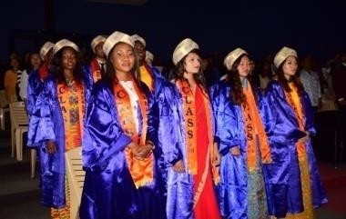
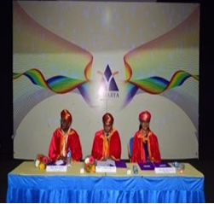
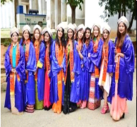
GRADUATION DAY - CLASS OF 2018

Slide 27
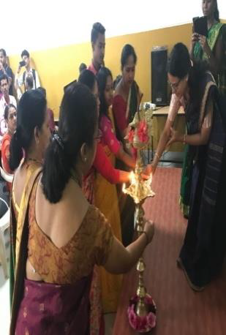
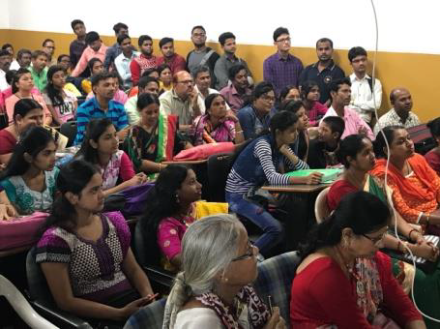
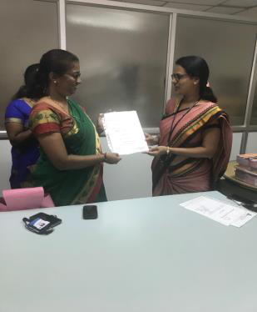
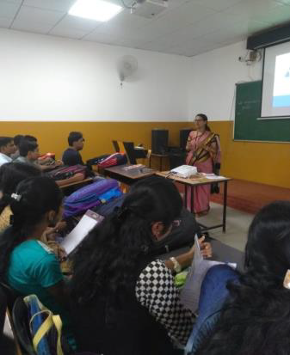
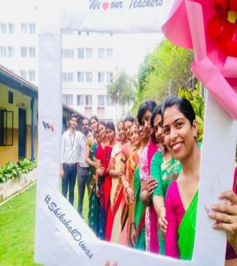
TEACHERS DAY

Slide 28
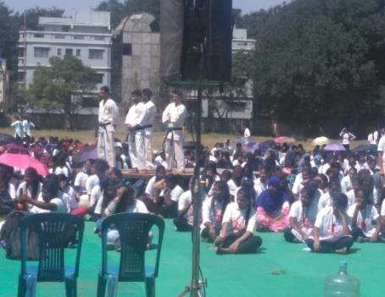
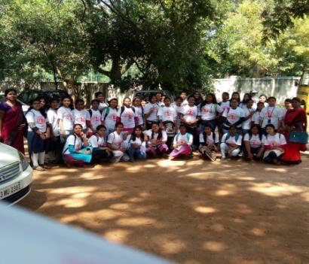
SELF DEFENCE CAMP

Slide 29
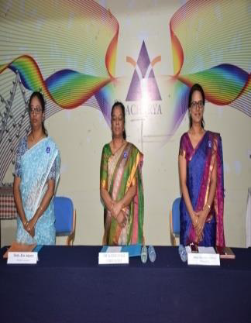
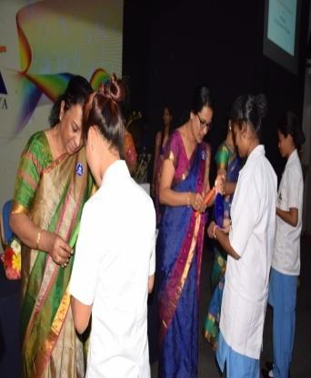
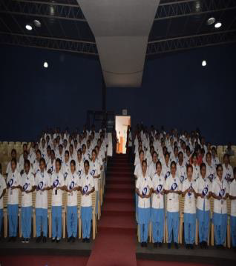
NURSING DEDICATION CECREMONY

Slide 30
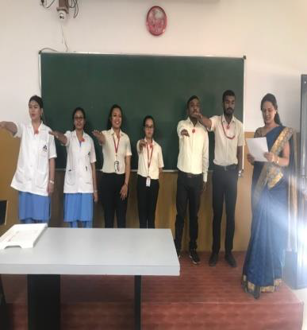
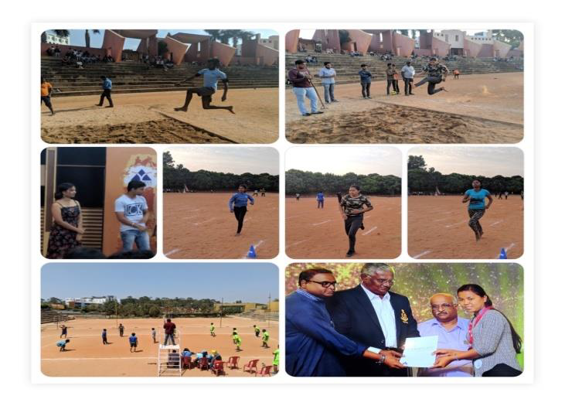
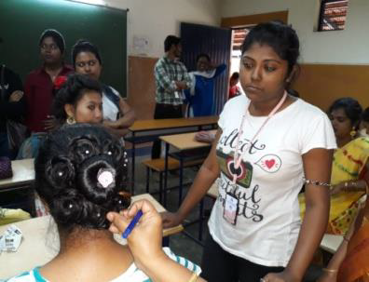
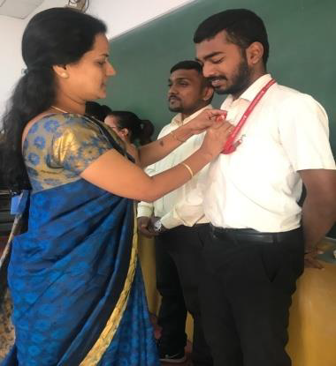
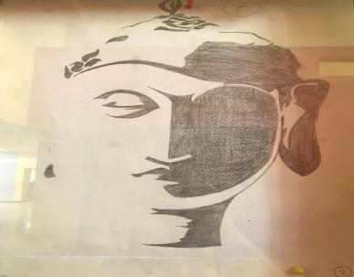
SNA SPORTS & CULTURALS

Slide 31
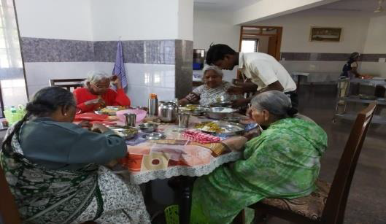
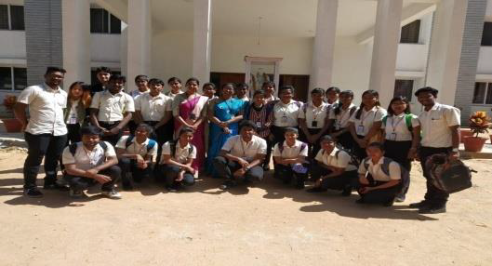
Smt. NAGARATHNAMMA JAYANTHI

Slide 32
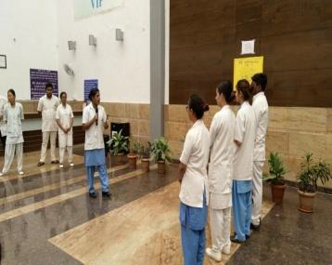
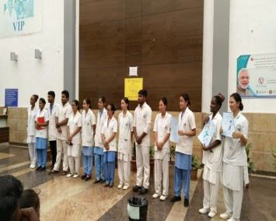
SWACHCHTA PAKHWADA
CLEAN INDIA MOVEMENT

Slide 33
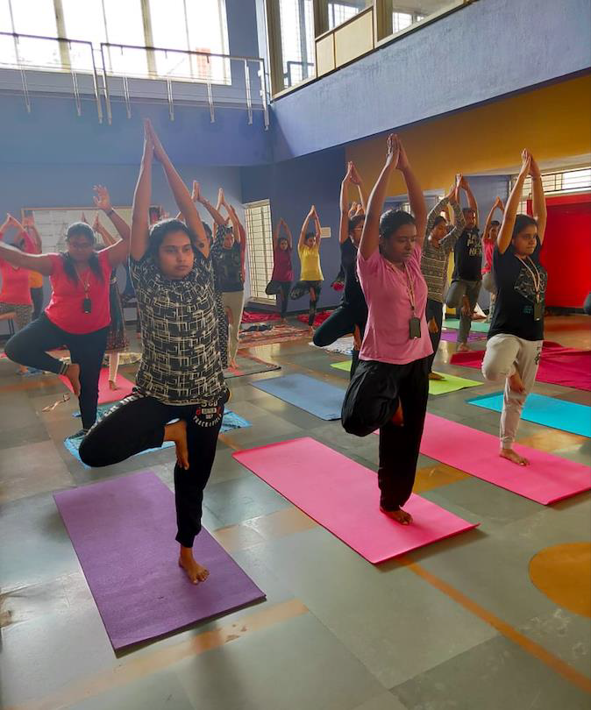
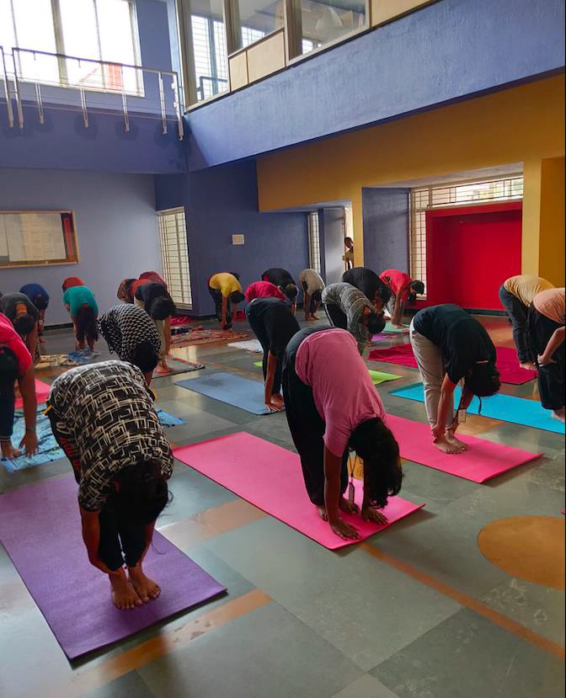
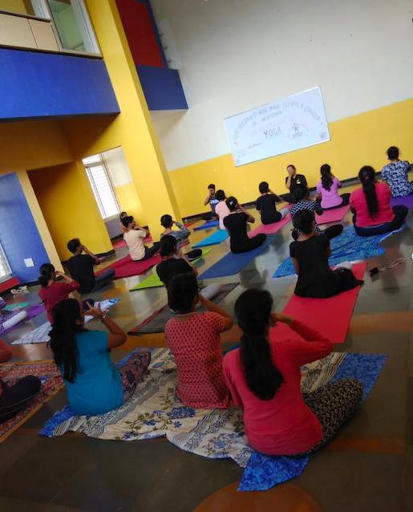
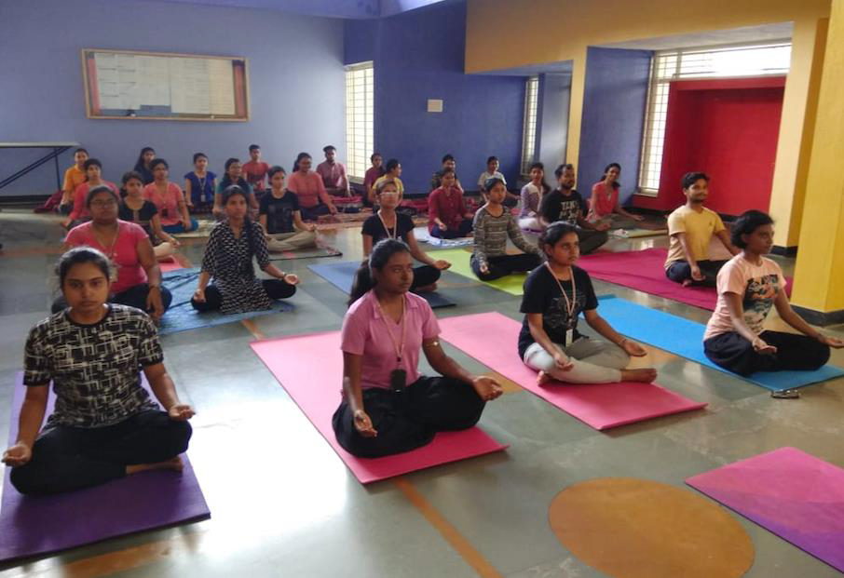
INTERNATIONAL DAY OF YOGA

Slide 34
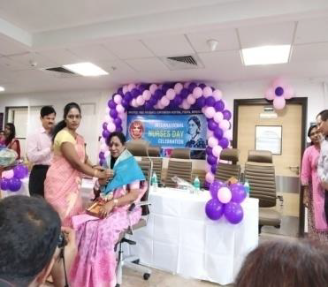
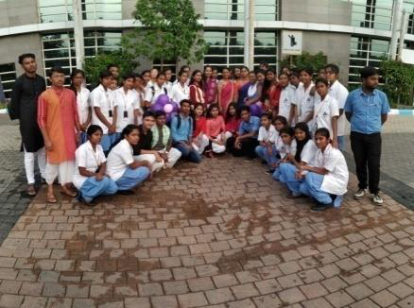
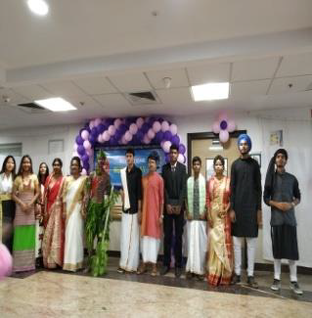
INTERNATIONAL NURSES DAY

Slide 35
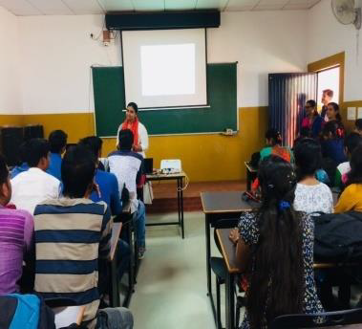
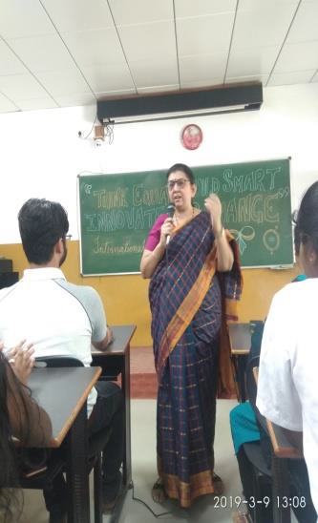
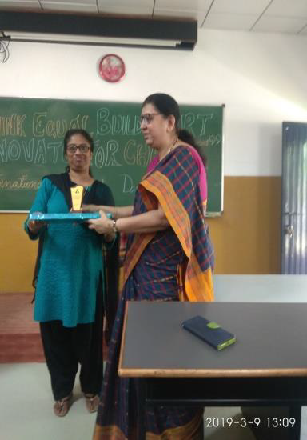
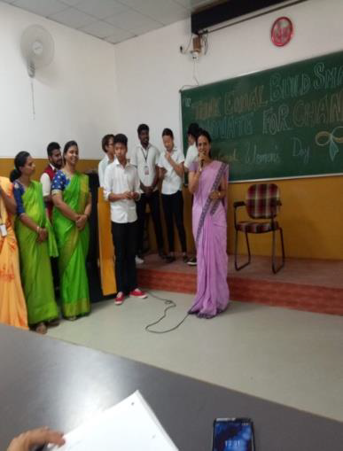
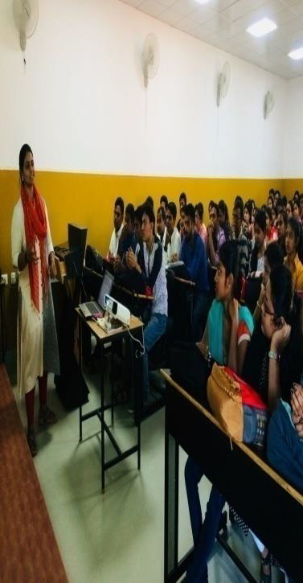
WORLD LITERACY DAY & INTERNATIONAL WOMEN’S DAY

Slide 36
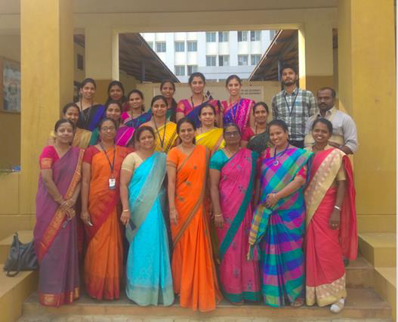
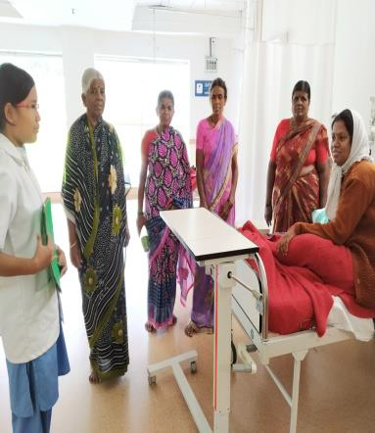
NURSING CAREER – A GATEWAY TO BRIGHT FUTURE

Slide 37
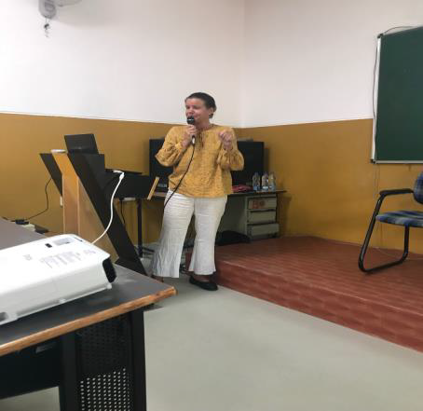
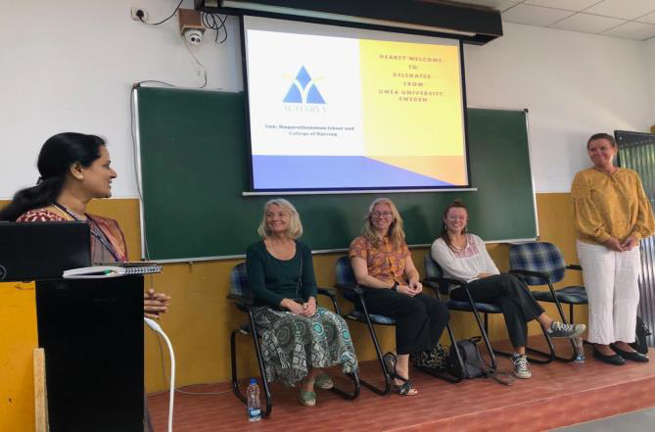
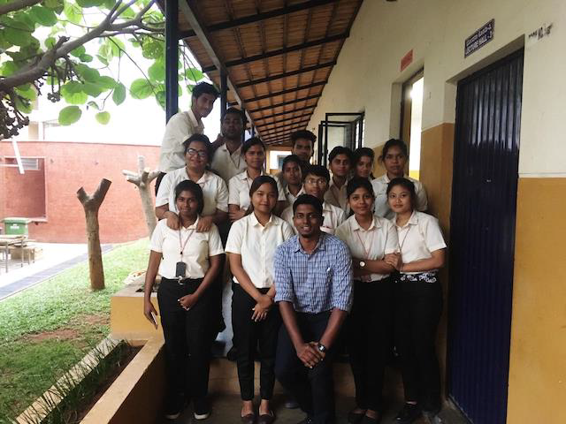
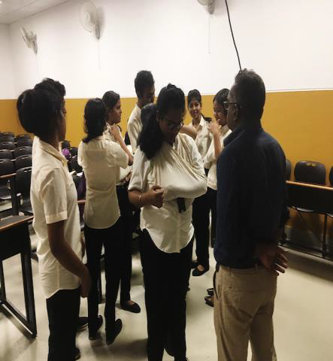
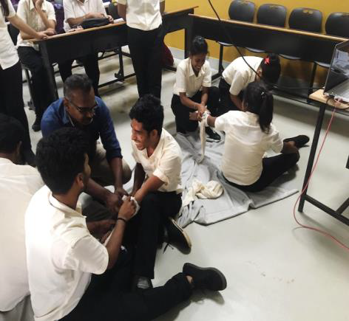
PRIMARY INITIAL ASSESSMENT IN TRAUMA CARE &
SKILL TRAINING WORKSHOP

Slide 38
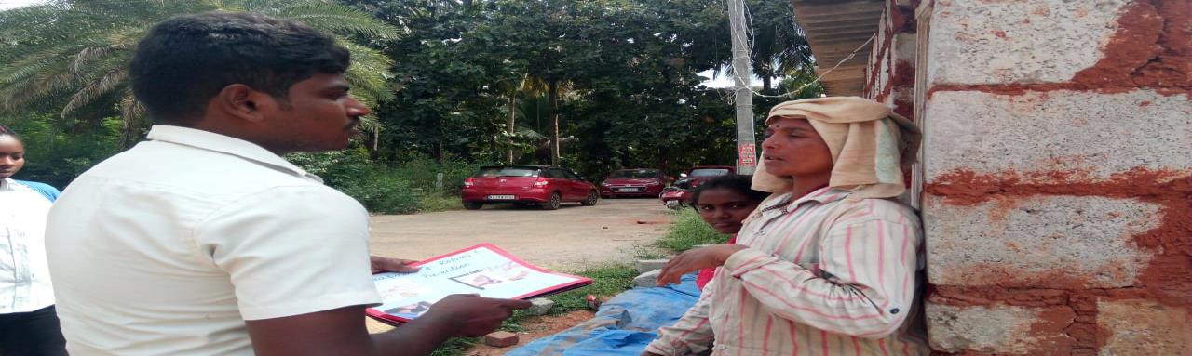
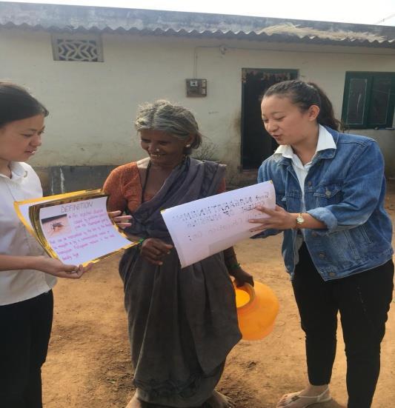
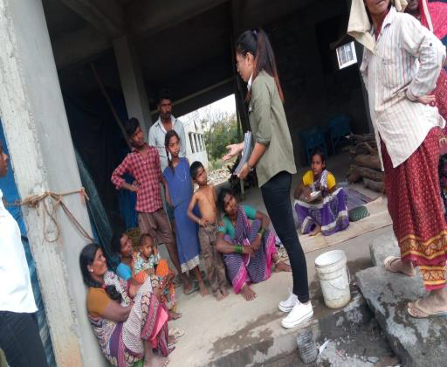
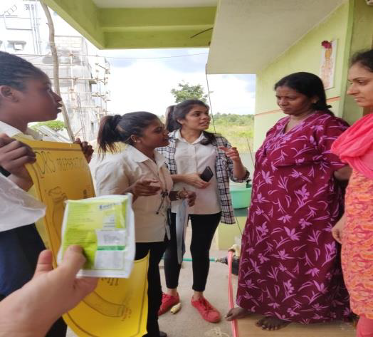
COMMUNITY AND OUTREACH ACTIVITIES

Slide 39
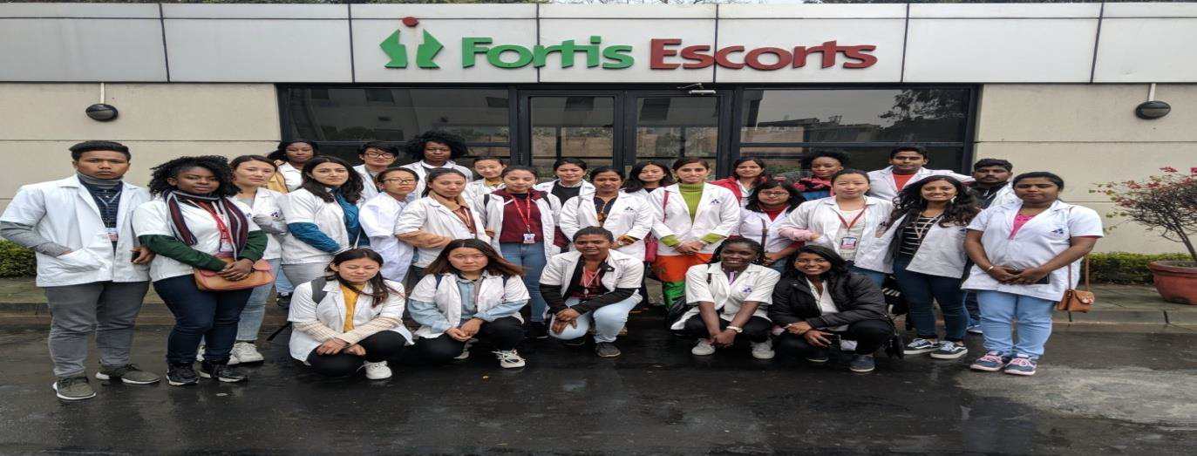
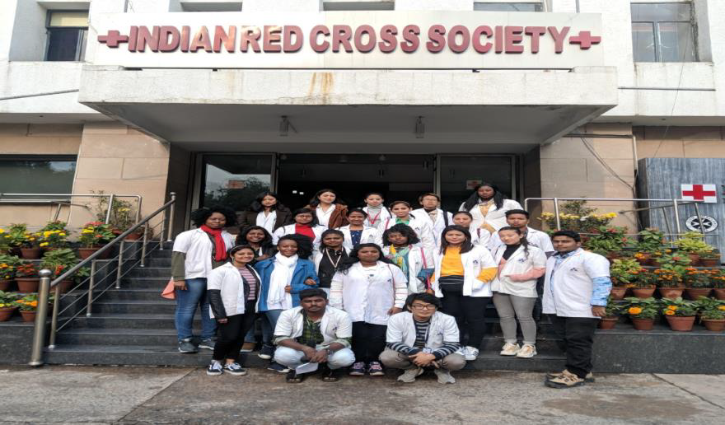
EDUCATIONAL VISIT FORTIS ESCORTS & INDIAN RED CROSS

Slide 40
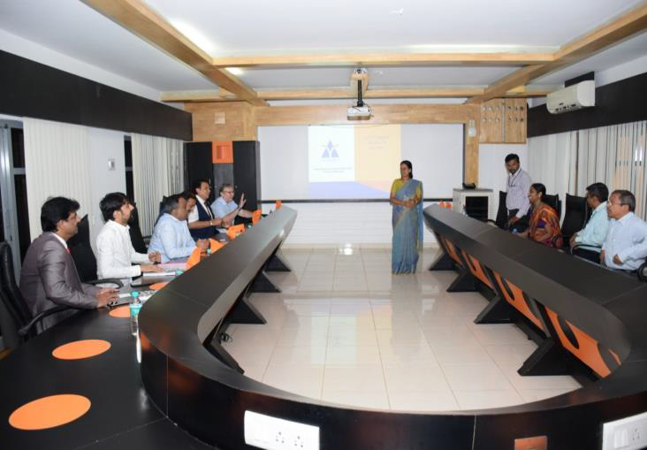
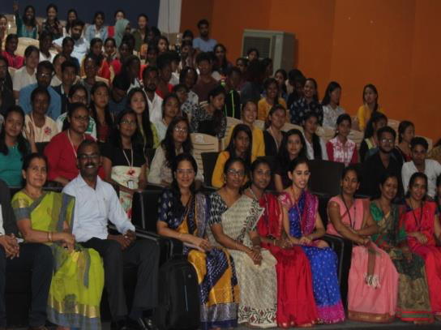
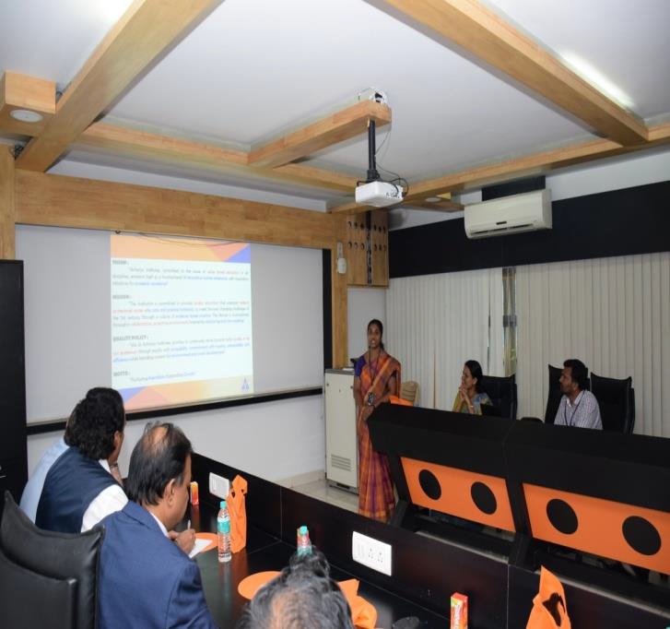
                FOREIGN UNIVERSITY VISIT & STATE LEVEL CONFERENCE

Slide 41



JOURNAL CLUB

Slide 42




ADMINISTRATIVE VISITS

Slide 43





FIELD VISITS

Slide 44





DEPARTMENTAL ACTIVITIES

Slide 45



AV AIDS EXHIBITION

Slide 46




FIRST AID TRAINING & BASIC LIFE SUPPORT

Slide 47





NSS ACTIVITIES

Slide 48





WORLD HEALTH DAY & WORLD ENVIRONMENT DAY

Slide 49




Farewell Batch of 2015-19

Slide 50
Thank You

