Slide 1
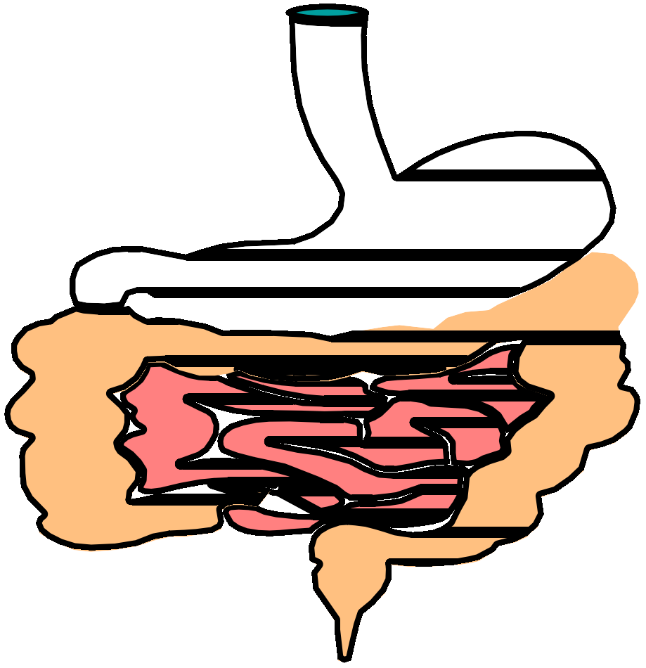
Constipation
By,
Kapu Manjula
Assistant Pofessor

Slide 2
What is Constipation?
Passage of hard, dry bowel movements, usually fewer than three times a week
Symptoms:
  painful bowel movements
  bloated
  uncomfortable
  sluggish

Slide 3
As a rule, if more than three days pass without a bowel movement, the intestinal contents may harden, and a person may have difficulty or even pain during elimination.
Straining during bowel movements or the feeling of
incomplete evacuation may also be reported as constipation

Slide 4
What are Some Common Misconceptions About Constipation?
that a bowel movement every day is necessary.
that wastes stored in the body are absorbed and are dangerous to health or shorten the life span.
These misconceptions have led to a marked overuse and abuse of laxatives.

Slide 5
Is Constipation Serious?
it may signal and be the only noticeable symptom of a serious underlying disorder such as cancer.
Complications
Hemorrhoids
Fissures

Slide 6
Constipation is a symptom not a disease.

Slide 7

What Causes Constipation?
Eating too little fiber
Not drinking enough liquids
Lack of exercise/physical activity

Slide 8


What Causes Constipation?
Change in routine
  travel
Older age
  Slower metabolism
Frequent use of laxatives
Certain diseases or conditions

Slide 9




What Causes Constipation?
–pain (narcotics)
–antacids containing aluminum
–antidepressants
–iron supplements
–diuretics (“water” pills)
Medications

Slide 10
Other causes
Imaginary constipation
Irritable bowel syndrome
Poor bowel habits
Hormonal disturbances
Pregnancy
Fissures and hemorrhoids
Mechanical compression

Slide 11

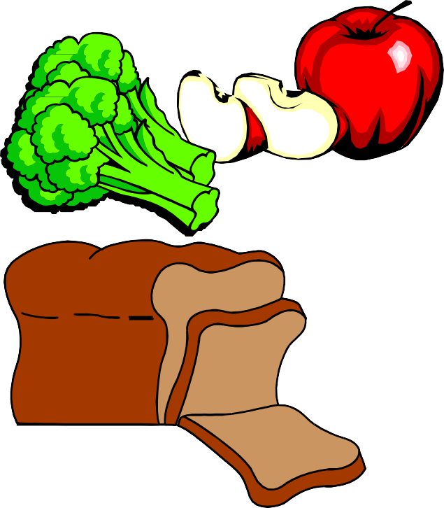
What Can You Do?
Eat more fiber
–More beans, whole grains and bran cereals, fresh fruits, vegetables
–Limit foods with no fiber (cheese, meat, sweets, processed foods)

Slide 12

What Can You Do?
Drink more water and other liquids
– Be sure to drink at least 8 to 10 glasses of water everyday
–Liquid helps keep the stool soft

Slide 13
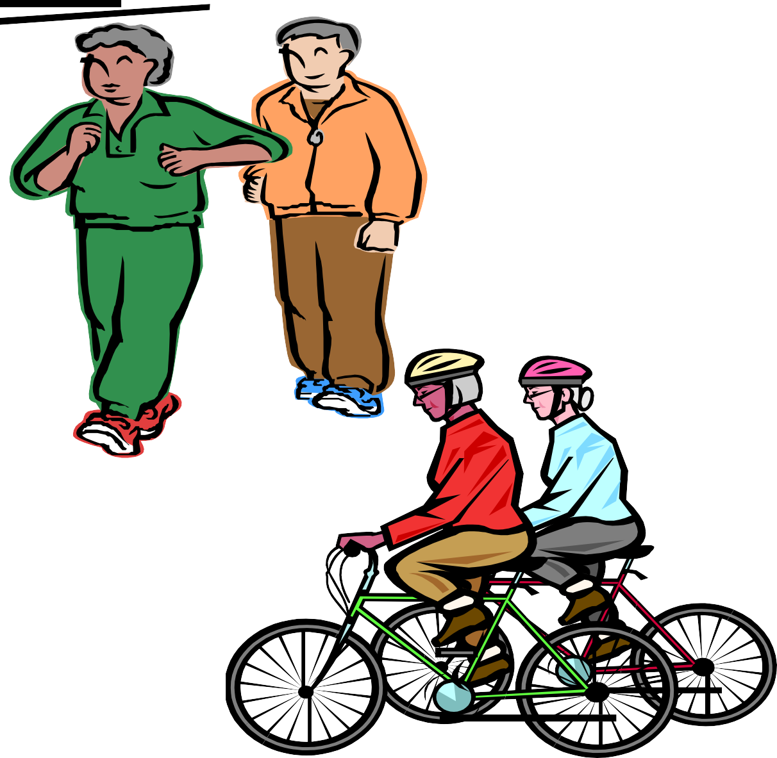

What Can You Do?
Become more physically active

Slide 14

What Can You Do?
Allow yourself enough time to have a bowel movement
–If you get in a hurry and ignore the urge to have a bowel movement, it can cause constipation

Slide 15

What Can You Do?
Fiber supplements are best choice
–Absorb water and make stool softer
–Safe to use everyday

Slide 16
What Can You Do?
Give laxatives only if really necessary
Laxatives can cause:
  Poor absorption of vitamins and minerals
  Loss of water, sodium and potassium
  Damage to your intestines

Slide 17
Pharmacological management
of constipation
Laxatives
Cathartics
Purgatives

Slide 18
Laxatives/cathartics/Purgative
Laxatives:
promote a soft stool Cathartics
Results in a soft to watery stool with some cramping
Purgative:
is a harsh cathartic causing a watery stool with abdominal cramping

Slide 19
TYPES OF LAXATIVES

Slide 20
According to their mode of action.
Bulk forming laxatives
Osmotic laxatives
Stimulant laxatives
Fecal softeners and lubricants

Slide 21
Bulk forming

Slide 22
Bulk forming laxatives
Natural: plant gum: agar, psyllium, and bran.
Synthetic: cellulose compounds
methylcellulose and carboxy methylcellulose.
Polysaccharide polymers

Slide 23
MOA
Absorb water into the intestine increasing fecal bulk and peristalsis
Dissolve or swell in the intestines
------- stimulate peristalsis

Slide 24
Onset of action: 8-24 hours
Peak action: 3 days

Slide 25
not absorbed from the intestines into the body safe for long-term use.
The benefits of bulk-forming laxatives are
safe for elderly patients.
Helpful in patients with irritable bowel syndrome, diverticulosis, and colostomies.

Slide 26
Precaution
Should be mixed in a glass of water or juice, stirred and drunk immediately followed by a half to a full glass of water.
Why with water or juice?
Because
Insufficient fluid intake cause the drug to solidify in GI tract results in intestinal obstruction

Slide 27
----- may not be appropriate for patients who must restrict oral fluid intake (such as patients with kidney failure).
Precautions for using bulk-forming laxatives.
Patients with narrowing of the digestive tract (including esophageal stricture, intestinal stricture, or severe adhesions)
----- risk of blockage of the intestine or the esophagus.

Slide 28
Osmotic laxatives

Slide 29
Osmotic laxatives
Include
Salts or saline products
Lactulose
glycerin

Slide 30
Osmotic laxatives
Glycerin
Lactulose
Saline products
Magnesium citrate
Magnesium hydroxide (milk of magnesia)
Magnesium oxide
Magnesium sulphate
Sodium biphospahte (Kleen enema)
Sodium phosphate

Slide 31
MOA
Hyperosmolar salts or saline products :
insoluble, remain in lumen pull water into colon and increase water in the feces to increase bulk – increase peristalsis
Lactulose:
draws water into intestine and promotes water and electrolytes retention
Decreases serum ammonia level Glycerin
acts like Lactulose increases water in the feces in large intestine

Slide 32
Therapeutic Uses
Preparation of bowel for colonoscopy, sigmoidoscopy, and barium enema.
Lactulose: liver disease (Hepatic encephalopathy)

Slide 33
SIDE EFFECTS
HYPERMAGNESEMIA :
drowsiness, weakness, paralysis, complete heart block, hypotension, flushing, respiratory depression.
Lactulose :
flatulence, diarrhea, abdominal cramps, nausea, vomiting, disturbance in diabetes

Slide 34
Precaution
Patients with congestive heart failure, kidney disease, and high blood pressure, should not use laxatives that contain sodium.

Slide 35
Stimulant or Irritant laxatives

Slide 36
Stimulant or Irritant laxatives
Castor oil Anthraquinone:
Senna
Cascara sagrada Diphenylmethanes
Bisacodyl
Phenophthalein

Slide 37
MOA
Increasing water and electrolyte secretion by the mucosa
By increasing peristalsis ---- by stimulating sensory nerve endings in GI mucosa

Slide 38
The feces are moved through the bowel too rapidly to allow colonic absorption of fecal water so a watery stool is eliminated

Slide 39
Bisacodyl (Dulcolax)
Can be given: orally , suppository or enema.
Onset of action
Oral form : 6 to 10 hours.
Suppository: 15 to 30 min

Slide 40
Senna,Cascara
sagrada, Aloe
Drug passes unchanged into the colon
bacteria
laxatives into active
compounds (anthracene derivative emodin).
The active compounds then absorb and have a direct stimulant effect on myenteric plexus ------
----------------------- contraction of colon muscles.
Onset of action: 6 to 8 hours.

Slide 41
Castor oil
Is hydrolyzed in upper small intestine to ricinoleic acid a Local irritant that increases Intestinal motility
Onset of action: usually within 2 to 6 hours.

Slide 42
Therapeutic Use
Cleansing the colon for colonoscopies, barium enemas, and intestinal surgeries.

Slide 43
Side effects
Phenophthalein: Nausea, abdominal cramps,
weakness, reddish brown urine)
Bisacodyl: Fluid and electrolyte imbalance
(Potassium and calcium) Mild cramping, and diarrhea
Castor oil: stimulates uterine contraction ---- spontaneous abortion
Senna: damage nerves--- loss of intestinal muscular tone

Slide 44
Precaution
Chronic, long-term use of stimulant laxatives can lead to:
loss of colon function (cathartic colon).
Consequently, constipation becomes increasingly worse and unresponsive to laxatives.

Slide 45
Stool softeners / Lubricants

Slide 46
Stool Softeners (Emollient laxatives)
The active ingredient in most stool softeners is a medicine called docusate.

Slide 47
MOA
prevent hardening of the feces by adding moisture to the stool.
Become emulsified with stool.
They decrease surface tension of the fecal mass to allow water to penetrate into the stool.
•

Slide 48
Therapeutic use
Used to prevent constipation
commonly recommended for patients who should avoid straining while defecating, including:
Patients who are recovering from
abdominal, pelvic, or rectal surgery,
childbirth,
or a heart attack;
persons with severe high blood pressure or abdominal hernias; and
patients with painful hemorrhoids and/or anal
fissures.

Slide 49
Mineral oil
Lubricant laxative
coats and softens stool
Soften stool by retarding colonic absorption of fecal water
Exact mechanism is unknown

Slide 50
Therapeutic use
Used by patients who need to avoid straining
hernia repair,
hemorrhoid surgery,
heart attacks, and
childbirth.

Slide 51
Precautions for using lubricant laxatives
Mineral oil should be avoided in patients taking blood thinners, such as Coumadin.
Mineral oil decreases the absorption of vitamin K (important in forming clotting factors in the blood) from the intestines.
Mineral oil should not be taken during pregnancy since it may inhibit vitamin absorption and decrease the availability of vitamin K to the fetus.
Mineral oil can cause pneumonia if it leaks into the lungs.

Slide 52
Enemas and Suppositories

Slide 53
Therapeutic Uses
to relieve constipation and rectal fecal impaction(blockage of the rectum by hard, compacted stool).
in conjunction with oral laxatives in cleansing the colon in preparation for barium enema studies.

Slide 54
Examples of enemas and
suppositories
Microenema, which contains docusate,
Ducolax Suppository, which contains bisacodyl,
Kleen Enema, which contains sodium biphosphate.

