Slide 1

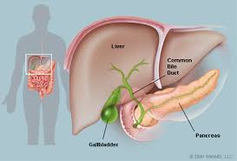
By,
Mrs.Kapu Manjula
Assistant Professor

Slide 2
GALLBLADDER
The gallbladder is a small, pear-shaped organ that is located underneath the liver.
The main purpose of the gallbladder is to store and concentrate bile.
Bile is a liquid produced by the liver that helps digest fats.

Slide 3
Over time, bile becomes more concentrated, which increases its effectiveness at digesting fats.
The gallbladder releases bile into the digestive system when it is needed.
The gallbladder is a useful, but not essential organ. The gallbladder can safely be removed without interfering with your ability to digest food.

Slide 4
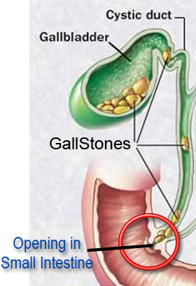
Gallstones
Gallstones are small stones that form in the gallbladder. They are usually made of cholesterol.
If a gallstone becomes trapped in the main opening of the gallbladder, called the cystic duct, it can cause the gallbladder to become severely inflamed.

Slide 5
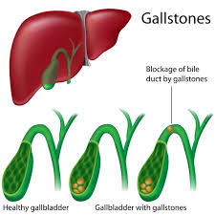
CHOLELITHIASIS

Slide 6
CHOLELITHIASIS -DEFINITION
Cholelithiasis is defined as the formation of Calculi or Gall stones in the gall bladder from the solid constituents of bile
-Brunner & Suddarth

Slide 7
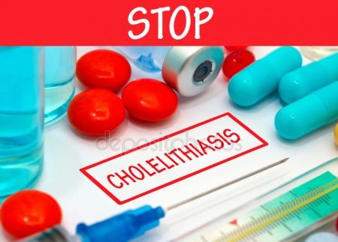
INCIDENCE
They are uncommon in children and young adults but become increasingly prevalent after 40 years of age
The incidence increases to 50% of those over the age of 70 and 50% of those over 80 will develop stones in the
bile tract

Slide 8
TYPES
1.CHOLESTEROL STONES:
Most common type,results from the presence of too much cholesterol in the bile
2.PIGMENT STONES:
These are formed from excess bilurubin,a waste product created by the break down of RBCs in the liver.
These can not be dissolved and must be remove surgically.

Slide 9
ETIOLOGY & RISK FACTORS
During pregnancy failure to empty the bile appropriately by the gall bladder
Biliary tract infection
Liver cirrhosis
Eating vey low calorie diet leading to rapid weight loss
Obesity
Bone marrow transplant
Intra venous nutrition
Medications(Cholesterol lowering drugs)

Slide 10
patho physiology
Cholelithiasis develops when the balance that keeps cholesterol,bile salts and ca+ solution is altered
Bile secreted by liver is super saturated with cholesterol
Bile in the gall bladder is also super saturated with cholesterol

Slide 11
If the bile is supersaturated,precipitation of cholesterol will occurs
Major concentration of bile stones will be cholesterol and other include bile salts,bilurubin and ca+
Stones remain in the the gall bladder or migrate to cystic duct or to bile duct
Cholelithiasis
Obstruction cholecystitis

Slide 12
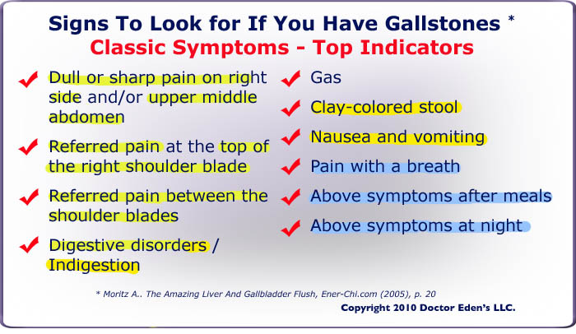

Slide 13
Low grade fever and chills
Sweating
Presence of fat in the stool(Steatorrhea)
Yellowing of the skin and whites of the eyes(Jaundice)
Abdominal tenderness
Abdominal swelling,distension or bloating

Slide 14
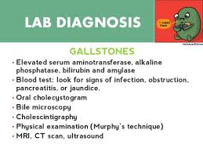

Slide 15
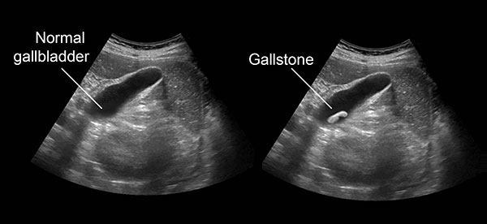
Abdominal ultra sound

Slide 16
Management
It includes
Medications
Non surgical management
surgery

Slide 17
Pharmacologic therapy
To dissolve Gall stones: drugs used are
; Ursodeoxycholic acid(Ursodiol,UDCA) and chenodeoxycholic acid(CDCA)
To relieve Pain-narcotics are used (Meperidine)
Antispasmodics and anticholinergics to relax smooth muscles and decrease ductal tone and spasm
Antiemetics to reduce nausea & vomiting

Slide 18
Other
NG tube insertion is needed
Iv fluids
Iv antibiotic therapy before surgery
Cholestramine may be given if patient has obstructive Jaundice with severe itching from accumulation of bile salts in the skin.

Slide 19
Non surgical therapy
A.Dissolution therapy:
Mono-octanoin or methy tertiary butyl ether in to the gall bladder through a tube or catheter inserted PC in to Gallbladder to dissolve stones
B.Stone removal by Instrumentation: fluoroscopy

Slide 20
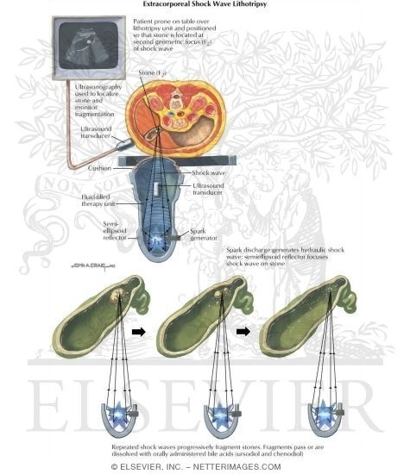
C.Extra corporeal Shock wave Lithotripsy: It is a technique that uses electric shock waves to dissolve gall stones.

Slide 21
Surgery
A.Cholecystectomy:
Laparoscopic cholecystectomy –removal of gall bladder
B.Cholecystotomy: In patients with critically ill with GB empyema and sepsis.it is a minimal procedure involving placement of drainage tube in gall bladder

Slide 22
3.Endoscopic sphincterectomy:
If surgical removal of common bile duct stones is immediately feasible,it will be done
Opening is created intraduodenal portion of common bile duct,through which stones can be extracted.
4.Endoscopic retrograde Cholangio Pancreatography:
useful in patients who are critically ill with ascending cholangitis

Slide 23
Nursing management
Acute pain related to inflammation of the gall bladder as evidenced by verbal reports
Fluid volume deficit related to vomiting as evidenced by dryness of skin
Nutrition, lessthan body requirement related to reduced dietary intake as manifested by weight loss
Ineffective thermo regulation related to infection of gall bladder

Slide 24
Nursing management
Self care deficit related to fatigue and weakness
Sleep pattern disturbance related to pain as manifested by frequent yawning
Knowledge deficit related to treatment modalities
Anxiety related to progression of disease

Slide 25
THANK YOU

