Slide 1
HEALTH ASSESSMENT
Mrs. Elaiyarasi S
Asst. Professor
Dept. of Community Health Nursing

Slide 23
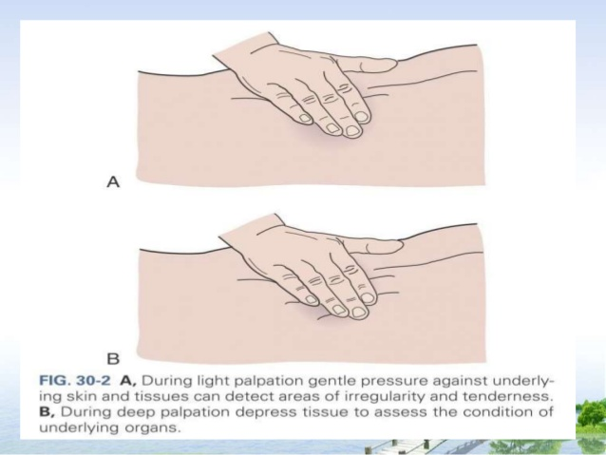

Slide 24
