Slide 1
Implementation of National Urban Health Mission (NUHM)
Joint Secretary (Urban Health)
Ministry of Health & Family Welfare
Government of India
13.5.2019

Slide 2
About NUHM
National Urban Health Mission (NUHM) was approved on 1st May, 2013 as a sub-mission of National Health Mission (NHM)
Aims to establish and strengthen primary healthcare delivery in urban areas with focus on slums and vulnerable population.
Cover cities/ towns with population above 50,000 & District Head Quarters above 30,000 population
De-congesting secondary/tertiary care facilities (DH/SDH/CHC) – Robust Comprehensive Primary Health Care services in urban areas
So far , more than 1000 cities/ towns covered under NUHM
HWC/ U-PHCs - Fulcrum of Preventive, Promotive and Curative services in cities closer to the communities
1591 HWCs made operationalized against 3299 U-PHCs approved

Slide 3
Poor Maternal and Child health Indicators among Urban poor (NFHS-III)
Under 5 Mortality is 72.7 among urban poor significantly higher than the urban average of 51.9
56% deliveries among the urban poor take place at home
Several health indicators among urban poor are worse than rural areas:
60% urban poor children do not receive complete immunization compared to 58% in rural areas
47.1 % urban poor children <3 are under-weight as compared to 45% of rural children
59% of woman (15-49 age group) are anemic as compared to 57% in rural
Notes:
3

Slide 4
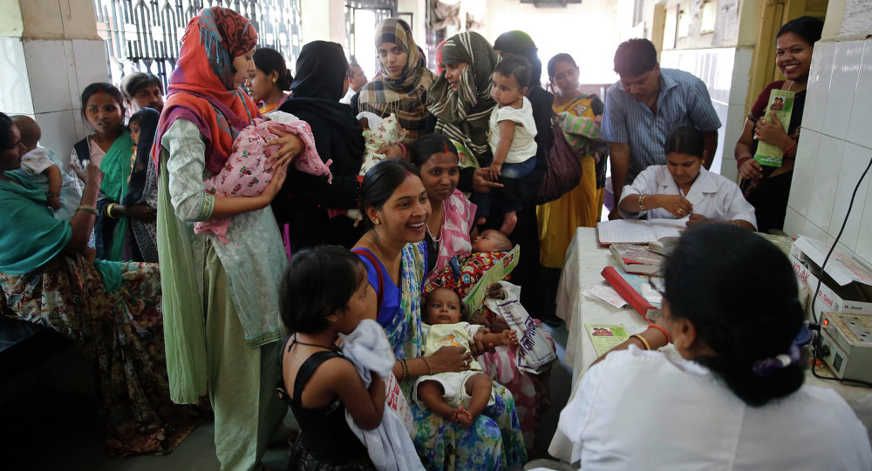
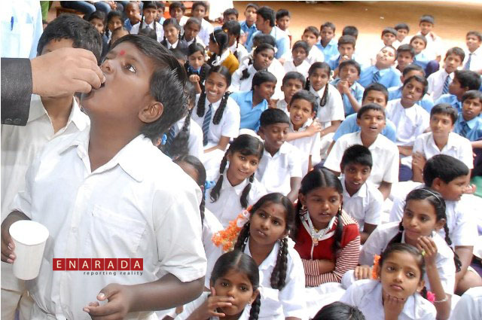
Key NFHS-4 Facts (Urban)- India
Institutional delivery in Public Health Facility-46.2.1%
JSY benefits to mothers-21.4%
Full Immunisation Coverage-63.9%
Breastfed within one hour of birth-42.8%
Anaemia in 15-49 age gp-45.7%
Children between 6-59 months anaemic-55.9%

Slide 5
NFHS-4 Indicators
Indicators | Urban | Rural | Total
Infant and Child Mortality Rates (Per 1,000 Live Births)
Infant Mortality Rate (IMR) | 29 | 46 | 41
Under-Five Mortality rate (U5MR) | 34 | 56 | 50
Delivery care (For births in the 5 Years before the survey)
Institutional births (%) | 88.7 |  | 75.1 | 78.9
Institutional Births in Public facility (%) | 46.2 |  | 54.4 | 52.1
Child Immunization
Children age 12-23 months fully immunized (BCG, measles and 3 doses each of polio and DPT (%) |  | 63.9 | 61.3 | 62.0

Slide 6
NFHS-4 Indicators
Indicators | Urban | Rural | Total
Child Feeding Practices and Nutritional Status of Children
Children under age 3 years breastfed within one hour of birth (%) | 42.8 | 41.1 | 41.6
Anaemia among Children and Adults
Pregnant Women age 15-49 years who are anaemic (<11.0g/dl) (%) | 45.7 | 52.1 | 50.3
All women age 15-49 years who are anaemic (%) | 50.8 | 54.2 | 53.0

Slide 7
Key urban health indicators (NSSO – 71st round)
Indicators
 | Urban | Rural
% of hospitalized cases using public facility | 32 | 42
% of non-hospitalized cases using public facility | 20 | 25
Non-hospitalized expenditure (Rs.)
OOPE per non-hospitalized ailing person (Rs.) – PUBLIC | 9620 | 9840
OOPE per non-hospitalized ailing person (Rs.) – PRIVATE | 18919 | 15804

Slide 8
Core Strategies- NUHM
Creation of new facilities
Rationalization and strengthening existing urban primary health structures
Deployment of MOs, Paramedical Staff at U-PHCs / U-CHCs, Engagement of ANMs
Selection of ASHAs and Formation of MAS
Involvement of ULBs in planning, implementation and monitoring of the program
Convergence with all National Health Programs and other Ministries
Capacity building of ULBs/ Medical and Paramedical staff/ASHA, MAS
Use of ICT For better service delivery, improved surveillance and monitoring

Slide 9
NUHM: Service Delivery Mechanism
Urban-PHC
For every 50,000 urban population
Outreach Sessions
For slum and vulnerable population, routine UHNDs and special outreach sessions
Mahila Arogya Samiti
Urban-CHC
30-50 bedded in cities 2.5lakh population
100 bedded for more than 500,000 population in metros
Comprehensive primary healthcare service
For every 50 – 100 households in slums and among vulnerable communities
BCC & Health Promotion

Slide 10
Implementation of NUHM
For the remaining cities, health department is the Primary implementation Agency for NUHM
For six mega cities, namely Mumbai, Kolkata, Chennai, Bengaluru, Hyderabad and Ahmedabad, implementation is through respective Urban Local Bodies (ULBs),

Slide 11
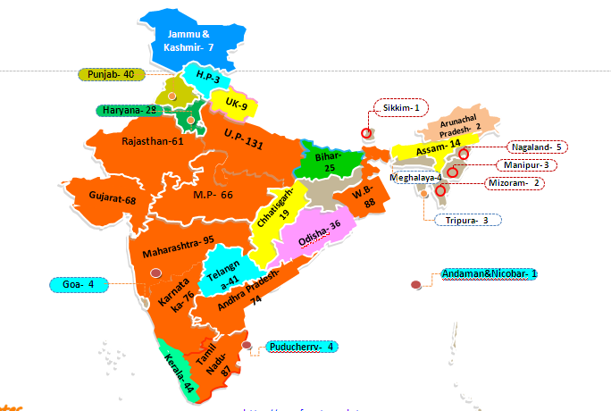
1067 Cities covered under NUHM
9 big States covering 70% cities of total cities approved
Jharkhand-22

Slide 12
Expected Outcomes of NUHM
Providing comprehensive quality health care to the urban poor and vulnerable through UPHCs/UCHCs
Special focus on health issues in urban areas- NCDs, Mental health, substance abuse etc.
Outreach through UHNDs and special outreach sessions to address specific community health needs
Mapping of urban vulnerable population- in catchment area of U-PHC
Provision of services under all National Health Programmes at the UPHC level
Address social determinants of health through intersectoral convergence.

Slide 13
Physical Progress under NUHM- India- as per QPR (ending December, 2018)

Slide 14
1. Year wise Progress of HR/U-PHC/ASHA/MAS
* Information not available for U-PHCs for year 2014-15

Slide 15
2. Human Resource
Total Staff
Approved- 37597
In-position- 28008(75%)
Clinical& Paramedical staff
Approved- 36182
In-position- 26829 (74%)
Program management staff
Approved- 1415
In-position- 1179 (83%)

Slide 16
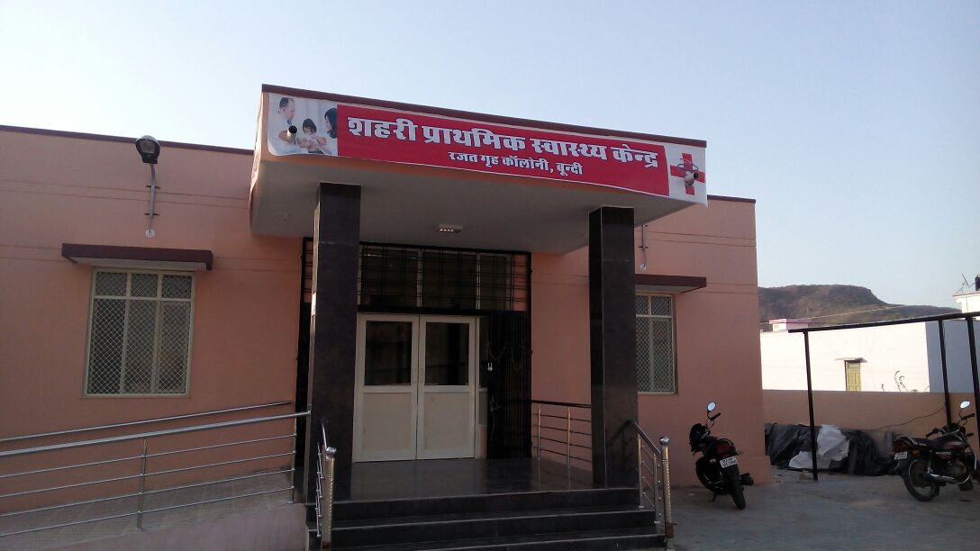
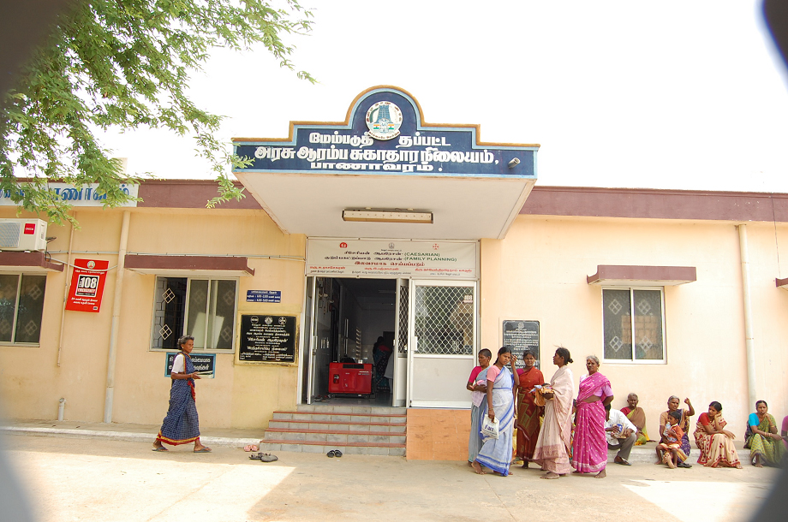
3. Operationalization of U-PHCs/U-CHCs
4578/4831 (95%) U-PHCs made functional
134/170 (90%) U-CHCs made functional

Slide 17
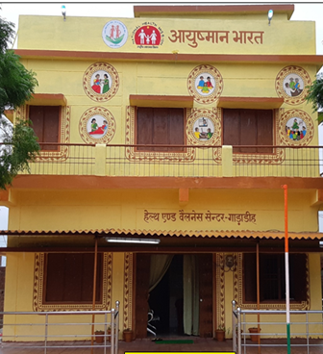
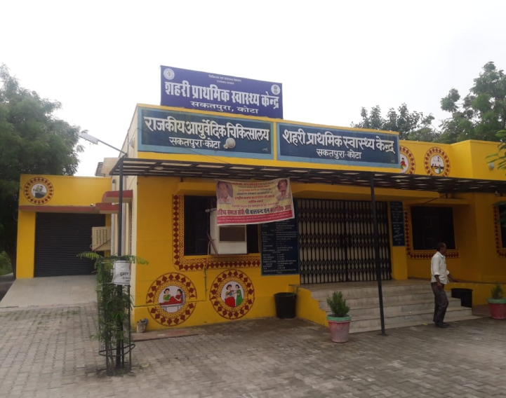
4. Health &Wellness Centres- urban areas
So, far 1591 HWCs have been made operationalized

Slide 18
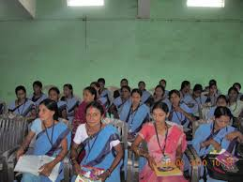
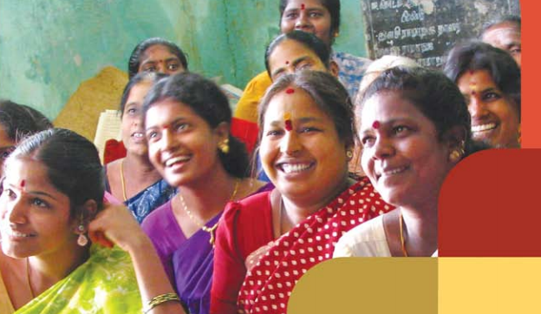
5. Community Process
ASHAs engaged 62005/70493
(88%)
MAS formed 79692/96854 (82%)
RKS formed 2998/4578
(66%)

Slide 19
6. Service Delivery Trend - HMIS
54% increase in OPD from FY 2014-15 to 2018-19
48% increase in OPD from FY 2014-15 to 2018-19
Data as reported by Urban Health Facilities (Public,Physical,Active) on HMIS portal. Comparison of FY 2016-17 & 2017-18 Data as on 24-08-2018

Slide 20
66% increase in OPD from FY 2014-15 to 2018-19
Data as reported by Urban Health Facilities (Public,Physical,Active) on HMIS portal. Comparison of FY 2016-17 & 2017-18 Data as on 11.5.2019

Slide 21
Financial Progress under NUHM- India

Slide 22
Financial Progress of NUHM in India since inception
(2013-14 to 2018-19
Overall utilization is 72% against available funds
Releases are updated till date and Expenditure is updated upto 31.03.2019(provisional)

Slide 23
% of Utilization of Funds under NUHM since inception (India)
Expenditure from 2013-14 to 2017-18 is based on audit reports and for FY 2018-19 on FMR (Provisional)

Slide 24
Priority Areas I. Key Activities
Capacity Development/training of service delivery and program management staff on
- NUHM orientation
- HWC training
- Training under all National Health Programmes
Strengthening of U-PHCs as Health and Wellness Centres (HWCs) in urban areas
Enhanced fixed day Specialist services at U-PHC/HWC for dental, eye, skin, mental health care etc.
Quality certification of health facilities
Extension of Kakayalp and SSS in urban areas
Utilizing MAS present in Slum areas for health promotion / awareness /follow-up/ vector control/ NCD/TB cases etc.
Population based screening for hypertension, diabetes and cancers (oral, breast and cervix)

Slide 25
Continued….
Immunisation activities in urban area- Identify gaps and recommend actions etc.
Integration of RNTCP activities in urban areas with Designated Microscopy Centers (DMCs) established at UPHCs and made operational as Treatment Centres of RNTCP
Provision of sanitary napkins, awareness on menstrual hygiene and safe disposal of sanitary napkins in urban areas
Integration of all National Health programs like RCH – Immunization, NCDs, NVBDCP etc. with NUHM at all facilities in urban areas
Leveraging Medical colleges to strengthen & support NUHM implementation.
Improving coordination mechanisms between State Departments and Urban Local Bodies (ULBs)
Regular and quality data reporting of health facilities on HMIS portal-

Slide 26
II. Strengthening Financial Management systems
Bank Accounts of all the UPHCs to be opened
Registration and transfer of funds under NUHM through PFMS including ULBs
e-transfer of Funds to the UPHCs/UCHCs- untied grants, other expenses
The formation and registration of RKS for all the UPHCs

Slide 27
Recent Publications
Guidelines, Manuals and Frameworks developed on various topics-
1) Vulnerability Mapping 2) Records &Registers for U-PHCs
3) Capacity building framework 4)Extension of kayakalp in urban areas
5)Orientation Training Module 6)Module RFP and SLA to operate U-PHC
7)ANM Handbook 8)Quality standards for U-PHCs
9)NUHM Brand module 10)Outreach session in urban areas
11)NUHM Financial Management guideline
Brochures on Thematic areas-
1) Thrust areas under NUHM
2) Community Process
3) Quality Assurance
4) IEC/BCC
5) Human Resource under NUHM
6) Collaboration with Medical Colleges
7) Inter Sectoral Convergence under NUHM

Slide 28
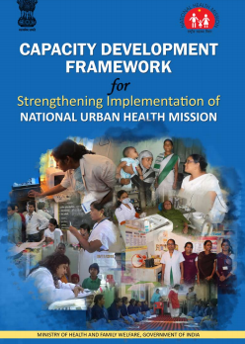
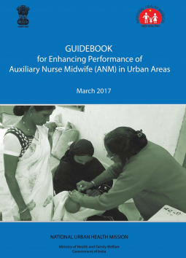
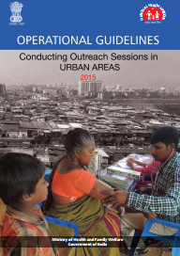
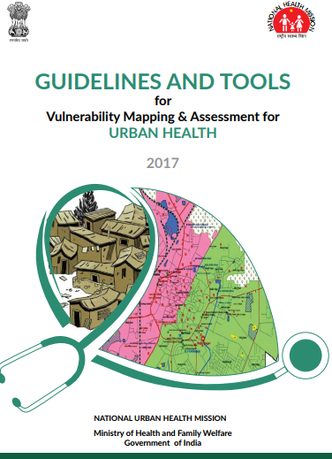
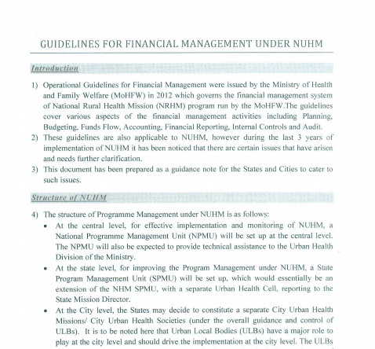
Manual/Guidelines developed under NUHM

Slide 29
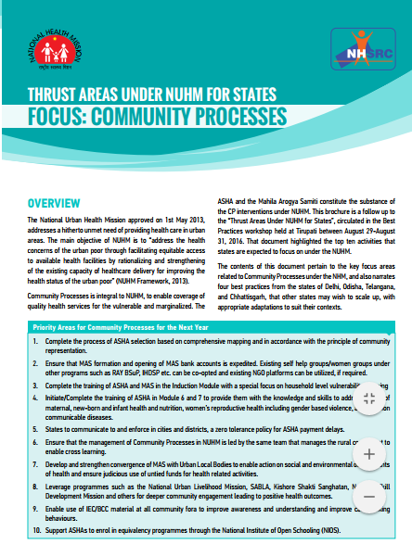
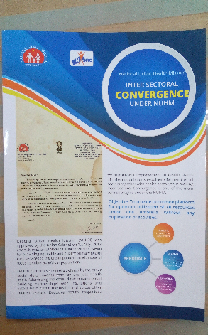
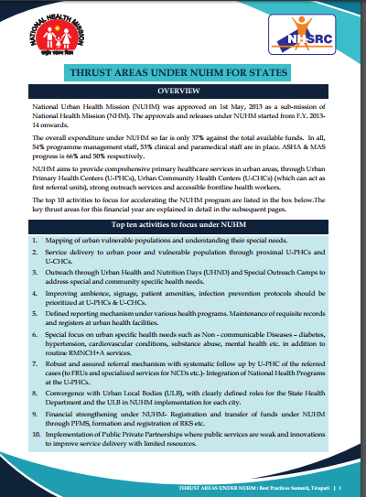
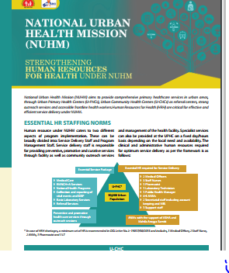
7 Brochures developed

