Slide 1
Mrs. Elaiyarasi S
Asst. Professor
Department of Community Health Nursing

Slide 13
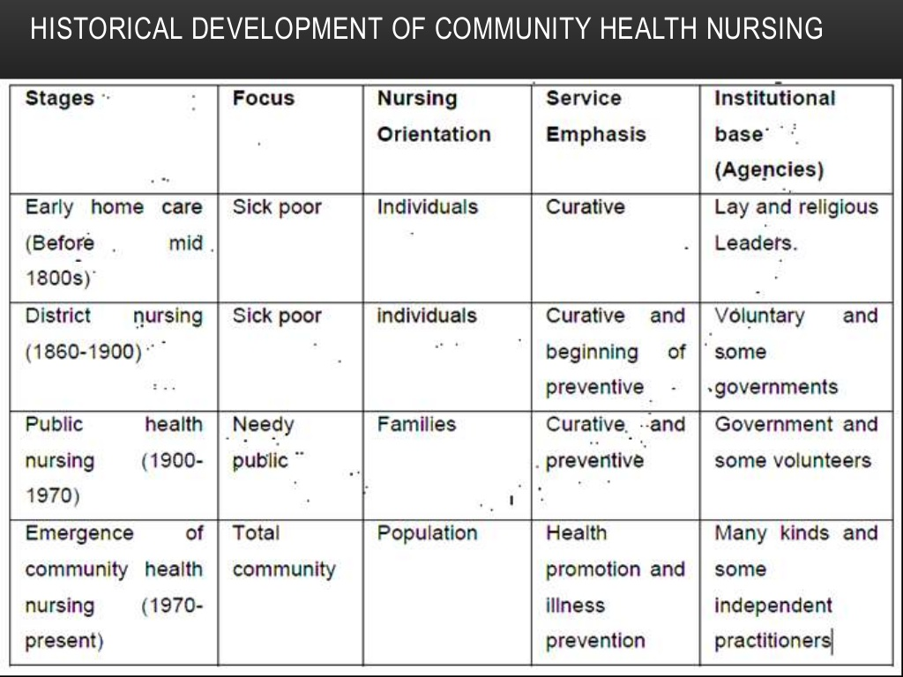

Slide 15
