Slide 1
MALE REPRODUCTIVE SYSTEM
Mrs.Mercy Deva Priya
Asst.Prof.
Dept of MHN

Slide 2
The male reproductive system-intro..
The male reproductive system consists of the following organs:
2 testes in the scrotum
2 epididymides
2 deferent ducts (vas deferens)
2 spermatic cords
2 seminal vesicles
2 ejaculatory ducts
1 prostate gland
1 penis.

Slide 3
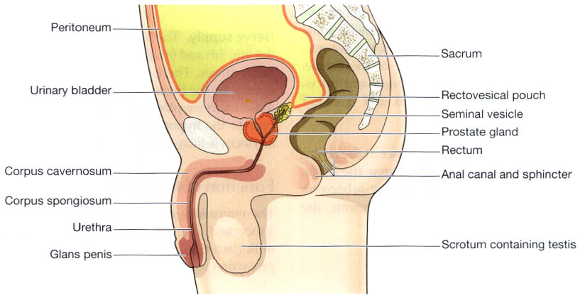

Slide 4
Scrotum
The scrotum is a pouch of deeply pigmented skin, fibrous and connective tissue and smooth muscle.
It is divided into two compartments each of which contains one testis, one epididymis and the testicular end of a spermatic cord.
It lies below the symphysis pubis, in front of the upper parts of the thighs and behind the penis.

Slide 5
Testes
The testes are the reproductive glands of the male and are the equivalent of the ovaries in the female.
They are about 4.5 cm long, 2.5 cm wide and 3 cm thick and are suspended in the scrotum by the spermatic cords.
They are surrounded by three layers of tissue.
The tunica vaginalis.
The tunica albuginea.
The tunica vasculosa

Slide 6
The tunica vaginalis.
This is a double membrane, forming the outer covering of the testes, and is a down growth of the abdominal and pelvic peritoneum.
During early fetal life the testes develop in the lumbar region of the abdominal cavity just below the kidneys.
They then descend into the scrotum taking with them coverings of peritoneum, blood and lymph vessels, nerves and the deferent duct.
The peritoneum eventually surrounds the testes in the scrotum, and becomes detached from the abdominal peritoneum.
Descent of the testes into the scrotum should be complete by the 8th month of fetal life

Slide 7
The tunica albuginea.
This is a fibrous covering beneath the tunica vaginalis that surrounds the testes.
Ingrowths form septa dividing the glandular structure of the testes into lobules.
The tunica vasculosa.
This consists of a network of capillaries supported by delicate connective tissue.

Slide 8
Structure of the testes
In each testis are 200 to 300 lobules and within each lobule
are 1 to 4 convoluted loops composed of germinal epithelial cells, called seminiferous tubules.
Between the tubules there are groups of interstitial cells (of Ley dig) that secrete the hormone testosterone after puberty.
At the upper pole of the testis the tubules combine to form a single tubule.
This tubule, about 6 m in its full length, is repeatedly folded and tightly packed into a mass called the epididymis.
It leaves the scrotum as the deferent duct
(vas deferens) in the spermatic cord.
Blood and lymph vessels pass to the testes in the spermatic cords.

Slide 9
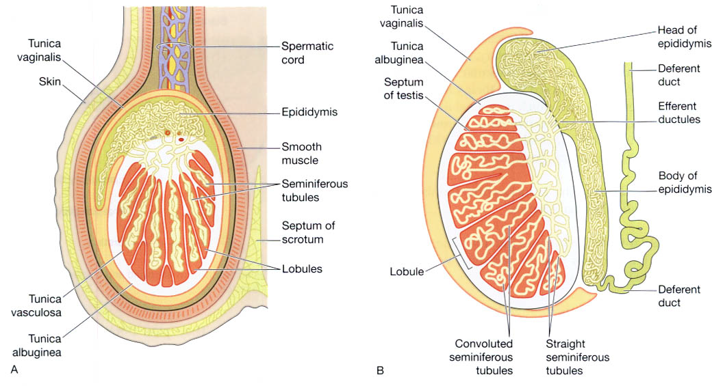

Slide 10
Functions of the testes
Spermatozoa (sperm) are produced in the seminiferous tubules of the testes, and mature as they pass through the long and convoluted epididymis, where they are stored.
The hormone controlling sperm production is FSH from the anterior pituitary
A mature sperm has a head, a body, and a long whip-like tail that is used for motility.
The head is almost completely filled by the nucleus, containing its DNA.

Slide 11
It also contains the enzymes required to penetrate the outer layers of the ovum to reach, and fuse with, its nucleus.
The body of the sperm is packed with mitochondria, which fuel the propelling action of the tail that powers the sperm on its journey into the female reproductive tract.

