Slide 1
The reproductive systems
Mrs.Mercy Deva Priya
Asst.Prof
Dept of MHN

Slide 2
INTRODUCTION
In human beings the process is one of sexual reproduction in which the male and female organs differ anatomically and physiologically.
Both males and females produce specialised reproductive germ cells, called gametes. The male gametes are called spermatozoa and the female gametes are called ova.

Slide 3
They contain the genetic material, or genes, on chromosomes, which pass inherited characteristics on to the next generation.
In other body cells there are 46 chromosomes
arranged in 23 pairs but in the gametes there are only 23, one from each pair.
Gametes are formed by meiosis
When the ovum is fertilised by a spermatozoon the resultant zygote contains 23 pairs of chromosomes, one of each pair obtained from the father and one from the mother.

Slide 4
The zygote embeds itself in the wall of the uterus where it grows and develops during the 40-week gestation period before birth.

Slide 5
The functions of the female reproductive system are:
formation of female gametes, ova
reception of male gametes, spermatozoa
provision of suitable environments for fertilisation of
the ovum by spermatozoa and development of the
resultant fetus
parturition (childbirth)
lactation, the production of breast milk, which
provides complete nourishment for the baby in its
early life.

Slide 6
The functions of the male reproductive system are:
production of male gametes, spermatozoa
transmission of spermatozoa to the female.

Slide 7
The female reproductive organs, or genitalia, are divided into external and internal organs

Slide 8
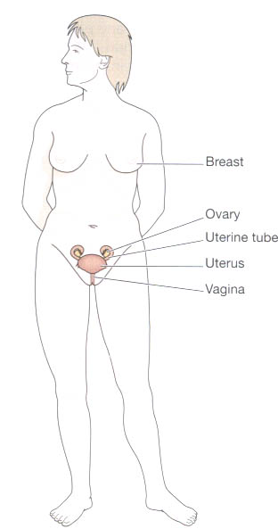
FEMALE REPRODUCTIVE SYSTEM
The female reproductive organs, or genitalia, are divided into external and internal organs

Slide 9
External genitalia (vulva)
The external genitalia are known collectively as the vulva, and consist of the
labia majora
Labia minora,
the clitoris,
the vaginal orifice,
the vestibule,
the
hymen and
the vestibular glands (Bartholin's glands).

Slide 10
Blood supply, lymph drainage and nerve supply
The arterial supply- branches from the internal pudendal arteries that branch from the internal iliac arteries and by external pudendal arteries that branch from the femoral arteries.
The venous drainage- forms a large plexus which eventually drains into the internal iliac veins.
Lymph drainage- through the superficial inguinal nodes.
Nerve supply- by branches from pudendal nerves.

Slide 11
Perineum
The perineum is the area extending from the base of the labia minora to the anal canal. It is roughly triangular and consists of connective tissue, muscle and fat.
It gives attachment to the muscles of the pelvic floor .

Slide 12
Internal genitalia
The internal organs of the female reproductive system lie in the pelvic cavity and consist of the vagina, uterus, two uterine tubes and two ovaries.
Vagina
The vagina is a fibromuscular tube lined with stratified squamous epithelium, connecting the external and internal organs of reproduction.
It runs obliquely upwards and backwards at an angle of about 45° between the bladder in front and rectum and anus behind.
In the adult the anterior wall is about 7.5 cm (3 inches) long and the posterior wall about 9 cm long. The difference is due to the angle of insertion of the cervix through the anterior wall.

Slide 13
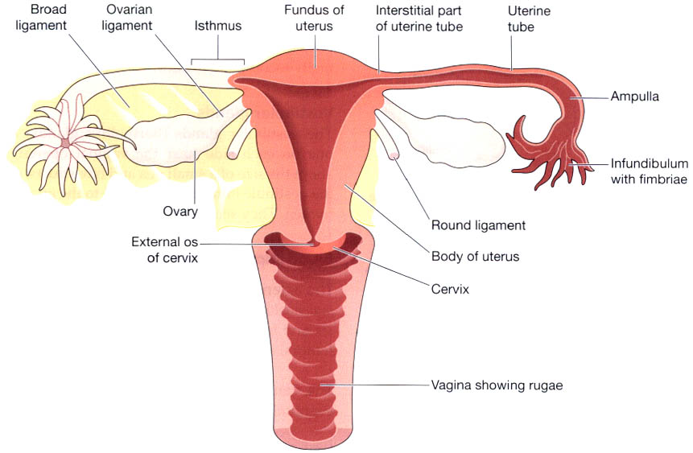

Slide 14
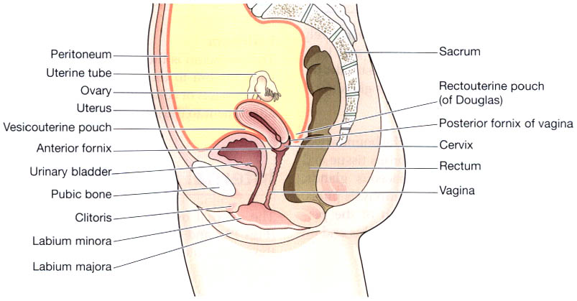

Slide 15
Structure of the vagina
The vagina has three layers:
an outer covering of areolar tissue,
a middle layer of smooth muscle and
an inner lining of stratified squamous epithelium that forms ridgesor rugae.
It has no secretory glands but the surface is kept moist by cervical secretions.

Slide 16
Blood supply, lymph drainage and nerve supply
Arterial supply- An arterial plexus is formed round the vagina, derived from the uterine and vaginal arteries which are branches of the internal iliac arteries.
Venous drainage- A venous plexus, situated in the muscular wall, drains into the internal iliac veins.
Lymph drainage. This is through the deep and superficial iliac glands.
Nerve supply. This consists of parasympathetic fibres from the sacral outflow, sympathetic fibres from the lumbar outflow and somatic sensory fibres from the pudendal nerves.

Slide 17
Functions of the vagina
The vagina acts as the receptacle for the penis during coitus, and provides an elastic passageway through which the baby passes during childbirth.

