Slide 1
The spermatic cords
Mrs.Mercy Deva Priya
Asst.Prof
Dept of MHN

Slide 2
The spermatic cords suspend the testes in the scrotum.
Each cord contains a testicular artery, testicular veins, lymphatics, a deferent duct and testicular nerves, which come together to form the cord from their various origins in the abdomen.
The cord, which is covered in a sheath of smooth muscle and connective and fibrous tissues, extends through the inguinal canal and is attached to the testis on the posterior wall.

Slide 3
The testicular artery. This branches from the abdominal aorta, just below the renal arteries.
The testicular vein. This passes into the abdominal cavity. The left vein opens into the left renal vein and the right into the inferior vena cava.
Lymph drainage. This is through lymph nodes around the aorta.

Slide 4
The deferent duct. This is some 45 cm long. It passes upwards from the testis through the inguinal canal and ascends medially towards the posterior wall of the bladder where it is joined by the duct from the seminal vesicle to form the ejaculatory duct.
The nerve supply. This is provided by branches from the 10th and llth thoracic nerves.

Slide 5
Seminal vesicles
The seminal vesicles are two small fibromuscular pouches lined with columnar epithelium, lying on the posterior aspect of the bladder
At its lower end each seminal vesicle opens into a short duct which joins with the corresponding deferent duct to form an ejaculatory duct.

Slide 6
Functions of the seminal vesicles
The seminal vesicles contract and expel their stored contents, seminal fluid, during ejaculation.
Seminal fluid, which forms 60% of the bulk of the fluid ejaculated at male orgasm, contains nutrients to support the sperm during their journey through the female reproductive tract.

Slide 7
Ejaculatory ducts
The ejaculatory ducts are two tubes about 2 cm long, each formed by the union of the duct from a seminal vesicleand a deferent duct.
They pass through the prostate gland and join the prostatic urethra, carrying seminal fluid and spermatozoa to the urethra.
The ejaculatory ducts are composed of the same layers of tissue as the seminal vesicles.

Slide 8
Prostate gland
The prostate gland lies in the pelvic cavity in
front of the rectum and behind the symphysis pubis, surrounding the first part of the urethra.
It consists of an outer fibrous covering, a layer of smooth muscle and glandular substance composed of columnar epithelial cells.

Slide 9
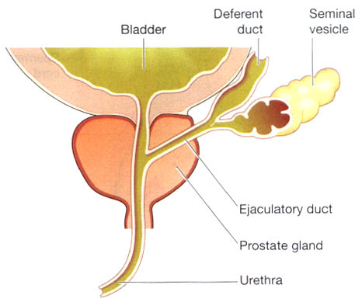

Slide 10
Functions of the prostate gland
The prostate gland secretes a thin, milky fluid that makes up about 30% of semen, and gives it its milky appearance.
It is slightly alkaline, which provides a protective local
environment for sperm arriving in the acidic vagina.
It also contains a clotting enzyme, which thickens the
semen in the vagina, increasing the likelihood of semen
being retained in the vicinity of the cervix.

Slide 11
Urethra and penis
The Urethra male urethra provides a common pathway for the flow of urine and semen, the combined secretions of the male reproductive organs.
It is about 19 to 20 cm long and consists of three parts.
The prostatic urethra originates at the urethral orifice of the bladder and passes through the prostate gland.
The membranous urethra is the shortest and narrowest part and extends from the prostate gland to the bulb of the penis, after passing through the perineal membrane.
The spongiose or penile urethra lies within the corpus spongiosum of the penis and terminates at the external urethral orifice in the glans penis

Slide 12
There are two urethral sphincters
The internal sphincter consists of smooth muscle fibres at the neck of the bladder above the prostate gland.
The external sphincter consists of skeletal muscle fibres surrounding the membranous part.

Slide 13
Penis
The penis has a root and a body.
The root lies in the perineum and the body surrounds the urethra.
It is formed by three cylindrical masses of erectile tissue and involuntary muscle.
The erectile tissue is supported by fibrous tissue and covered with skin and has a rich blood supply.

Slide 14
The two lateral columns are called the corpora cavernosa and the column between them, containing the urethra is the corpus spongiosum.
At its tip it is expanded into a triangular structure known as the glans penis.
Just above the glans the skin is folded upon itself and forms a movable double layer, the foreskin or prepuce.
Arterial blood is supplied by deep, dorsal and bulbar arteries of the penis which are branches from the internal pudendal arteries.

Slide 15
A series of veins drain blood to the internal pudendal and internal iliac veins.
The penis is supplied by autonomic and somatic nerves.
Parasympathetic stimulation leads to filling of the spongy erectile tissue with blood, caused by arteriolar dilatation and venoconstriction, which increases blood flow into the penis and obstructs outflow.
The penis therefore becomes engorged and erect, an essential prerequisite for coitus to occur.

Slide 16
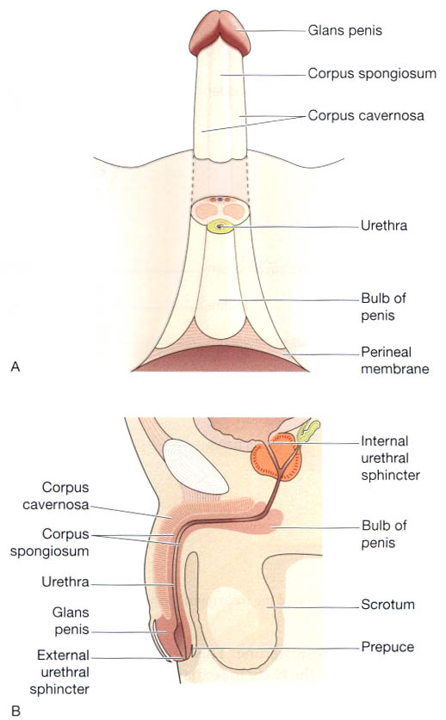

Slide 17
Ejaculation
During ejaculation, which occurs at the point of male orgasm, spermatozoa are expelled from the epididymis and pass through the deferent duct, the ejaculatory duct and the urethra.
The semen is propelled by powerful rhythmical contraction of the smooth muscle in the walls of the deferent duct; the muscular contractions are sympathetically mediated.
Muscle in the walls of the seminal vesicles and prostate gland also contracts, adding their contents to the fluid passing through the genital ducts.
The force generated by these combined processes leads to emission of the semen through the external urethral sphincter

Slide 18
Puberty in the male
This occurs between the ages of 10 and 14. Luteinising hormone from the anterior lobe of the pituitary gland stimulates the interstitial cells of the testes to increase the production of testosterone.
This hormone influences the development of the body to sexual maturity.
The changes which occur at puberty are:

Slide 19
growth of muscle and bone and a marked increase in height and weight
enlargement of the larynx and deepening of the voice —it 'breaks'
growth of hair on the face, axillae, chest, abdomen and pubis
enlargement of the penis, scrotum and prostate gland
maturation of the seminiferous tubules and
production of spermatozoa
the skin thickens and becomes more oily.

Slide 20
In the male, fertility and sexual ability tend to decline gradually with ageing. The secretion of testosterone gradually declines, usually beginning at about 50 years of age.
There is no period comparable to the female menopause.

