Slide 1
UTERUS
Mrs.Mercy Deva Priya
Asst.Prof
Dept of MHN

Slide 2
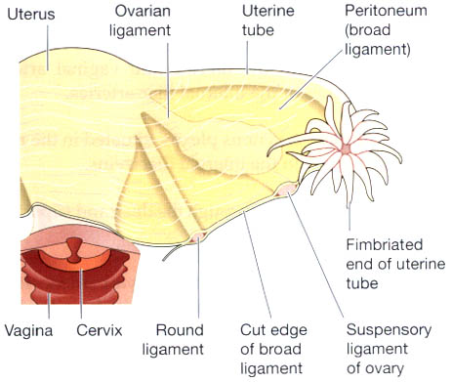

Slide 3
The uterus is a hollow muscular pear-shaped organ, flattened anteroposteriorly.
It lies in the pelvic cavity between the urinary bladder and the rectum.
In most women, it leans forward (anteversiori), and is bent forward (anteflexiori) almost at right angles to the vagina, so that its anterior wall rests partly against the bladder below, and forming the vesicouterine pouch between the two organs.

Slide 4
When the body is in the upright position the uterus lies in an almost horizontal position.
It is about 7.5 cm long, 5 cm wide and its walls are about 2.5 cm thick.
It weighs from 30 to 40 grams.
The parts of the uterus are the fundus, body and cervix.

Slide 5
The fundus. This is the dome-shaped part of the uterus above the openings of the uterine tubes.
The body. This is the main part. It is narrowest inferiorly at the internal os where it is continuous with the cervix.
The cervix ('neck' of the uterus). This protrudes through the anterior wall of the vagina, opening into it at the external os.

Slide 6
Structure of the uterus
The walls of the uterus are composed of three layers of tissue: perimetrium, myometrium and endometrium
Perimetrium This is peritoneum, which is distributed differently on the various surfaces of the uterus . Anteriorly it extends over the fundus and the body. Posteriorly the peritoneum extends over the fundus, the body and the cervix. Laterally only the fundus is covered

Slide 7
Myometrium
This is the thickest layer of tissue in the uterine wall. It is a mass of smooth muscle fibres interlaced with areolar tissue, blood vessels and nerves.
EndometriumThis consists of columnar epithelium containing a large number of mucus-secreting tubular glands.
It is divided functionally into two layers.
The functional layer
The basal layer

Slide 8
The functional layer is the upper layer and it thickens and becomes rich in blood vessels in the first half of the menstrual cycle. If the ovum is not fertilised and does not implant, this layer is shed during menstruation.
The basal layer lies next to the myometrium, and is not lost during menstruation. It is the layer from which the fresh functional layer is regenerated during each cycle.

Slide 9
Blood supply, lymph drainage and nerve supply
The arterial supply. This is by the uterine arteries which are branches of the internal iliac arteries.
Venous drainage. The veins follow the same route as the arteries and eventually drain into the internal iliac veins.
Lymph drainage. There are deep and superficial lymph vessels which drain lymph from the uterus and the uterine tubes to the aortic lymph nodes

Slide 10
Supports of the uterus
The uterus is supported in the pelvic cavity by surrounding organs, muscles of the pelvic floor and ligaments that suspend it from the walls of the pelvis.
The broad ligaments.
The round ligaments.
The uterosacral ligaments
The transverse cervical ligaments (cardinal ligaments).

Slide 11
Functions of the uterus
After puberty, the endometrium of the uterus goes through a regular monthly cycle of changes, the menstrual cycle, which is under the control of hypothalamic and anterior pituitary hormones.
The purpose of the cycle is to prepare the uterus to receive, nourish and protect fertilised ovum.
The cycle is usually regular, lasting between 26 and 30 days.
If the ovum is not fertilised a new cycle begins with a short period of bleeding
(menstruation).

Slide 12
If the ovum is fertilised the zygote embeds itself in the uterine wall. The uterine muscle grows to accommodate the developing baby, which is called an embryo during its first 8 weeks, and a fetus for the remainder of the pregnancy.
Uterine secretions nourish the ovum before it
implants in the endometrium, and after implantation the rapidly expanding ball of cells is nourished by the endometrial cells themselves.

Slide 13
The placenta, which is attached to the fetus by the umbilical cord, is firmly attached to the wall of the uterus, and provides the means by which the growing baby receives oxygen and nutrients, and gets rid of its wastes.
During pregnancy, which normally lasts about 40 weeks, the muscular walls of the uterus are prevented from contracting and expelling the baby early by high levels of the hormone progesterone secreted by the placenta.

Slide 14
At the end of pregnancy (at term) the hormone oestrogen, which increases uterine contractility, becomes the predominant sex hormone in the blood.
oxytocin is released from the posterior pituitary, and also stimulates the uterine muscle. Control of oxytocin release is by positive feedback
During labour, the uterus forcefully expels the baby by means of powerful rhythmical contractions.

