Slide 1
LARYNX
Done by:
Mrs. Mercy Deva Priya
Asst.Professor .Dept of MHN

Slide 2
Position
The larynx or 'voice box' extends from the root of the tongue and the hyoid bone to the trachea. It lies in front of the laryngo-pharynx at the level of the 3rd, 4th, 5th and 6th cervical vertebrae.
Until puberty there is little difference in the size of the larynx between the sexes.
Thereafter it grows larger in the male, which explains the prominence of the 'Adam's apple' and the generally deeper voice.

Slide 3
Structures associated with the larynx
Superiorly — the hyoid bone and the root of the
tongue
Inferiorily — it is continuous with the trachea
Anteriorly — the muscles attached to the hyoid
bone and the muscles of the neck
Posteriorly — the laryngopharynx and 3rd to 6th
cervical vertebrae
Laterally — the lobes of the thyroid gland

Slide 4
Structure
The larynx is composed of several irregularly shaped
cartilages attached to each other by ligaments and
membranes. The main cartilages are:
• 1 thyroid cartilage
• 1 cricoid cartilage
• 2 arytenoid cartilages
• 1 epiglottis
hyaline cartilage
elastic fibrocartilage.

Slide 5
The thyroid cartilage
This is the most prominent and consists of two flat pieces of hyaline cartilage, or laminae, fused anteriorly, forming the laryngeal prominence (Adam's apple).
Immediately above the laryngeal prominence the laminae are separated, forming a V-shaped notch known as the thyroid notch.

Slide 6
The thyroid cartilage is incomplete posteriorly and the posterior border of each lamina is extended to form two processes called the superior and inferior cornu.
The upper part of the thyroid cartilage is lined with stratified squamous epithelium like the larynx, and the lower part with ciliated columnar epithelium like the trachea.
There are many muscles attached to its outer surface.

Slide 7
The cricoid cartilage
This lies below the thyroid cartilage and is also composed of hyaline cartilage.
It is shaped like a signet ring, completely encircling the larynx with the narrow part anteriorly and the broad part posteriorly.
The broad posterior part articulates with the arytenoid cartilages above and with the inferior cornu of the thyroid cartilage below.

Slide 8
The arytenoid cartilages.
These are two roughly pyramid- shaped hyaline cartilages situated on top of the broad part of the cricoid cartilage forming part of the posterior wall of the larynx.
They give attachment to the vocal cords and to muscles and are lined with ciliated columnar epithelium.

Slide 9
The epiglottis.
This is a leaf-shaped fibroelastic cartilage attached to the inner surface of the anterior wall of the thyroid cartilage immediately below the thyroid notch.
It rises obliquely upwards behind the tongue and the body of the hyoid bone.
It is covered with stratified squamous epithelium. If the larynx is likened to a box then the epiglottis acts as the lid; it closes off the larynx during swallowing, protecting the lungs from accidental inhalation of foreign objects.

Slide 10
Blood and nerve supply
Blood is supplied to the larynx by the superior and inferior laryngeal arteries and drained by the thyroid veins, which join the internal jugular vein.
The parasympathetic nerve supply is from the superior laryngeal and recurrent laryngeal nerves, which are branches of the vagus nerves.

Slide 11
Interior of the larynx
The vocal cords are two pale folds of mucous membrane with cord-like free edges which extend from the inner wall of the thyroid prominence anteriorly to the arytenoid cartilages posteriorly.

Slide 12
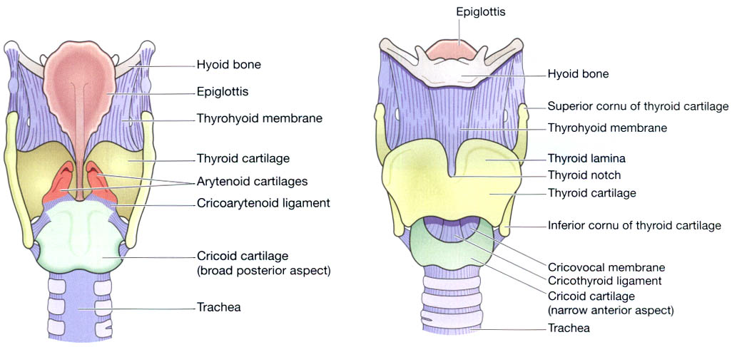

Slide 13
Functions
Production of sound.
Speech.
Protection of the lower respiratory tract
Passageway for air.
Humidifying, filtering and warming.

Slide 14
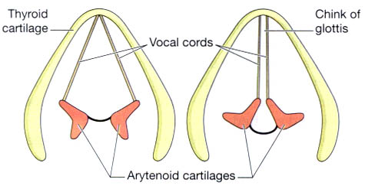
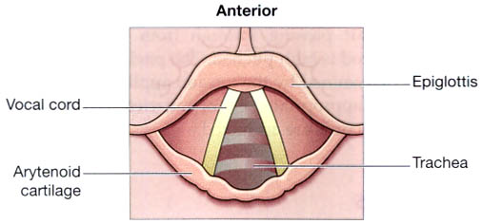
Interior of the larynx viewed from above.
The extreme positions of the vocal cords.

