Slide 1
Diffusion of gases
Done by:
Mrs. Mercy Deva Priya
Asst.Professor .Dept of MHN

Slide 2
Diffusion of gases
Exchange of gases occurs when a difference in partial pressure exists across semi-permeable membranes.
Gases move by diffusion from the higher concentration to the lower until equilibrium is established .
Atmospheric nitrogen is not used by the body so its partial pressure remains unchanged and is the same in inspired and expired air, alveolar air and in the blood.

Slide 3
External respiration
This is exchange of gases by diffusion between the alveoli and the blood. Each alveolar wall is one cell thick and is surrounded by a network of tiny capillaries.
Venous blood arriving at the lungs has travelled from all the active tissues of the body, and contains high levels of CO2 and low levels of O2.
Carbon dioxide diffuses from venous blood down its concentration gradient into the alveoli until equilibrium with alveolar air is reached.
By the same process, oxygen diffuses from the alveoli into the blood.

Slide 4
When blood leaves the alveolar capillaries, the oxygen and carbon dioxide concentrations are in equilibrium with those of alveolar air .

Slide 5
Internal respiration
This is exchange of gases by diffusion between blood in the capillaries and the body cells.
PO2 of blood arriving at the capillary bed is therefore the same as blood leaving the lungs.
Blood arriving at the tissues has been cleansed of its CO2 and saturated with O2 during its passage through the lungs, and therefore has a higher PO2 and a lower PCO2 than the tissues.
This creates concentration gradients between the blood and the tissues, and gaseous exchange therefore occurs.

Slide 6
O2 diffuses from the bloodstream through the capillary wall into the tissues.
CO2 diffuses from the cells into the extracellular fluid then into the bloodstream towards the venous end of the capillary.

Slide 7
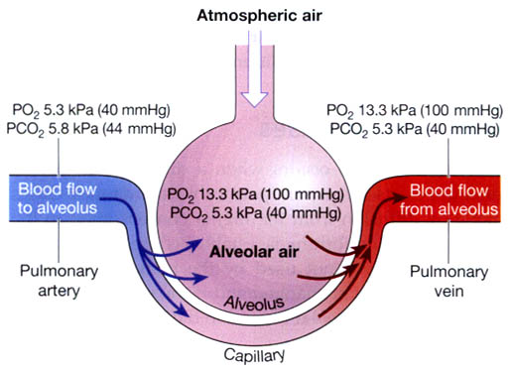

Slide 8
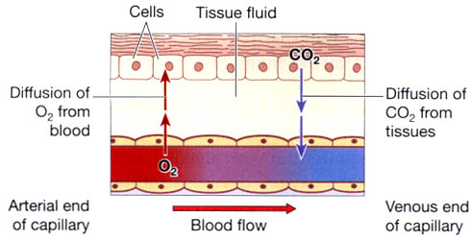

Slide 9
Control of respiration
Control of respiration is normally involuntary.
The respiratory centre-This is formed by groups of nerve cells that control the rate and depth of respiration.
They are situated in the brain stem, in the medulla oblongata and the pons.

Slide 10
Chemoreceptors

