Slide 1
RESPIRATION
Done by:
Mrs. Mercy Deva Priya
Asst.Professor .Dept of MHN

Slide 2
RESPIRATION
Inflation and deflation of the lungs occurring with each breath ensures that regular exchange of gases takes place between the alveoli and the external air.

Slide 3
Muscles of respiration
The expansion of the chest during inspiration occurs as a result of muscular activity, partly voluntary and partly involuntary.
The main muscles of respiration in normal quiet breathing are the intercostal muscles and the diaphragm.
During difficult or deep breathing they are assisted by the muscles of the neck, shoulders and abdomen.

Slide 4
Intercostal muscles
There are 11 pairs of inter-costal muscles that occupy the spaces between the 12 pairs of ribs.
They are arranged in two layers, the external and internal inter-costal muscles

Slide 5
The external inter-costal muscle fibres. These extend in a downwards and forwards direction from the lower border of the rib above to the upper border of the rib below.
The internal inter-costal muscle fibres. These extend in a downwards and backwards direction from the lower border of the rib above to the upper border of the rib below, crossing the external inter-costal muscle fibres at right angles.

Slide 6
The first rib is fixed. Therefore, when the inter-costal muscles contract they pull all the other ribs towards the first rib.
Because of the shape of the ribs they move outwards when pulled upwards.
In this way the thoracic cavity is enlarged antero-posteriorly and laterally.
The inter-costal muscles are stimulated to contract by the inter-costal nerves.

Slide 7
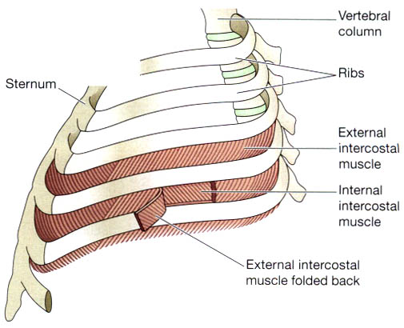

Slide 8
Diaphragm
The diaphragm is a dome-shaped structure separating the thoracic and abdominal cavities.
It forms the floor of the thoracic cavity and the roof of the abdominal cavity and consists of a central tendon from which muscle fibres radiate to be attached to the lower ribs and sternum and to the vertebral column by two crura.

Slide 9
When it contracts, its muscle fibres shorten and the central tendon is pulled downwards to the level of the 9th thoracic vertebra, enlarging the thoracic cavity in length.
This decreases pressure in the thoracic cavity and increases it in the abdominal and pelvic cavities.
The diaphragm is supplied by the phrenic nerves.

Slide 10
The inter-costal muscles and the diaphragm contract simultaneously ensuring the enlargement of the thoracic cavity in all directions, that is from back to front, side to side and top to bottom.

Slide 11
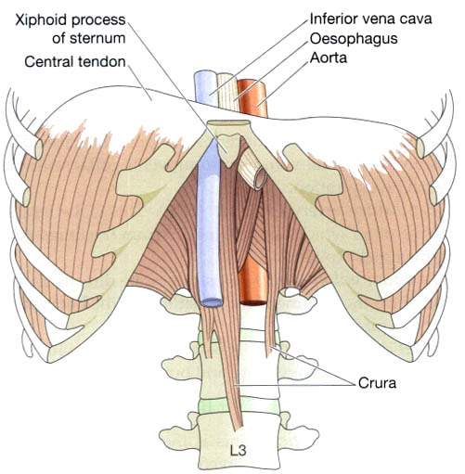

Slide 12
Cycle of respiration
This occurs 12 to 15 times per minute and consists of
three phases:
• inspiration
• expiration
• pause.

Slide 13
Inspiration-is as active process
When the capacity of the thoracic cavity is increased by simultaneous contraction of the intercostal muscles and the diaphragm, the parietal pleura moves with the walls of the thorax and the diaphragm.
This reduces the pressure in the pleural cavity to a level considerably lower than atmospheric pressure.
The visceral pleura follows the parietal pleura pulling the lung with it.
This stretches the lungs and the pressure within the alveoli and in the air passages falls, drawing air into the lungs in an attempt to equalise the atmospheric and alveolar air pressures.

Slide 14
Expiration
Relaxation of the inter-costal muscles and the diaphragm results in downward and inward movement of the rib cage and elastic recoil of the lungs.
As this occurs, pressure inside the lungs exceeds that in the atmosphere and therefore air is expelled from the respiratory tract.
The lungs still contain some air and are prevented from complete collapse by the intact pleura.
This process is passive as it does not require the expenditure of energy.
After expiration, there is a pause before the next cycle

Slide 15
Lung volumes and capacities- self study

