Slide 1
TRACHEA

Slide 2
Position
The trachea or windpipe is a continuation of the larynx and extends downwards to about the level of the 5th thoracic vertebra where it divides (bifurcates) at the carina into the right and left bronchi, one bronchus going to each lung.
It is approximately 10 to 11 cm long and lies mainly in the median plane in front of the oesophagus

Slide 3
Structures associated with the trachea
Superiorly —the larynx
Inferiorly —the right and left bronchi
Anteriorly —upper part: the isthmus of the
thyroid gland lower part: the arch of the aorta and the sternum
Posteriorly —the oesophagus separates the
trachea from the vertebral column
Laterally —the lungs and the lobes of the
thyroid gland.

Slide 4
Structure
The trachea is composed of from 16 to 20 incomplete
(C-shaped) rings of hyaline cartilages lying one above the other.
The cartilages are incomplete posteriorly.
Connective tissue and involuntary muscle join the cartilages
and form the posterior wall where they are incomplete.
The soft tissue posterior wall is in contact with the
oesophagus .
There are three layers of tissue which 'clothe' the cartilages of the trachea.
The outer layer. This consists of fibrous and elastic
tissue and encloses the cartilages.

Slide 5
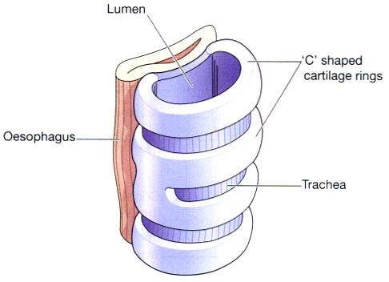
The relationship of the trachea to the oesophagus.

Slide 6
The middle layer. This consists of cartilages and bands of smooth muscle that wind round the trachea in a helical arrangement.
There is some areolar tissue, containing blood and lymph vessels and autonomic nerves.
The inner lining. This consists of ciliated columnar epithelium, containing mucus-secreting goblet cells.

Slide 7
Blood and nerve supply, lymph drainage
The arterial blood supply.
This is mainly by the inferior thyroid and bronchial arteries and the venous return is by the inferior thyroid veins into the brachiocephalic veins.
The nerve supply.
This is by parasympathetic and sympathetic fibres. Parasympathetic supply is by the recurrent laryngeal nerves and other branches of the vagi.
Sympathetic supply is by nerves from the sympathetic ganglia.

Slide 8
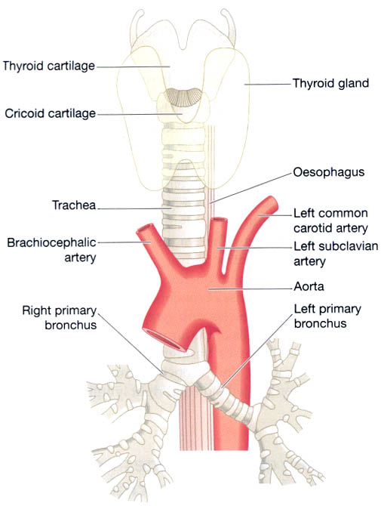
The trachea and some of its associated structures.

Slide 9
Functions
Support and patency.
Mucociliary escalator.
Cough reflex.
Warming, humidifying and filtering of air

Slide 10
BRONCHI AND SMALLER AIR PASSAGES
The two primary bronchi are formed when the trachea divides, i.e. about the level of the 5th thoracic vertebra.
The right bronchus.
This is wider, shorter and more vertical than the left bronchus and is therefore the more likely of the two to become obstructed by an inhaled foreign body.
It is approximately 2.5 cm long.
After entering the right lung at the hilum it divides into three

Slide 11
branches, one to each lobe. Each branch then subdivides into numerous smaller branches.
The left bronchus.
This is about 5 cm long and is narrower than the right. After entering the lung at the hilum it divides into two branches, one to each lobe.
Each branch then subdivides into progressively smaller tubes within the lung substance.

Slide 12
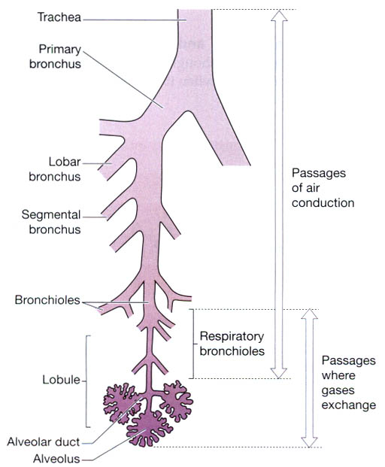

Slide 13
Bronchi and bronchioles
Structure
The bronchi are composed of the same tissues as the
trachea. They are lined with ciliated columnar epithelium.
The bronchi progressively subdivide into bronchioles
terminal bronchioles, respiratory bronchioles,
alveolar ducts and finally, alveoli. Towards the distal end of the bronchi the cartilages become irregular in shape and are absent at bronchiolar level.

Slide 14
Blood and nerve supply, lymph drainage
right and left bronchial arteries and the venous return is mainly through the bronchial veins
The nerve supply. This is by parasympathetic and
sympathetic nerves.
The vagus nerves (parasympathetic) stimulate contraction of smooth muscle in the bronchial tree, causing bronchoconstriction, and sympathetic stimulation causes bronchodilatation

Slide 15
The lymphatic vessels and lymph nodes.
Lymph is drained from the walls of the air passages in a network of lymph vessels. It passes through lymph nodes situated around the trachea and bronchial tree then into the
thoracic duct on the left side and right lymphatic duct on the other.

Slide 16
Functions of air passages not involved in gaseous exchange
Control of air entry.
The following functions continue as in the upper
airways:
• warming and humidifying
• support and patency
• removal of particulate matter
• cough reflex.

Slide 17
Respiratory bronchioles and alveoli
Lobules are the blind ends of the respiratory tract distal
to the terminal bronchioles, consisting of: respiratory bronchioles, alveolar ducts and alveoli (tiny air sacs)
It is in these structures that the process of ga exchange
occurs.
The walls gradually become thinner until muscle and connective tissue fade out leaving a single layer of simple squamous epithelial cells in the alveolar ducts and alveoli.

Slide 18
The alveoli are surrounded by a network of capillaries. The exchange of gases during respiration takes place across two membranes, the alveolar and capillary membranes.

Slide 19
Interspersed between the squamous cells are other cells
that secrete surfactant, a phospholipid fluid which prevents the alveoli from drying out.
In addition, surfactant reduces surface tension and prevents alveolar walls collapsing during expiration. Secretion of surfactant into the distal air passages and alveoli begins about the 35th week of fetal life.
Its presence in newborn babies facilitates expansion of the lungs and the establishment of respiration.
It may not be present in sufficient amounts in the immature lungs of premature babies, causing difficulty in establishing respiration.

