Slide 1
HUMAN BODY
Mrs.Mercy Deva Priya
Asst.Prof.
Dept of MHN

Slide 10
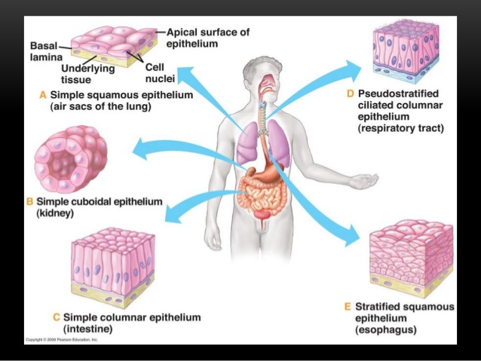

Slide 13
