Slide 1
ORGAN SYSTEM
Mrs.Mercy Deva Priya
Asst.Prof.
Dept of MHN

Slide 4
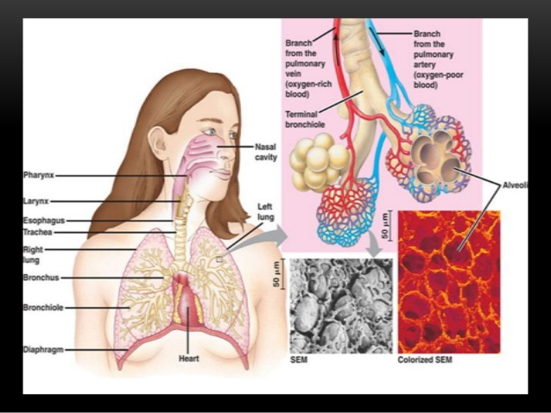

Slide 5
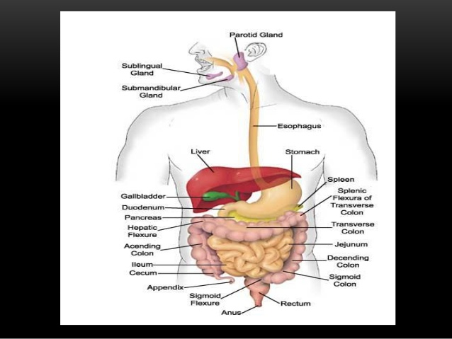

Slide 6
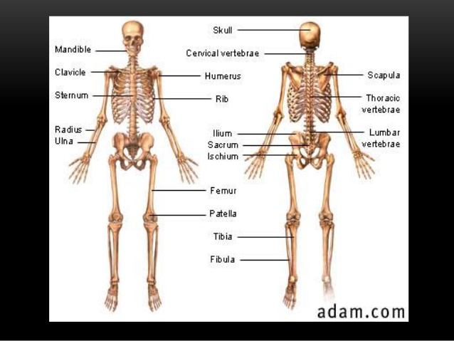

Slide 7
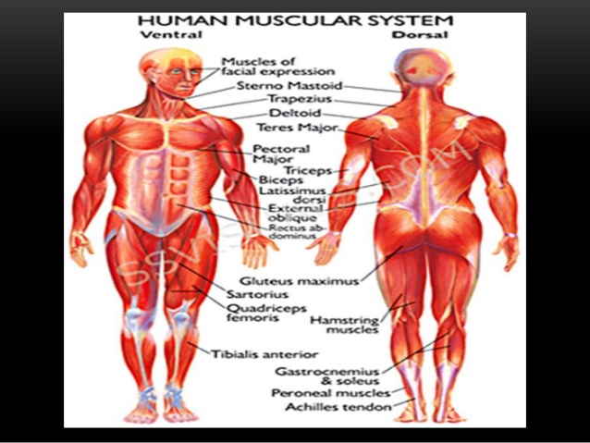

Slide 8
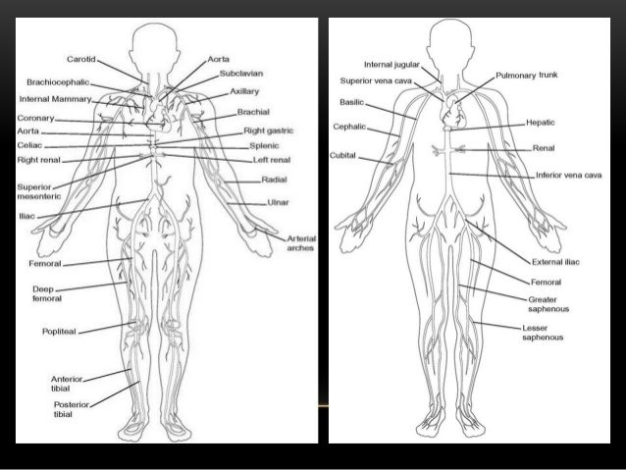

Slide 9
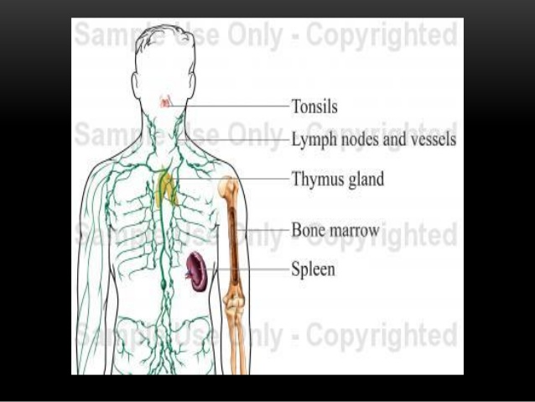

Slide 10
