Slide 1
DEEP VEIN THROMBOSIS (DVT)
By: Gincy Samuel
Asst. Professor
Department: MSN

Slide 2
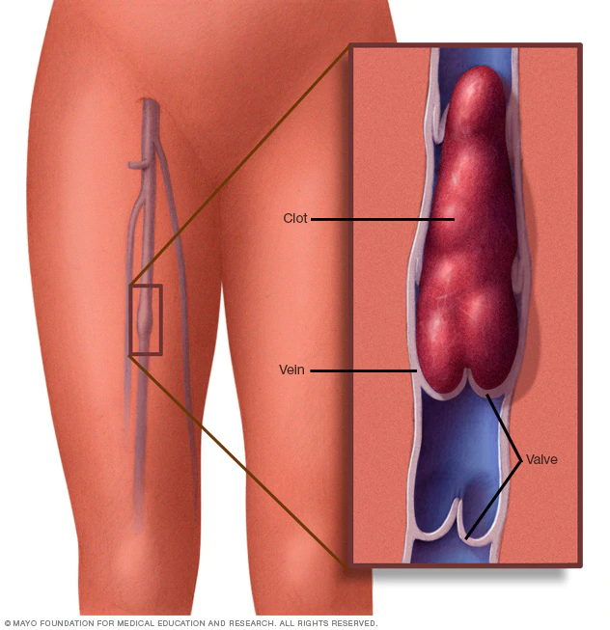
DEEP VEIN THROMBOSIS (DVT)
The blood clot (thrombus) forms in one or more of the deep veins in the body, usually in the legs.

Slide 3
Causes
Injury to vein
Surgery
Certain medications
Limited movement

Slide 4
Risk factors
Family history
Overweight or obese
Blood-clotting disorder
Prolonged bed rest
Pregnancy
Birth control pills
Smoking
Diseases: Cancer, Heart failure

Slide 5
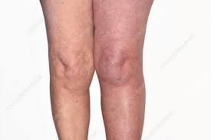
Symptoms
Swelling in the affected leg
Pain in the leg
The cramping pain in the calf
Red or discolored skin on the leg
Warm skin in the affected leg

Slide 6
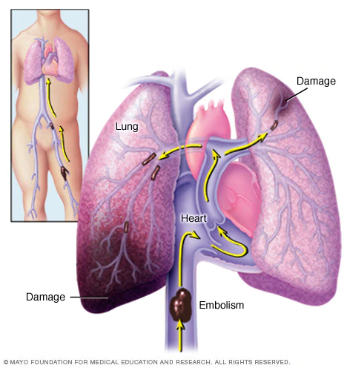
Complications
Pulmonary embolism: The blood vessel in the lung becomes blocked by a blood clot (thrombus) that travels to the lung, usually from legs.

Slide 7
Signs and symptoms of a pulmonary embolism:
Sudden shortness of breath
Chest pain during deep breath or cough
Fainting
Rapid pulse
Blood in the cough

Slide 8
Diagnostic Test
Ultrasound
Blood test
Venography
CT or MRI scans

Slide 9
Treatment
Anticoagulants: Blood thinners, prevent clots from getting bigger
Thrombolytic drugs: to break the blood clots
vena cava filter: prevent clots to break loose and obstructing in the lungs.
Compression stockings: prevent swelling

Slide 10
Prevention
Advice to avoid sitting or crossing legs for a longer duration
Advice to lose weight and quit smoking
Advice regular exercise to lowers the risk of blood clots
Advice to check for excessive bleeding during the time of medications

