Slide 1
CARDIAC ARREST
By: Gincy Samuel
Asst. Professor
Department: MSN

Slide 2
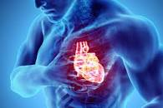
CARDIAC ARREST
It is the sudden loss of heart function, breathing and consciousness. Occurs due to an electrical disturbance in the heart that disturbs its pumping action and stops blood flow to the body.

Slide 3
Causes
Abnormal electrical impulses
Irregularly arrhythmia
Coronary artery disease
Heart attack
Enlarged heart (cardiomyopathy)
Valvular heart disease
Congenital heart disease

Slide 4
Risk factor
Family history of coronary artery disease
Smoking
High blood pressure
High blood cholesterol
Obesity
Diabetes
Sedentary lifestyle

Slide 5
Symptoms
Sudden collapse
No pulse
No breathing
Loss of consciousness

Slide 6
Complications
Unconsciousness
Brain damage

Slide 7
Diagnostic Test
Electrocardiogram (ECG): prolonged QT interval
Blood tests: to check the levels of potassium, magnesium, hormones
Chest X-ray
Echocardiogram
Angiogram

Slide 8
Treatment
CPR: Chest compressions with artificial ventilation

Slide 9
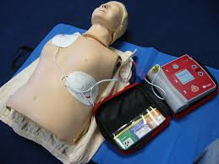
Defibrillation: An AED (automated external defibrillator) is a lightweight, battery-operated, portable device that checks the heart's rhythm and sends shock to the heart to restore a normal rhythm.

Slide 10
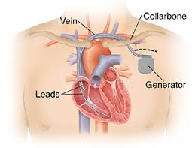
Implantable cardioverter-defibrillator (ICD): It is a small battery-powered device placed in the chest to monitor and detect irregular heartbeats. It deliver electric shocks through wires connected to the heart.

Slide 11
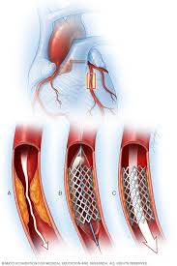
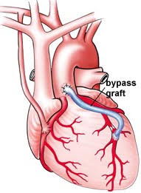
Coronary angioplasty
Coronary bypass surgery

