Slide 1
BUERGER'S DISEASE
By: Gincy Samuel
Asst. Professor
Department: MSN

Slide 2
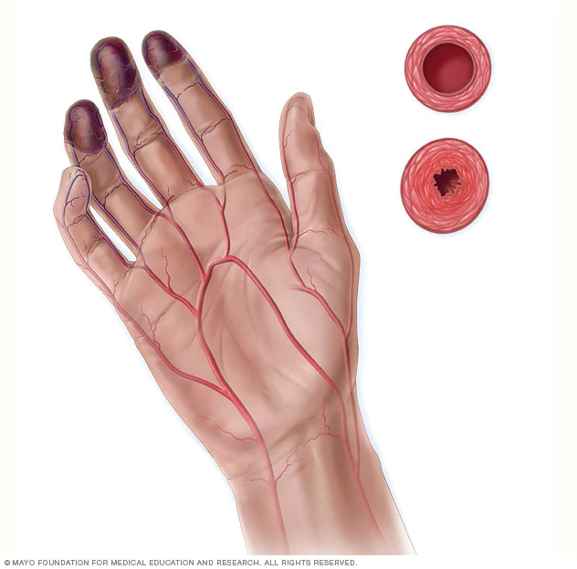
BUERGER'S DISEASE
It is the Inflammation and thrombosis in small and medium-sized blood vessels of the arms and legs, leading to gangrene.

Slide 3
Causes and Risk factors
Unknown
Smoking: Chemicals in tobacco
Autoimmune disorders
Chronic gum diseases
Gender: common in male
Age: within 45 years

Slide 4
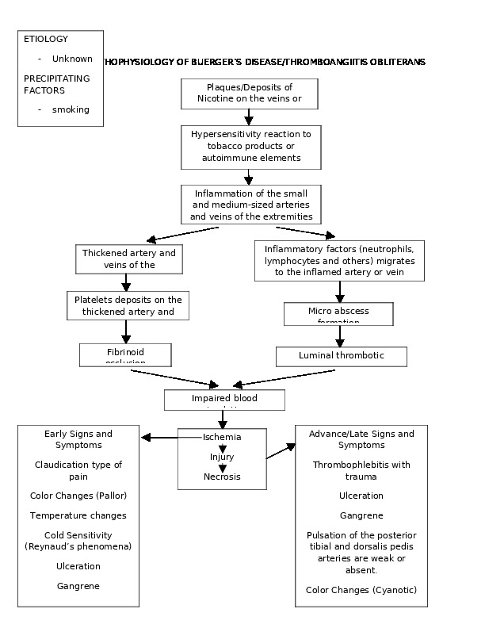

Slide 5
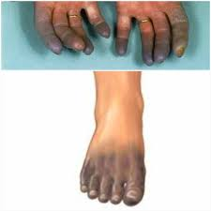
Symptoms
Tingling or numbness in the hands or feet.
Pale, reddish or blue hands or feet.
Inflammation in veins
Fingers and toes turns pale
when exposed to cold
Painful open sores on the fingers and toes.

Slide 6
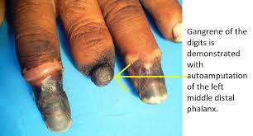
Complications
Gangrene: It is a type of tissue death caused by a lack of blood supply
-black or blue skin
-loss of feeling in the affected finger or toe
-foul smell from the affected area

Slide 7
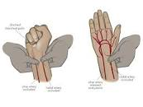
Diagnosis
Blood tests
Allen's test: Used to assess the
arterial blood supply of the hand.
If hand flushes within 5-15 seconds
it indicates positive results.
Angiogram

Slide 8
Treatment
Smoking cessation
Medications to dilate blood vessels, improve blood flow or dissolve blood clots
Intermittent compression of the arms and legs to increase blood flow to the extremities
Amputation if infection or gangrene

Slide 9
Prevention
Exercise: 30 minutes of moderate aerobic exercise
Skin care: Check the skin of arms and legs daily for cuts or discoloration
Infection prevention: Clean any cut with soap and water, apply antibiotic ointment, and cover it with a clean bandage.
Gum care: avoid gum disease with regular follow up

