Slide 1
ANEURYSM
By: Gincy Samuel
Asst. Professor
Department: MSN

Slide 2
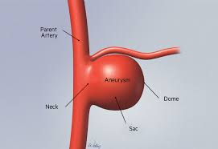
ANEURYSM
When artery wall weakens and causes an abnormally large bulge, it ruptures and cause internal bleeding.
Aneurysm can occur in any part of the body, such as:
brain
aorta
legs
spleen

Slide 3
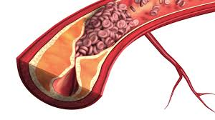
Causes
Atherosclerotic disease: Plaque collects in the arteries
High blood pressure: enlarge or weaken the blood vessels.
Damaged tissue in the arteries

Slide 4
Risk Factor
Intake of diet high in fats/cholesterol
Family history of heart disease and heart attack
Smoking
Obesity
Pregnancy
Age above 60
Common in males

Slide 5
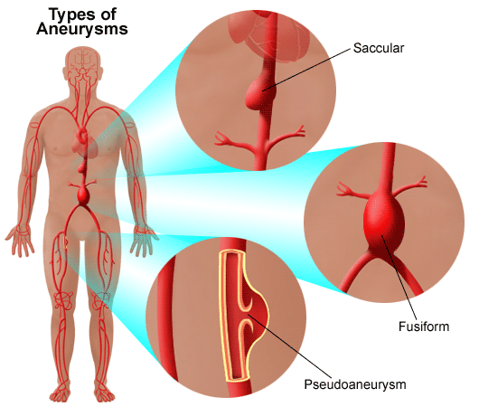
Types
Saccular Aneurysm
Fusiform Aneurysm
Pseudo Aneurysm

Slide 7
Symptoms
Ruptured aneurysms symptoms are:
bleeding
increased heart rate
pain
Lightheadedness
near the surface of the body: signs of swelling and pain

Slide 8
Diagnostic Test
CT Scan
MRI
Angiography
Ultrasound of arteries

Slide 9
Treatment
Beta blockers: metoprolol, lower the blood pressure
Statins: atorvastatin, lower your cholesterol
Anti hypertensive drugs

Slide 10
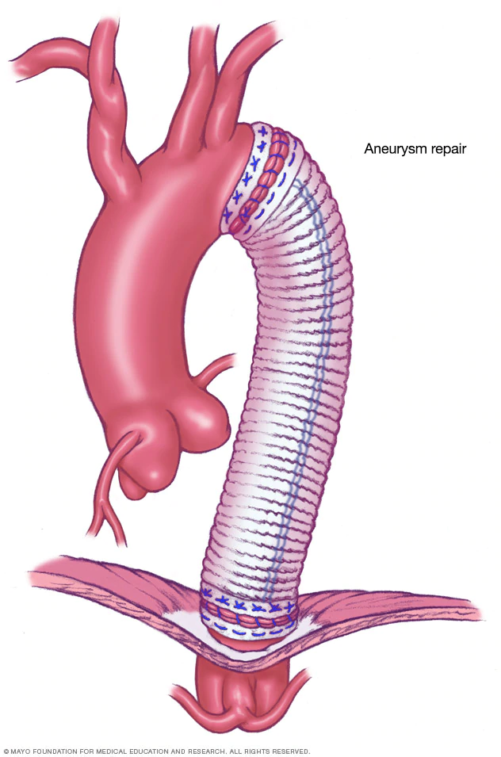
Surgery
Open-chest surgery: removing the damaged section of the aorta and replacing it with a synthetic tube

Slide 11
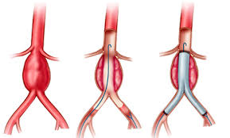
Endovascular surgery: a small incision near the blood vessels. A special fabric tube device framed with stainless steel self-expanding stents, is inserted through the arteries in a catheter and a long, narrow flexible tube positioned inside the aorta.

