Slide 1
AORTIC AND PULMONARY VALVE DISEASES
By: Gincy Samuel
Asst. Professor
Department: MSN

Slide 2
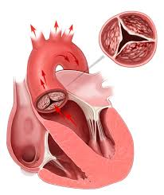
AORTIC VALVE DISEASES
The valve between the main pumping chamber of the heart (left ventricle) and the main artery to the body (aorta) doesn't work properly. It is a congenital disease.

Slide 3
Risk factors
Older age
congenital heart diseases
History of infections that can affect the heart
Chronic kidney disease
History of radiation therapy to the chest

Slide 4
Types of aortic valve disease
Aortic valve stenosis: The aortic valve become thick and stiff or fuse together. This causes narrowing of the aortic valve opening.
Aortic valve regurgitation: The aortic valve doesn't close properly which causes backward flow of blood into the left ventricle.

Slide 5
Symptoms
Abnormal heart sound (heart murmur)
Shortness of breath( during activity or lying down)
Dizziness
Fainting
Chest pain or tightness
Irregular heartbeat
Fatigue (after activity)
Anorexia
No weight gain

Slide 6
Complications
Heart failure
Stroke
Blood clots
Heart rhythm abnormalities
Death

Slide 7
Diagnostic test
Echocardiogram
Cardiac computerized tomography (CT) scan
Cardiac MRI
Chest x-ray
Exercise tests or stress tests
Cardiac catheterization

Slide 8
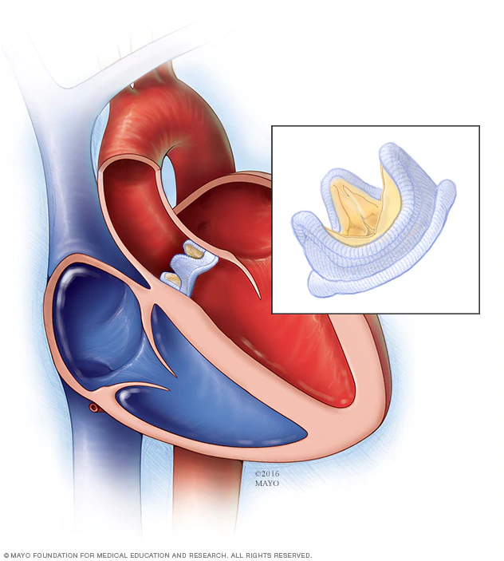
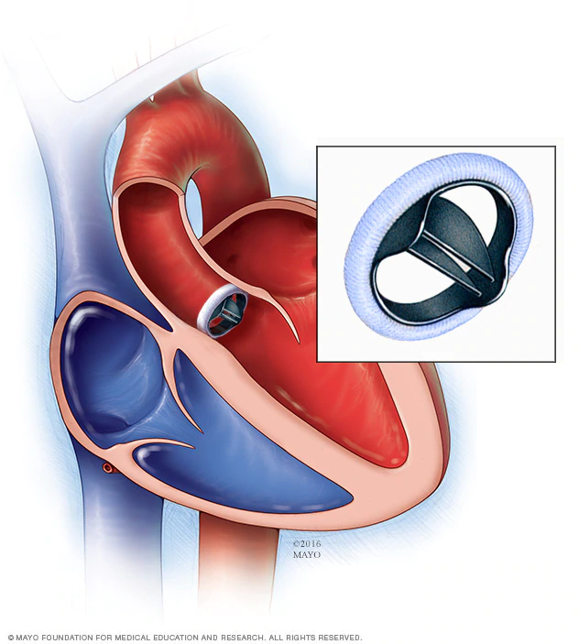
Surgical management
Aortic valve repair (valvuloplasty)
Aortic valve replacement

Slide 9
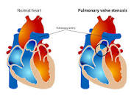
Pulmonary valve diseases
The pulmonary valve — located between the heart's lower right heart chamber (right ventricle) and the artery that delivers blood to the lungs (pulmonary artery) — doesn't work properly

Slide 10
Causes and Risk factors
Rheumatic fever
Pulmonary valve replacement
Congenital heart abnormalities

Slide 11
Complications
Infection
Heart-pumping problems
Heart failure
Irregular heartbeat (arrhythmia)

Slide 12
Symptoms of pulmonary stenosis
Heart murmur — an abnormal whooshing sound heard using a stethoscope, caused by turbulent blood flow
Fatigue
Shortness of breath (during exertion)
Chest pain
Loss of consciousness (fainting)

Slide 13
Treatment
Balloon valvuloplasty
Open-heart surgery

Slide 14
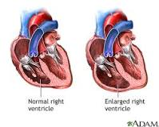
Tricuspid valve disease
The valve between the two right heart chambers (right ventricle and right atrium) doesn't function properly.

Slide 15
Symptoms of Tricuspid valve regurgitation
Fatigue
Reduced exercise capacity
Swelling in the abdomen, legs or neck veins
Abnormal heart rhythms
Palpitation
Shortness of breath with activity

Slide 16
Causes and risk factors
Infective endocarditis
Pacemakers
Endo myocardial biopsy
chest trauma
Rheumatic fever
Congenital heart defects
Radiation

