Slide 1
BURNS
Mrs. Gincy Samuel
Asst. Professor
Department: MSN

Slide 2
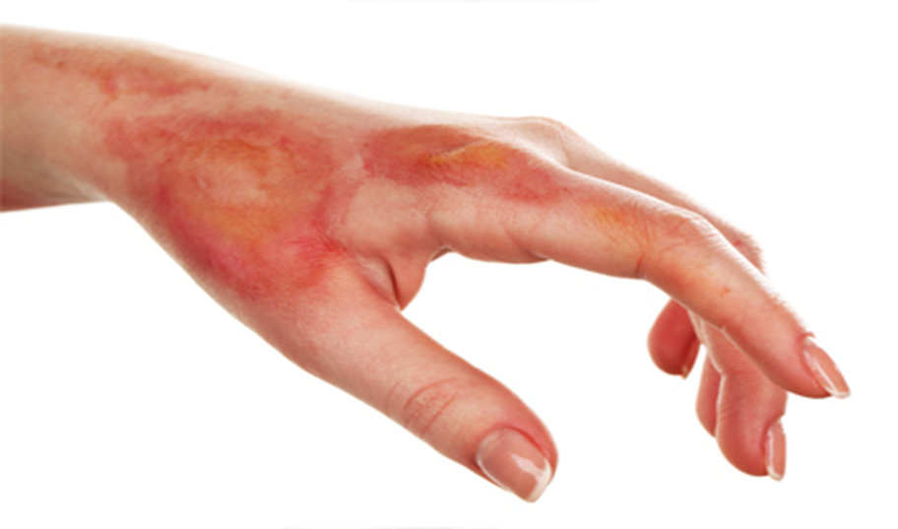
BURNS
It is damage to the skin or other body parts caused by extreme heat, flame, contact with heated objects, or chemicals.

Slide 3
Causes
Thermal burn
Chemical burn
Electrical burn
Radiation burn
Inhalation injury

Slide 4
Classification
According to the burn depth:
Superficial partial thickness or first degree burn: minimal tissue damage on upper layer of skin. Eg: sunburn
Redness, pain and minor swelling, dry skin with blister
Heals within 3 to 6 days

Slide 5
Deep partial thickness or second degree burns: affects both the epidermis, dermis, sweat glands and hair follicles.
Redness, pain, swelling, blisters and scar
Heals within 1 to 3 weeks

Slide 6
full thickness wound or third degree burns:
Affects epidermis, dermis, hypodermis, organs, tissues, muscle and bones.
Dry surface, waxy white, leathery, brown with no pain or little pain
Slow healing usually with skin grafting

Slide 7
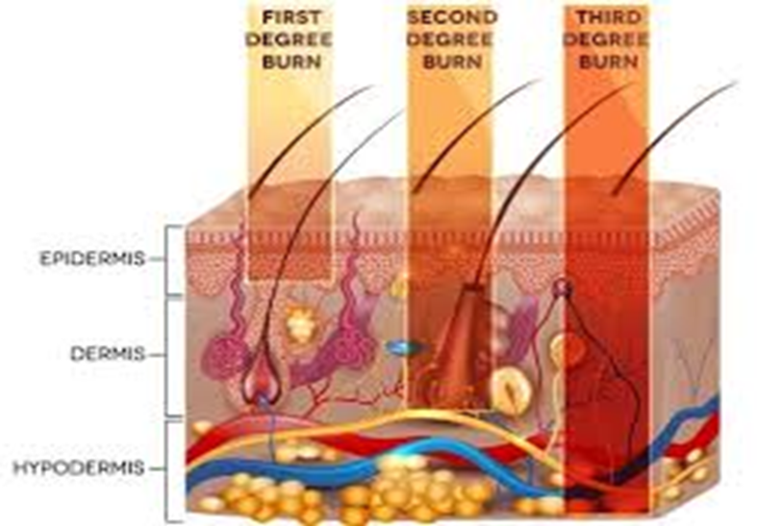

Slide 8
Fourth degree burns: damage muscle, bone and tendons exposed to surface due to electrical or chemical injuries. In this amputation required.

Slide 9
According To Severity:
Minor burns: all first degree and second degree burns less than 10% of body surface.
Moderate burns: burns on hands, feet, face or genitals more than 10% of body surface.
Severe burns: full thickness burn with 25% of body surface area.

Slide 12
Complications
Bacterial infection (sepsis)
Fluid loss (hypovolemia)
Low body temperature (hypothermia)
Breathing problems
Scars (keloids)
Bone and joint (contractures)

Slide 13
Diagnosis
Percent total body surface area (TBSA)
Burns >20-25% TBSA require IV fluid resuscitation
Burns >30-40% TBSA may be fatal without treatment
In adults: "Rule of Nines" is used as a rough indicator of % TBSA

Slide 14
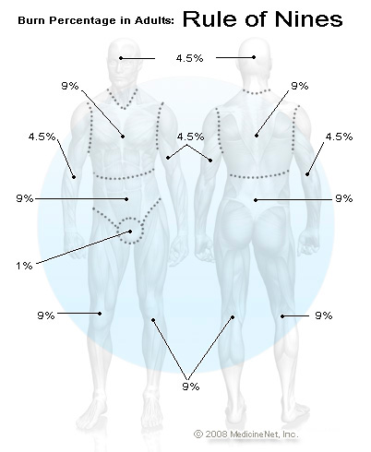
According To The Extent Of Body Surface Area Injured:

Slide 15
Lund And Browder Method

Slide 16
Effects Of Burns
Local effects
Tissue damage
Inflammation
Infection
b) Systematic effects
Fluid loss
Multiple organ failure
Inhalation injury

Slide 17
Burn Management
Wound care
First aid
• Drench the burn thoroughly with cool water to prevent further damage and remove all burned clothing.
• If the burn area is limited, immerse the site in cold water for 30 minutes to reduce pain and edema and to minimize tissue damage.

Slide 18
If burn area is large, wash with cool water, apply clean wraps on burned area to prevent hypothermia.
Transport the patient with severe burns to a hospital as soon as possible.

Slide 19
Initial treatment
Administer tetanus prophylaxis.
Debride all necrotic tissue
Gently scrub and cleanse the burn area with mild water based antiseptic.
Apply a thin layer of antibiotic cream (silver sulfadiazine).
Dress the burn with thick dry gauze

Slide 20
Daily treatment
Change the dressing daily or twice in a day
Inspect the wounds for discoloration, Cellulitis or hemorrhage
Antibiotic: silver sulfadiazine for dressing
Diet rich in calories and protein required for proper healing of skin

Slide 21
Management Of Burn
Medical treatment
Water-based treatments
Fluids to prevent dehydration
Pain and anxiety medications
Burn creams and ointments : bacitracin and silver sulfadiazine
Dressings
IV antibiotics
Tetanus shot

Slide 22
Surgical Treatment
Skin grafts. A skin graft is a surgical procedure in which sections of healthy skin are used to replace the scar tissue caused by deep burns.

Slide 23
Plastic surgery (reconstruction) : Plastic surgery can improve the appearance of burn scars and increase the flexibility of joints affected by scarring.

Slide 24
Re-Constuctive and Cosmetic surgery
To improve both the function and the cosmetic appearance of burn scars. This involves altering scar tissue, with both non-operative and operative treatment.

Slide 25
There are two main categories of burn surgery:
Acute Surgery and Reconstructive Surgery
Acute burn care occurs immediately after the injury. It is treated by General Surgeons (specialized in acute burn care).
Complex burns is treated by plastic surgeons.

Slide 26
Types of surgery
Skin grafts: skin is removed from one area of the body and transplanted to another. There are two types of skin graft: split-thickness grafts in which just a few layers of outer skin are transplanted and full-thickness grafts, which involve all of the dermis.

Slide 27
Cont..
Microsurgery: By using a microscope, the surgeon can actually sew tiny blood vessels or nerves, allowing to repair damaged nerves and arteries.

Slide 28
Cont..
Free flap procedure: During the procedure, muscle, skin, or bone is transferred along with the original blood supply from donor site to the surgical site in order to reconstruct the area with microsurgery. Total recovery may take six to eight weeks or longer.

Slide 29
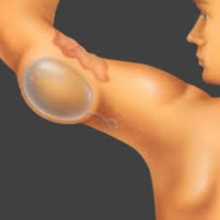
Cont..
Tissue expansion: by inserting an instrument known as a "balloon expander" under the skin near the area in need of repair. This balloon will be gradually filled with saline solution (salt water), slowly causing the skin to stretch and grow.

