Slide 1


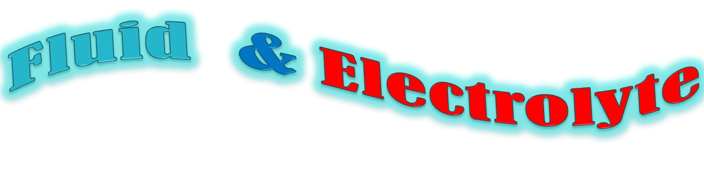

Na⁺
_{H}+
-
HCO
3
cl⁻
B a l a n c
e

Slide 2
Contents
✓Introduction
✓ Body Fluids
Source Functions Composition
✓Movements of Body Fluids
✓Fluid Balance
✓ Regulation of Body Water
✓Electrolytes
✓Electrolyte balance
✓Homeostasis
✓Imbalance disorders
✓Acid –Base Balance
✓conclusion

Slide 3
Introduction
▪ To achieve homeostasis, the body maintains strict control of water and electrolyte distribution and of acid-base balance.
This control is a function of the complex interplay of cellular membrane forces, specific organ activities and systemic and local hormone actions.
▪
Pestana C:fluids and electolytes in surgical patients, 2nd ed Baltimore, williams and wilkins, 2001 pp 101-144

Slide 4
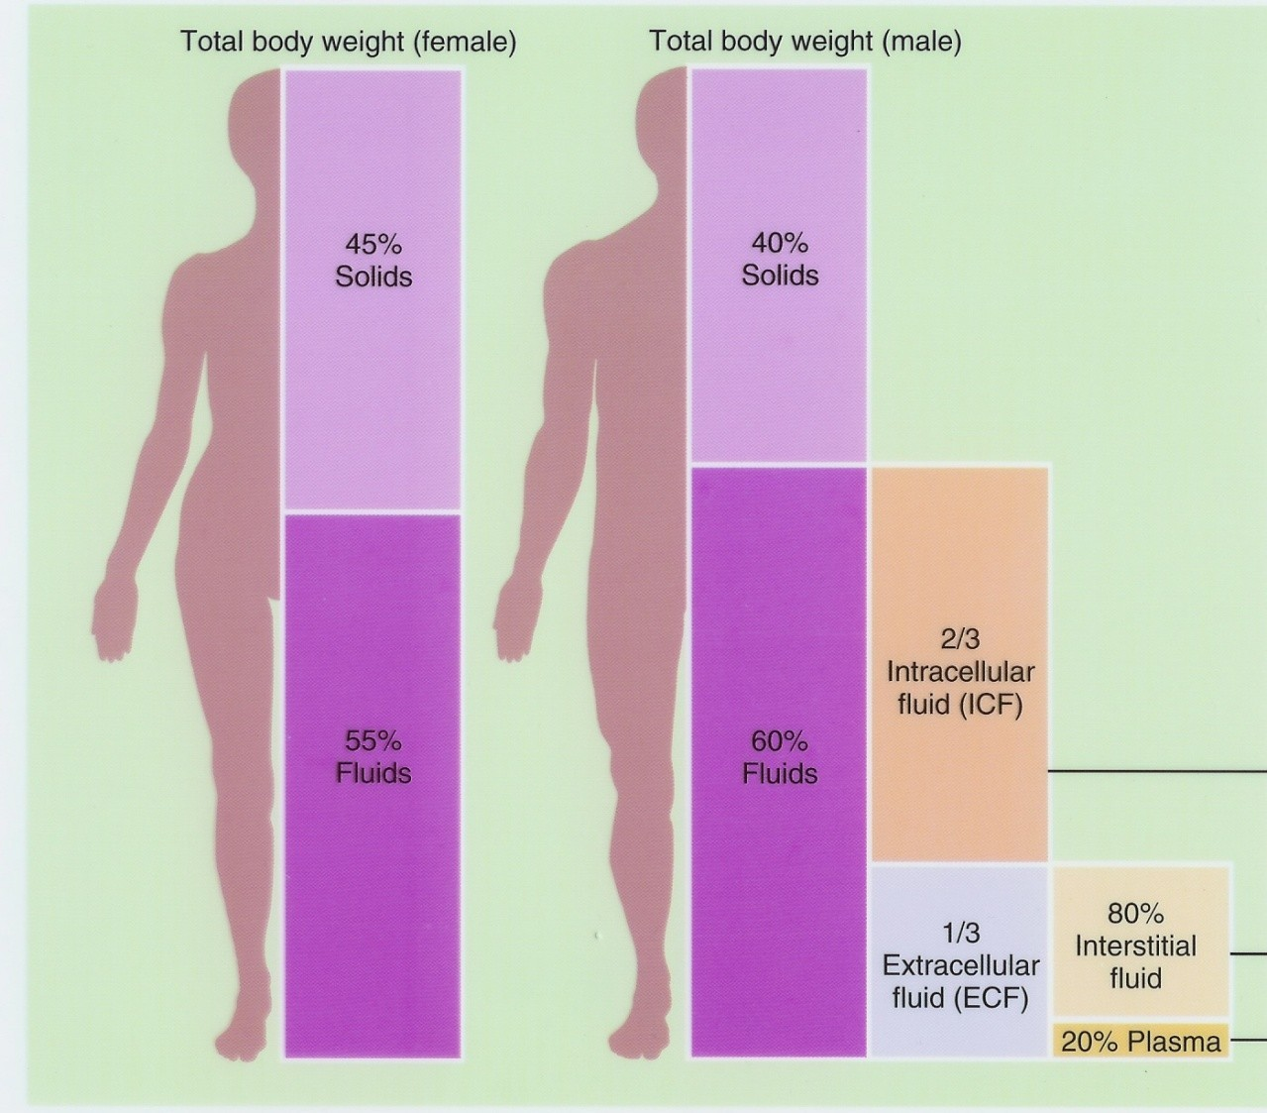
Total body water (TBW)
5

Slide 5
•
Water constitutes an average 50 to 70% of the total body weight.
Young males | - | 60% | of total body weight
Older males – |  | 52%
Young females – |  | 50% | of total body weight
Older females – |  | 47%
•
Variation of ±15% in both groups is normal.
Obese have 25 to 30% less body water than lean people. Infants 75 to 80%
gradual physiological loss of body water.
65% at one year of age.
•
•

Slide 6
Sources of Body Fluids
Preformed water represents about 2,300 ml/day of daily intake.
Metabolic water is produced through the catabolic breakdown of nutrients occurring during cellular respiration. This amounts to about 200 ml/d.
Combining preformed and metabolic water gives us total daily intake of 2,500 ml.

Slide 7
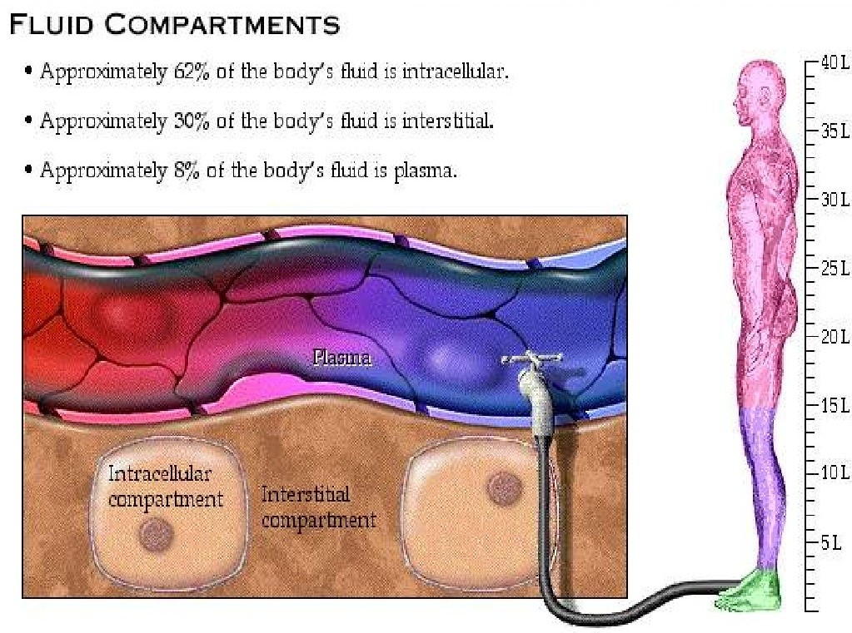

Slide 8
Functions
1
2
3
4
5
6
7
All chemical reactions occur in liquid medium.
It is crucial in regulating chemical and bioelectrical distributions within cells.
Transports substances such as hormones and nutrients.
O₂ transport from lungs to body cells.
CO₂ transport in the opposite direction.
Dilutes toxic substances and waste products and transports them to the kidneys and the liver.
Distributes heat around the body.

Slide 9
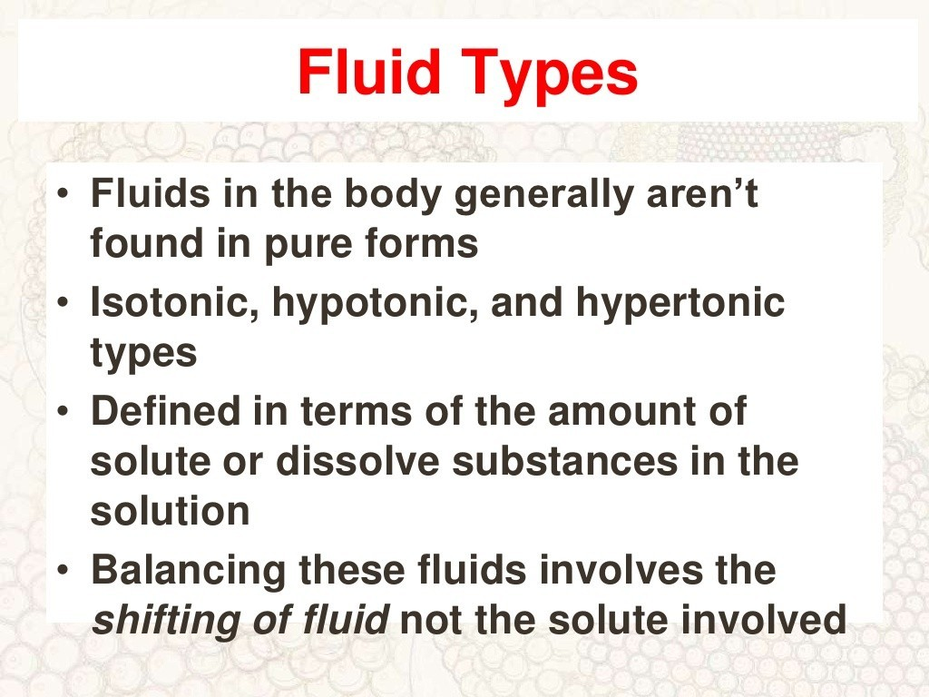

Slide 10
Composition of Body Fluids
Nonelectrolytes include most organic molecules, do not dissociate in water, and carry no net electrical charge.
Electrolytes dissociate in water to ions, and include inorganic salts, acids and bases, and some proteins.
The major cation in extracellular fluids is sodium, and the major anion is chloride; in intracellular fluid the major cation is potassium, and the major anion is phosphate.
Electrolytes are the most abundant solutes in body fluids, but proteins and some nonelectrolytes account for 60-–97% of dissolved solutes.
▪
▪
▪
▪

Slide 11
Principles of Body Water Distribution
Body control systems regulate ingestion and excretion:
- constant total body water
- constant total body osmolarity
Homeostatic mechanisms respond to changes in ECF.
No receptors directly monitor fluid or electrolyte balance.
- Respond to changes in plasma volume or osmotic concentrations




Slide 12
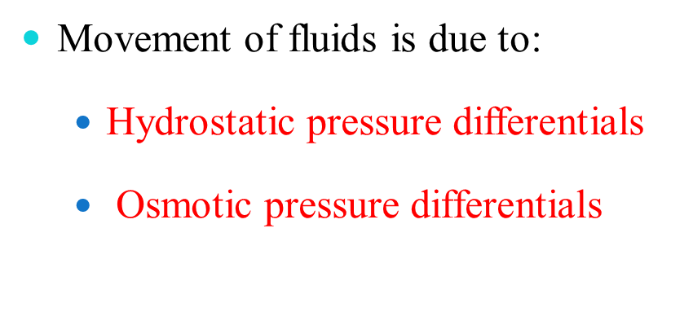
Fluid Movements

Slide 13
Movement of BODY FLUIDS
Diffusion
Osmosis
Active Transport
Filtration

Slide 14




















Osmosis
Fluid
Low Solute Concentration, High Fluid Concentration
High Solution Concentration, Low Fluid Concentration

Slide 15




















Diffusion
Fluid
Solutes
High Solute Concentration
Low Solute Concentration

Slide 16
Active transport
Na +
Na + Na + _{Na + Na +}
Na +
ATP
Na +
Na +
Na +
+
Na +
Na + Na + ^{Na +} _{Na}
Na +
ATP
Na +
Na +
Na +
Na +
Na +
K
+
K
+
K
K
+ K
+ K
+
K
+
K
+ K
K
+ K
+
K
ATP
K +
K +
K
+
ATP
K +
K +
₊₊ ++ ++
INTRACELLULAR
EXTRACELLULAR FLUID
FLUID

Slide 17
Filtration
Filtration is the transport of water and dissolved
materials through a membrane from an area of higher pressure to an area of lower pressure

Slide 18
Fluid Movement Among Compartments
Compartmental exchange is regulated by
osmotic and hydrostatic pressures.
Net leakage of fluid from the blood is picked up by lymphatic vessels and returned to the bloodstream.
Exchanges between interstitial and intracellular fluids are complex due to the selective permeability of the cellular membranes.
Two-way water flow is substantial.
Ion fluxes are restricted and move
selectively by active transport.
Nutrients, respiratory gases, and wastes move unidirectionally.
Plasma is the only fluid that circulates throughout the body and links external and internal environments.
Osmolalities of all body fluids are equal; changes in solute concentrations are quickly followed by osmotic changes.

Slide 19
Water —
Two liters of water per day are generally sufficient for adults.
Most of this minimum intake is usually derived from the water content of food and the water of oxidation, therefore.
it has been estimated that only 500ml of water needs be imbibed given normal diet and no increased losses.
These sources of water are markedly reduced in patients who are not eating and so must be replaced by maintenance fluids.

Slide 20
water requirements increase with:
fever, sweating, burns, tachypnea, surgical drains, polyuria, or ongoing significant gastrointestinal losses.

Slide 21
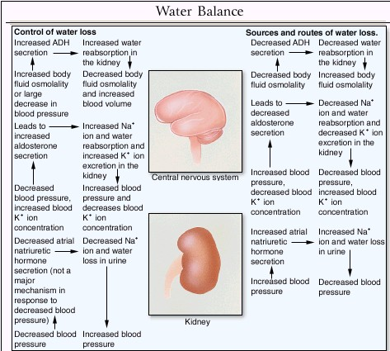

Slide 22
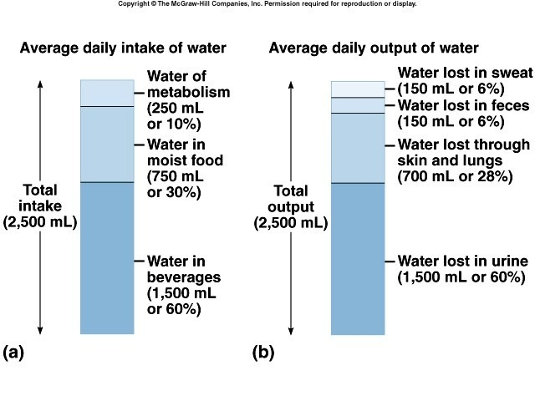
Fluid Balance
23

Slide 23
Fluid Balance
The body tries to maintain homeostasis of fluids and electrolytes by regulating:
Volumes
Solute charge and osmotic load

Slide 24
Fluid balance
Normally, there is a balance achieved between our total daily intake and output of water.
Total fluid intake is modified by the induction of the sensation of thirst.
This is produced by a reaction of cells in Hypothalamus to the increased osmotic pressure of the blood passing through this region.
Another stimulus of thirst would be the degree of dryness of the oral mucosa.

Slide 25
Regulation of body water
Any of the following:
Decreased amount of water in body
Increased amount of Na+ in the body
Increased blood osmolality
Decreased circulating blood volume
Results in:
Stimulation of osmoreceptors in hypothalamus
Release of ADH from the posterior pituitary
Increased thirst

Slide 26
Regulation of Water Intake
The thirst mechanism is triggered by a decrease in plasma osmolarity, which results in a dry mouth and excites the hypothalamic thirst center.
 Thirst is quenched as the mucosa of the mouth is moistened, and continues with distention of the stomach and intestines, resulting in inhibition of the hypothalamic thirst center.

Slide 27
Regulation of Water Output
Drinking is necessary since there is obligatory water loss due to the insensible water losses.
Beyond obligatory water losses, solute concentration and volume of urine depend on fluid intake.

Slide 28
Influence of ADH
The amount of water reabsorbed in the renal collecting ducts is proportional to ADH release.
When ADH levels are low, most water in the collecting ducts is not reabsorbed, resulting in large quantities of dilute urine.
When ADH levels are high, filtered water is reabsorbed, resulting in a lower volume of concentrated urine.
ADH secretion is promoted or inhibited by the hypothalamus in response to changes in solute concentration of extracellular fluid, large changes in blood volume or pressure, or vascular baroreceptors.

Slide 29

Problems of Fluid Balanc e
Deficient fluid volume
Hypovolemia
Dehydration
Excess fluid volume
Hypervolemia
Water intoxication
Electrolyte imbalance
Deficit or excess of one or more electrolytes
Acid-base imbalance

Slide 30
Factors Affecting Fluid Balance
Lifestyle factors
  Nutrition
  Exercise
  Stress
Physiological factors
  Cardiovascular
  Respiratory
  Gastrointestinal
  Renal
  Integumentary
  Trauma
Developmental factors
  Infants and children
  Adolescents and middle-aged adults
  Older adults
Clinical factors
  Surgery
  Chemotherapy
  Medications
  Gastrointestinal intubation
  Intravenous therapy
Elsevier items and derived items © 2007 by Saunders, an imprint of Elsevier Inc.

Slide 31


Slide 32
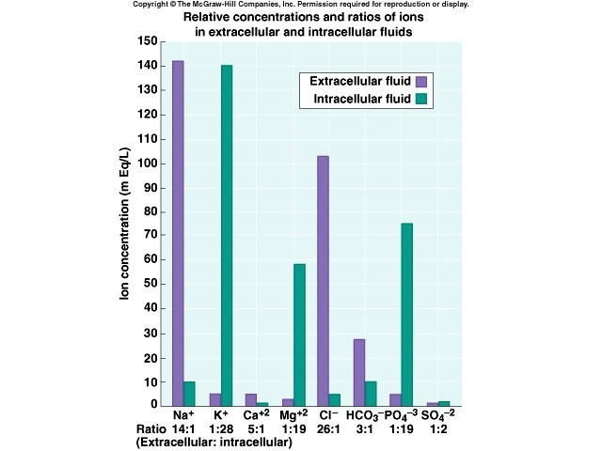
Electrolytes
33

Slide 33
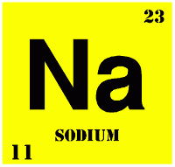
Electrolyte balance
Na⁺ Predominant extracellular cation
136 -145 mEq / L
Pairs with Cl⁻ , HCO₃⁻ to neutralize charge
Most important ion in water balance
Important in nerve and muscle function
Reabsorption in renal tubule regulated by:
•
•
•
Aldosterone Renin/angiotensin
Atrial Natriuretic Peptide (ANP)

Slide 34
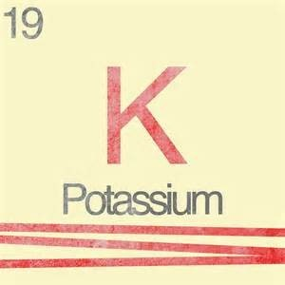
Electrolyte balance
_{K} +
Major intracellular cation
•
150- 160 mEq/ L
•
Regulates resting membrane potential
•
Regulates fluid, ion balance inside cell
Regulation in kidney through:
•
•
Aldosterone Insulin

Slide 35
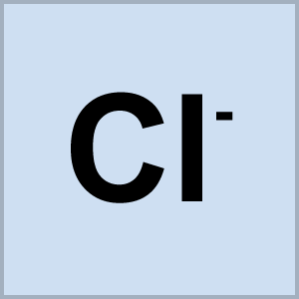
Electrolyte balance
Cl ˉ (Chloride)
Major extracellular anion
105 mEq/ L Regulates tonicity
Reabsorbed in the kidney with sodium
•
•
•
Regulation in kidney through:
•
•
Reabsorption with sodium
Reciprocal relationship with bicarbonate

Slide 36
SODIUM HOMEOSTASIS
Normal dietary intake is 6-15g/day.
Sodium is excreted in urine, stool, and sweat.
Urinary losses are tightly regulated by renal mechanisms.

Slide 37
Sodium abnormalities
Hypernatremia:
Defined as a serum sodium concentration that exceeds 150mEq/L.
Always accompanied by hyperosmolarity.

Slide 38
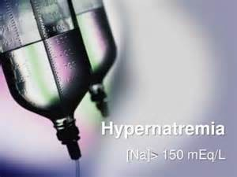
Etiology
Excessive salt intake
Excessive water loss
Reduced salt excretion
Reduced water intake
Administration of loop diuretics
Gastrointestinal losses

Slide 39
Treatment:
Restore circulating volume with isotonic saline solution
After intravascular vol. correction hypernatremia is corrected using free water.

Slide 40
Hyponatremia
 Serum sodium concentration less than 135mEq/L .
Renal losses caused by diuretic excess, osmotic diuresis, salt- wasting nephropathy, adrenal insufficiency, proximal renal tubular acidosis, metabolic alkalosis, and pseudohypoaldosteronism result in a urine sodium concentration greater than 20 mEq/L
Extrarenal losses caused by vomiting, diarrhea, sweat, and third spacing result in a urine sodium concentration less than 20 mEq/L

Slide 41
Etiology
Excessive water intake
Impaired renal water excretion
Loss of renal diluting capacity

Slide 42
Treatment of Hyponatremia
Correct serum Na by 1mEq/L/hr
Use 3% saline in severe hyponatremia.
Goal is serum Na 130.
43

Slide 43
Hypochloremia
Most commonly from gastric losses
Often presents as a contraction alkalosis with paradoxical aciduria (Na+ retained and H+ wasted in the kidney)
Treatment : resuscitation with normal saline.

Slide 44
Hyperchloremia
Most commonly from over-resuscitation with normal saline.
Often presents as a hyperchloremic acidemia with paradoxical alkaluria.
Rx: stop normal saline and replace with hypotonic crystalloid.

Slide 45
Hypokalemia
Serum K⁺ < 3.5 mEq /L

Slide 46
Causes of Hypokalemia
Decreased intake of K⁺
Increased K⁺ loss
Chronic diuretics
Severe vomiting/diarrhea
Acid/base imbalance
Trauma and stress
Increased aldosterone
Redistribution between ICF and ECF
47

Slide 47
Hyperkalemia
Serum K+ > 5.5 mEq / L
48

Slide 48
Hyperkalemia
Management
10% Calcium Gluconate or Calcium Chloride
Insulin (0.1U/kg/hr) and IV Glucose
Lasix 1mg/kg (if renal function is normal)

Slide 49
Hypokalemia:
Serum potassium level<3.5mEq/L
Etiology:
GI losses from vomiting, diarrhea, or fistula and use of diuretics

Slide 50
Treatment:
Correction of the underlying condition
K should be given orally unless severe(<2.5mEq/L), patient is symptomatic or the enteral route is contraindicated
Oral K supplements (60-80mEq/L) coupled with normal diet is sufficient.
ECG monitoring along with frequent assessment of serum K level is reqiured

Slide 51
Calcium homeostasis
Body contains approx. 1400gm of calcium
Reduction in calcium level leads to increases calcium reabsorption from the bone.
 It increases calcium reabsorption and stimulates the formation of the active metabolite of vit. D that increases gut reabsorption of elemental calcium and facilitates the action on the bone.

Slide 52
Calcium abnormalities:
Hypercalcemia:
Ionized calcium conc. > 5.3mg/dL

Slide 53
Etiology:
Hyperparathyroidism
Cancer
Paget's disease
Pheochromacytoma
Hyperthyroidism
Thiazide diuretics

Slide 54
Treatment:
Severe hypercalcemia-
Initial supportive therapy includes furosamide to increase calcium excretion.
Calcitonin reduces bone resorption and has an immediate effect and lasts for 48 hrs. prolongation can be done by using corticosteroids

Slide 55
Hypocalcemia:
Ionized calcium conc. < 4.4mg/dL

Slide 56
Etiology:
Parathyroid or thyroid surgery
Severe pancreatitis
Magnesium deficiency
Massive blood transfusion

Slide 57
Treatment:
Asymptomatic
Calcium supplementation is not required
Symptomatic
IV calcium therapy- initially 100mg elemental calcium over a period of 5-10mins.susequently, a calcium infusion of 0.5- 2mg/kg/hr is given.

Slide 58
Phosphate homeostasis
Dietary intake-800-1200mg/day.
Reabsorbed in the jejunum.
Kidney acts as the principle regulator.
Normal serum P conc. Is 2.5-4.5mg/dL.

Slide 59
Phosphate abnormalities:
Hyperphosphatemia:
Serum phosphate level>4.5mg/dL

Slide 60
Etiology:
Renal insufficiency
Thyrotoxicosis
Malignant hyperthermia
Hypoparathyroidism

Slide 61
Treatment:
Treatment of the underlying renal failure.
Chronic- phosphate binding antacids are effective.
Acute- end stage renal disease. Dialysis is required.

Slide 62
Electrolyte Disorders
Signs and Symptoms
Electrolyte Sodium (Na)
Excess
Hypernatremia
Thirst
CNS deterioration
Increased interstitial fluid
Deficit
Hyponatremia
CNS deterioration
Potassium (K)
Hyperkalemia
Ventricular fibrillation
ECG changes
CNS changes
Hypokalemia
Bradycardia
ECG changes
CNS changes

Slide 63
Electrolyte Disorders
Signs and Symptoms
Electrolyte Calcium (Ca)
Excess
Hypercalcemia
Thirst
CNS deterioration
Increased interstitial fluid
Deficit
Hypocalcemia
Tetany
Chvostek’s, Trousseau’s signs
Muscle twitching
CNS changes
ECG changes
Hypomagnesemia
Hyperactive DTRs
CNS changes
Magnesium (Mg)
Hypermagnesemia
Loss of deep tendon reflexes (DTRs)
Depression of CNS
Depression of neuromuscular function

Slide 64
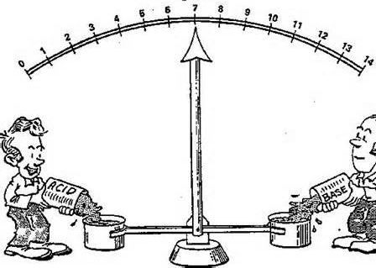
Acid-Base Balance
Usually present clinically as
Tissue malfunction due to disturbed pH
2⁰ changes in respiration as a response to the underlying metabolic changes.
Clinical picture is dominated by the cause of the acid-base change.

Slide 65
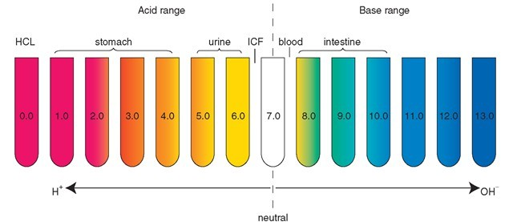
 Chlorine plays a major role in acid-base balance because of its production of hydrochloric acid (HCl).
Water contains equal components of both an acid and a base .
Pure water is considered a neutral solution.

Slide 66
Acid Base Imbalance
Metabolic Acidosis
Etiology and assessment
Occurs when acids other than carbonic acid accumulates in the body resulting in ↓ plasma bicarbonate.

Slide 67
Management:
Identify and correct the cause.
IV fluid resuscitation is needed due to associated water and sodium depletion.
Bicarbonate infusions can be started in cases where the underlying cause cannot be identified and the acidosis level is critical.

Slide 68
Metabolic alkalosis
It’s the inability of the kidney to excrete the excess bicarbonate ions or to retain hygrogen ion.
Usually accompanied by respiratory compensation.

Slide 69
Etiology:
Chloride responsive metabolic alkalosis
 Chloride-unresponsive metabolic alkalosis

Slide 70
Treatment:
Correction of the underlying defect
Contraction alkalosis treated with saline

Slide 71
Respiratory acidosis
Present when the pH is low and the PCO₂ is elevated.
Two types based upon etiology, time of evolution of the disorder and the degree of renal compensation -
Acute
Chronic

Slide 72
Etiology :
Due to ineffective alveolar ventilation
Decompensation of pre existing respiratory disease
Asthma
Neuromuscular disorders
CNS depression
Airway obstruction

Slide 73
Treatment:
Improve alveolar ventilation
By intubation
By mechanical ventilation

Slide 74
Respiratory alkalosis
Present when the pH is high and PCO₂ is low.
May be acute or chronic.

Slide 75
Etiology:
Alveolar hyperventilation
In surgical patients
Hypoxia
CNS lesions
Pain
Hepatic encephalopathy
Mechanical ventilation

Slide 76
Treatment:
Correction of the underlying problem.

Slide 77
Conclusion
Fluid movements in the body and Fluid – electrolyte balance are the inevitable process for normal body function.
Assessment of body fluid is important to determine causes of imbalance disorders.

Slide 78
References – Text Books
Oral and maxillofacial surgery-Daniel M Laskin
Essentials of surgery-Becker and Stucchi
Human physiology Mahabatra
General surgery - Shenoy
Human physiology(from cells to system – lauralee Sherwood.
Human physiology – Vanders
Principles of Surgery – Das
Principles of Human Anatomy & Physiology – Tortora Grabowski
Human Physiology – Shembulingam

Slide 79
References - Articles
Adrogue H, madias N: management of life threatening acid base disorders. N Engl J Med 338:26-34, 2008
Gennari F:serum osmolality, N Engl J Med 310:102-105, 2004
Kobrin S, goldfarb s: hypocalcemia and hypercalcemia. In adrogue H acid base and electrolyte disorders. Newyork, churchill, livingstone, 1999, pp69-96
Pestana C:fluids and electolytes in surgical patients, 2nd ed Baltimore, williams and wilkins, 2001 pp 101-144

Slide 80
PREVIOUS YEAR QUESTIONS
Osmosis (RGUHS 2010, 10 marks)

Slide 81


