Slide 1
Congestive Heart Failure
Presenter
DeviNanjappan
Principal
[FACULTY OF NURSING]

Slide 2
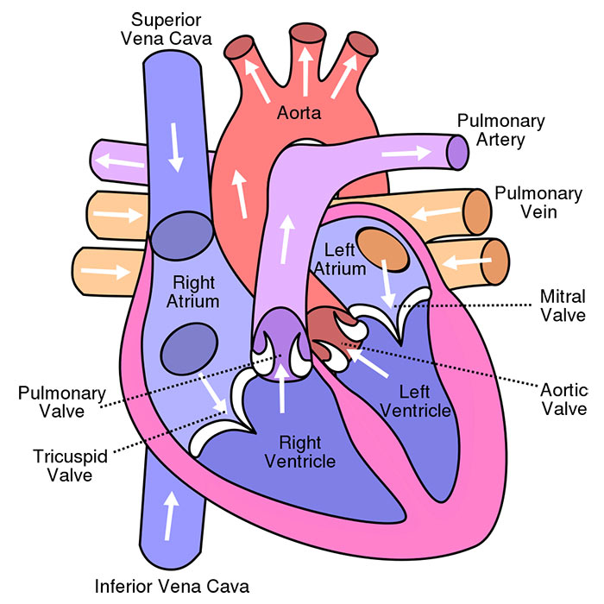
Review :Circulation

Slide 3
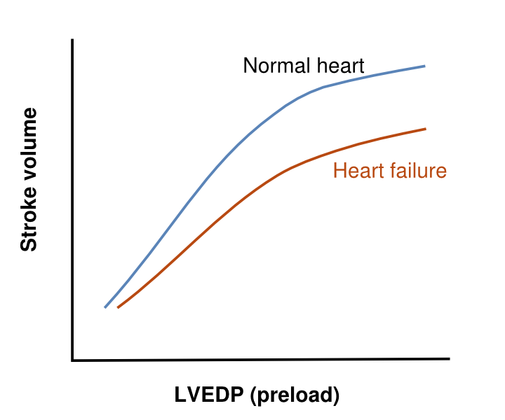
in case of CCF

Slide 4
in case of CCF
LVEDP (mm Hg) | Physiologic Consequence
3–12 | None (normal)
15 | Pulmonary hypertension, right-sided heart failure, peripheral edema
18 | Pulmonary interstitial edema
25 | Pulmonary alveolar edema

Slide 5
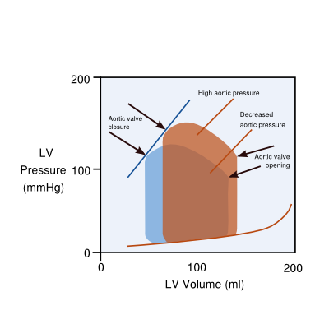
in case of CCF
Effects of decreased afterload. Red arrows indicate aortic valve opening, which occurs later and at higher LV systolic pressure when the diastolic aortic pressure is higher. Blue arrows indicate closing of the aortic valve. Bidirectional arrows represent stroke volume. When aortic pressure is decreased, stroke volume increases as a result of a lower aortic pressure during closure of the aortic valve.

Slide 6
Definition :CCF/CHF
It is a clinical syndrome of varied etiology in which the heart is unable to pump enough blood to meet the metabolic needs of the body resulting in systemic and pulmonary vascular congestion
HF is caused by a loss of cardiac pump function, which can be due to a structural abnormality of the heart muscle (e.g. myocardial infarction) or a change in the heart function (and often structure) in response to an abnormal load (e.g. aortic valve stenosis)

Slide 7
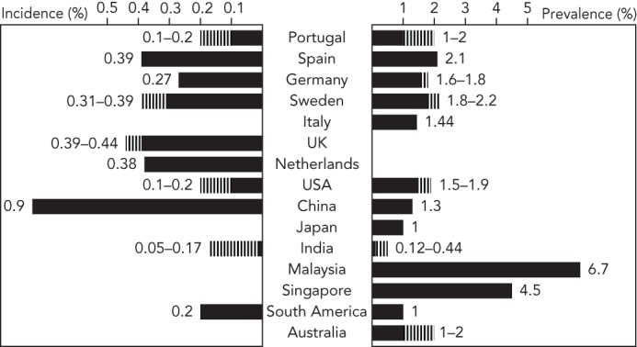
Incidence

Slide 8
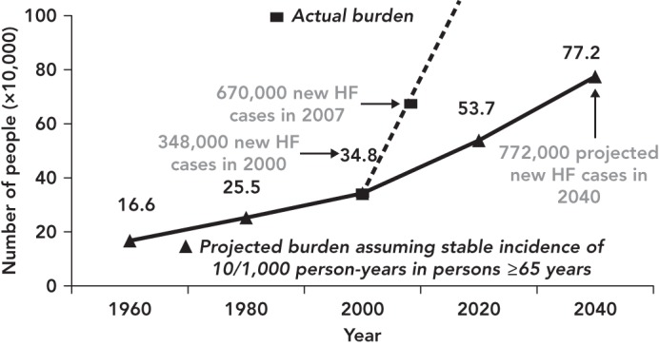
Burden of HF

Slide 9
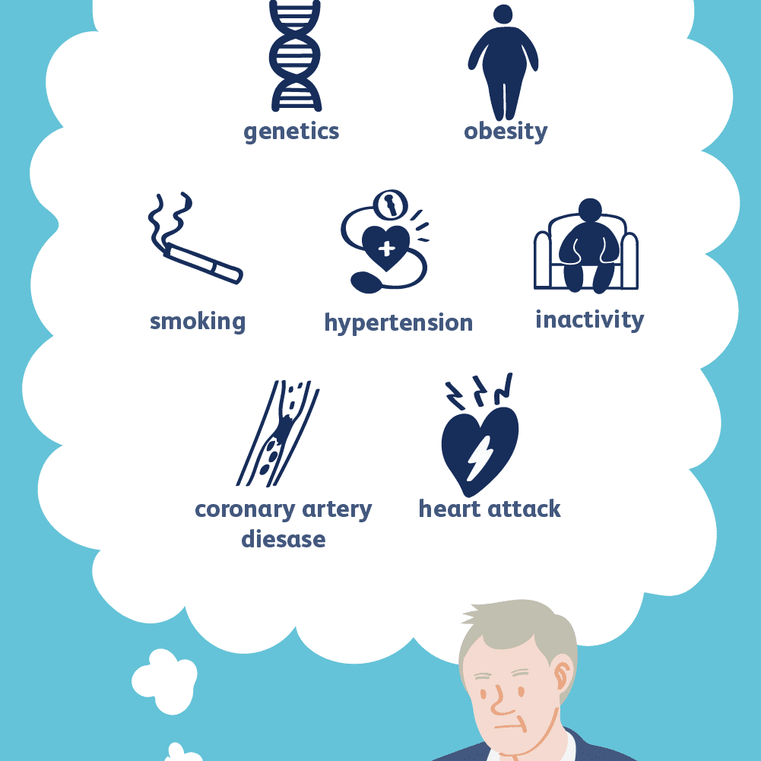
Causes and risk factors

Slide 10
Prevention
The prevention of heart failure (HF) is an urgent public health need with national and global implications
chronic cardiac injury that can be prevented with aggressive risk factor management,.

Slide 11
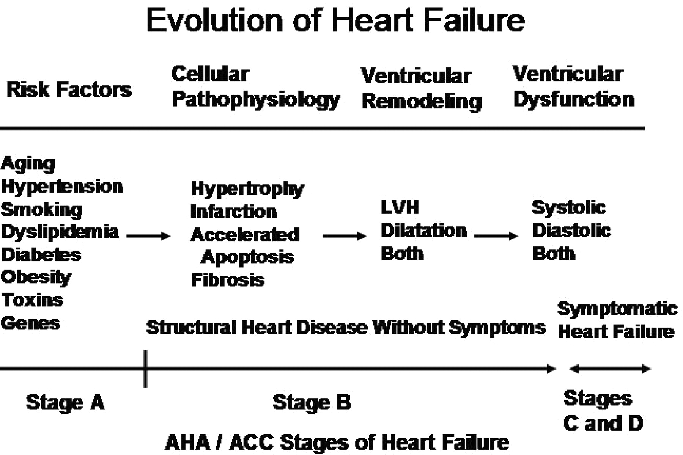
Stages of CCF

Slide 12
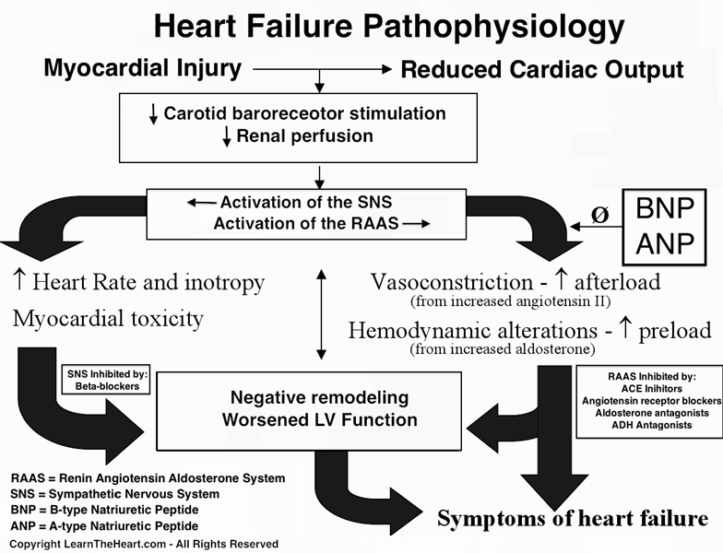
Pathophysiology

Slide 13
types of CHF?
Systolic heart failure occurs when the left ventricle fails to contract normally. This reduces the level of force available to push blood into circulation. Without this force, the heart can’t pump properly.
Diastolic failure, or diastolic dysfunction, happens when the muscle in the left ventricle becomes stiff. Because it can no longer relax, the heart can’t quite fill with blood between beats.
Right-sided CHF occurs when the right ventricle has difficulty pumping blood to your lungs. Blood backs up in your blood vessels, which causes fluid retention in your lower extremities, abdomen, and other vital organs.
It’s possible to have left-sided and right-sided CHF at the same time. Usually, the disease starts in the left side and then travels to the right when left untreated

Slide 14
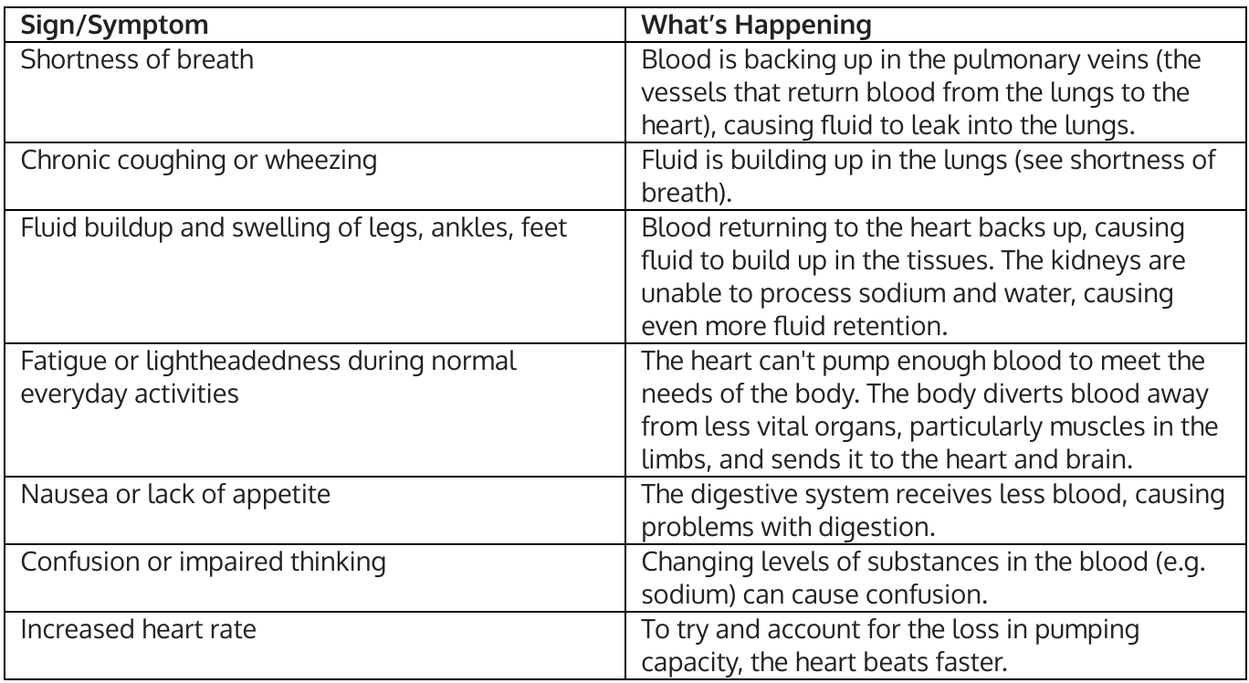
S/S

Slide 15
S/S
Symptoms you may notice first | Symptoms that indicate your condition has worsened | Symptoms that indicate a severe heart condition
fatigue | irregular heartbeat | chest pain that radiates through the upper body
swelling in your ankles, feet, and legs | a cough that develops from congested lungs | rapid breathing
weight gain | wheezing | skin that appears blue, which is due to lack of oxygen in your lungs
increased need to urinate, especially at night | shortness of breath, which may indicate pulmonary edema | fainting

Slide 16
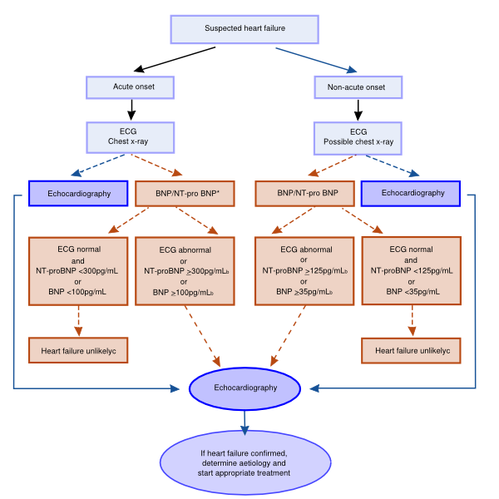
Clinical evaluation

Slide 17
Prognosis
The life expectancy of a patient with heart failure is determined by age, NYHA class, LVEF, normal level of sodium, systolic blood pressure, use of medication and use of ICD or CRT-D,CRT-P

Slide 18
Management: Non Pharmacology
Education: MI
Fluid -1500 ml and sodium restriction less than 2 gm
Body weight-2 kg/3 day, In obese patients (body mass index >30 kg/m²)
Alcohol intake should be minimized,
Smoking cessation should be encouraged.
Exercise training is recommended to all chronic stable HF patients
immunization of HF patients

Slide 19
Management: Pharmacology
NYHA I & EF <40% | NYHA II | NYHA III | NYHA IV
Diuretic
ACE-inhib
AT-II antagonist |  | Alternative | Alternative | Alternative
Betablocker | Post infarction
Aldosteron antagonist |  | EF < 35% | EF < 35% | EF < 35%
Nitrate / Hydralazine |  | Afro-American | Afro-American | Afro-American
Ivabradine |  | SR>75/min & EF<35% | SR>75/min & EF<35% | SR>75/min & EF<35%
Digoxin

Slide 20
Management: Pharmacology
Other
Anticoagulants
Anti platelet agents
Statins
Anti arrhythmic medication
Calcium antagonists

Slide 21
Management: device management
Implantable cardioverter-defibrillator (ICD) therapy is recommended in survivors of cardiac arrest , irrespective of EF, when life expectancy is >1 year

Slide 22
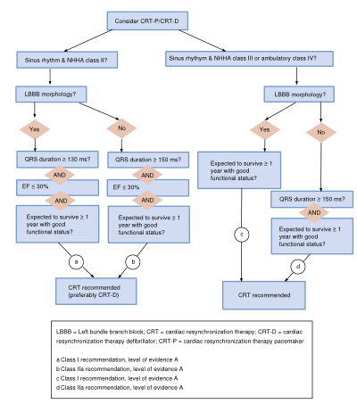
Management: device management

Slide 23
Heart transplantation and Left Ventricular Assist Devices

