Slide 1
Rheumatic Heart Disease
Presenter
DeviNanjappan
Principal
[FACULTY OF NURSING]

Slide 2
Definition
Rheumatic heart disease occurs when attacks of ARF cause permanent scarring and damage to the valves of the heart. When valves have been damaged by RHD they cannot open and close normally, causing blood to move in the wrong direction. When this happens the heart cannot pump blood effectively, causing heart failure.
Rheumatic heart disease (RHD) is characterized by permanent damage to the valves of the heart that develops as a serious consequence of repeated episodes of acute rheumatic fever (ARF), an autoimmune reaction to a group A streptococcus (GAS) bacterial infection.

Slide 3
What is strep throat?
Sore throat (Pharyngitis) commonly affects children and adults. Most sore throats are caused by a viral infection.
Some sore throats are caused by bacterial infections – these are often known as strep throat because they are caused by group A streptococci germ.
These strep throat infections cause throat pain and can lead to serious complications including rheumatic fever

Slide 4
What is rheumatic fever?
Acute rheumatic fever (ARF) is an abnormal immune reaction to group A streptococcal (strep) infections. This infection often occurs in the throat and may be known as strep throat. Some researchers believe that ARF may also occur after group A streptococcal (strep) infections of the skin. The exact immune mechanism of ARF is still being studied.

Slide 5
Incidence
This most commonly occurs when there is circulatory failure manifested as hypotension (ie, reduced tissue perfusion);
It is crucial to recognize that a patient in shock can present hypertensive, normotensive, or hypotensive. Shock is initially reversible,
It must be recognized and treated immediately to prevent progression to irreversible organ dysfunction.
Rheumatic heart disease (RHD) is a major problem in developing countries and is the cause of most of the cardiovascular mortality in young people.
The overall prevalence of RHD was estimated at 10 to 15 cases per 1,000
RHD follows ARF in 30-45% of cases.

Slide 6
Causes
Rheumatic heart disease is caused by rheumatic fever, an inflammatory disease that can affect many connective tissues, especially in the heart, joints, skin, or brain. The heart valves can be inflamed and become scarred over time.

Slide 7
Risk factors
The biggest risk factor for developing RHD is having repeated episodes of ARF.
This risk can be reduced by regular antibiotic medication.
RHD usually begins in adolescence but can be diagnosed into adulthood.
80% of people living with RHD live in developing countries.
Others live in vulnerable populations in developed settings.

Slide 8
Prevention
ARF and RHD can be prevented. Antibiotic therapy (such as penicillin) to treat Group A Streptococcus throat infection can dramatically reduce the risk of ARF and its complication, rheumatic heart disease. If ARF or RHD do occur, long-term antibiotics can reduce progression to more severe disease.

Slide 9
Pathophysiology
RF involves all three layers of the heart, as a result of cytokines and other inflammatory molecules which are released to act against the streptococci, as well as attack by immune cells upon the cardiac tissues.
The first step is a pharyngeal infection with Streptococcus pyogenes, followed by the presentation of antigens to the immune T and B cells. It is noteworthy that skin infections with the same strain of bacteria do not result in ARF.
Activation of CD4+ cells leads to the production of specific acute and chronic phase antibodies (IgM and IgG, respectively) by B lymphocytes.
These antibodies and activated T cells react with structurally similar proteins or peptides in heart tissue, which is called cross-reaction. As a result, the heart becomes inflamed. Joints develop swelling and pain due to the accumulation of immune complexes, formed by antigen-antibody combinations. Chorea and skin rashes or nodules are other manifestations of this immune activation, in the basal ganglia and the skin respectively
Calcification also occurs as part of this inflammation and is linked to the level of a chemical called osteopontin in the blood. Other markers of inflammation such as CRP and oxidation products of proteins are also raised in the blood of patients with RHD.

Slide 10
Clinical S/S
There may be no symptoms in the early stages of RHD, this is sometimes called the asymptomatic or latent phase
The first symptoms of RHD are usually from heart failure
Heart murmurs heart through a stethoscope
Changes in the way heart valves work may be seen on an heart scan (echocardiography)
Fatigue (feeling tired)
Feeling short of breath, this may be worse when exercising or when lying down.

Slide 11
Diagnosis
Echocardiography is the gold standard for diagnosis of RHD.
WHDC
Johns Criteria

Slide 12
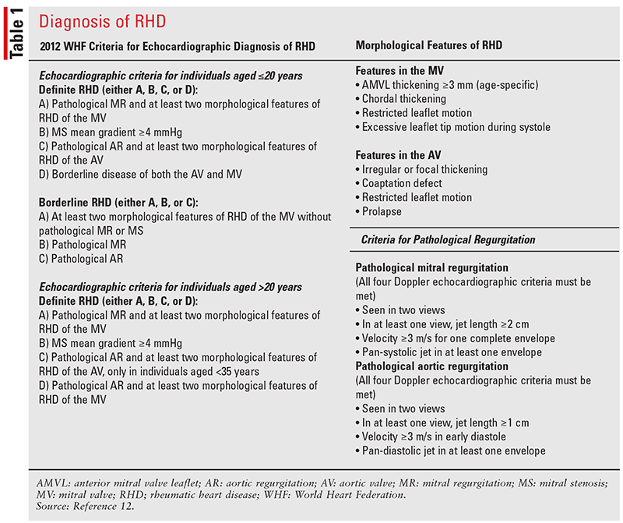
World Heart Federation Criteria

Slide 13
John’s Criteria
Major criteria: carditis (clinical and/or subclinical), arthritis (polyarthritis), chorea, Erythema marginatum, and subcutaneous nodules.
Minor criteria: olyarthralgia, fever (≥38.5° F), sedimentation rate ≥60 mm and/or C-reactive protein (CRP) ≥3.0 mg/dl, and prolonged PR interval (unless carditis is a major criterion

Slide 14
Complication
Heart failure
Stroke
Arrhythmia
Endocarditis
Complications in pregnancy

Slide 15
Treatment
Treatment of RHD usually requires young people to have regular antibiotics which prevent further attacks of ARF and damage to heart valves.
Penicillin is the most commonly used antibiotic and is often given as an injection every 3 – 4 weeks.

